Slide 1
Putting Artificial Intelligence Into Perspective
IPD’s 25th Anniversary Conference at Columbia University
September 12-13th, 2025
Clement E. Bohr

Slide 2
How Might Artificial Intelligence Affect the Economy?
The Next Business Cycle?
Less than a decade of productivity growth of 3-4%
Similar to telecom boom in late 1990s
The Next Technological Revolution?
Decades of productivity growth greater than 2%
Similar to 2nd Industrial Revolution
The Next Inflection Point in Economic Growth?
Permanently higher level of productivity growth
Similar to the birth of Modern Growth

Slide 3
How Might Artificial Intelligence Affect the Economy?
The Next Business Cycle?
Less than a decade of productivity growth of 3%
Similar to dot-com bubble in late 1990s
The Next Technological Revolution?
Decades of productivity growth greater than 2%
Similar to 2nd Industrial Revolution
The Next Inflection Point in Economic Growth?
Permanently higher level of productivity growth
Similar to the birth of Modern Growth
New GPTs have historically led to boom & busts
“Canal Mania” of 1793,
“Railway Mania” of 1847
Automobiles and electrification of “Roaring 1920s”
“Dot-com Bubble” in late 1990s
Signs of past GPT boom & busts are present
Record asset valuations and concentration
Huge technology capital expenditures
”New Era” theories abound

Slide 4
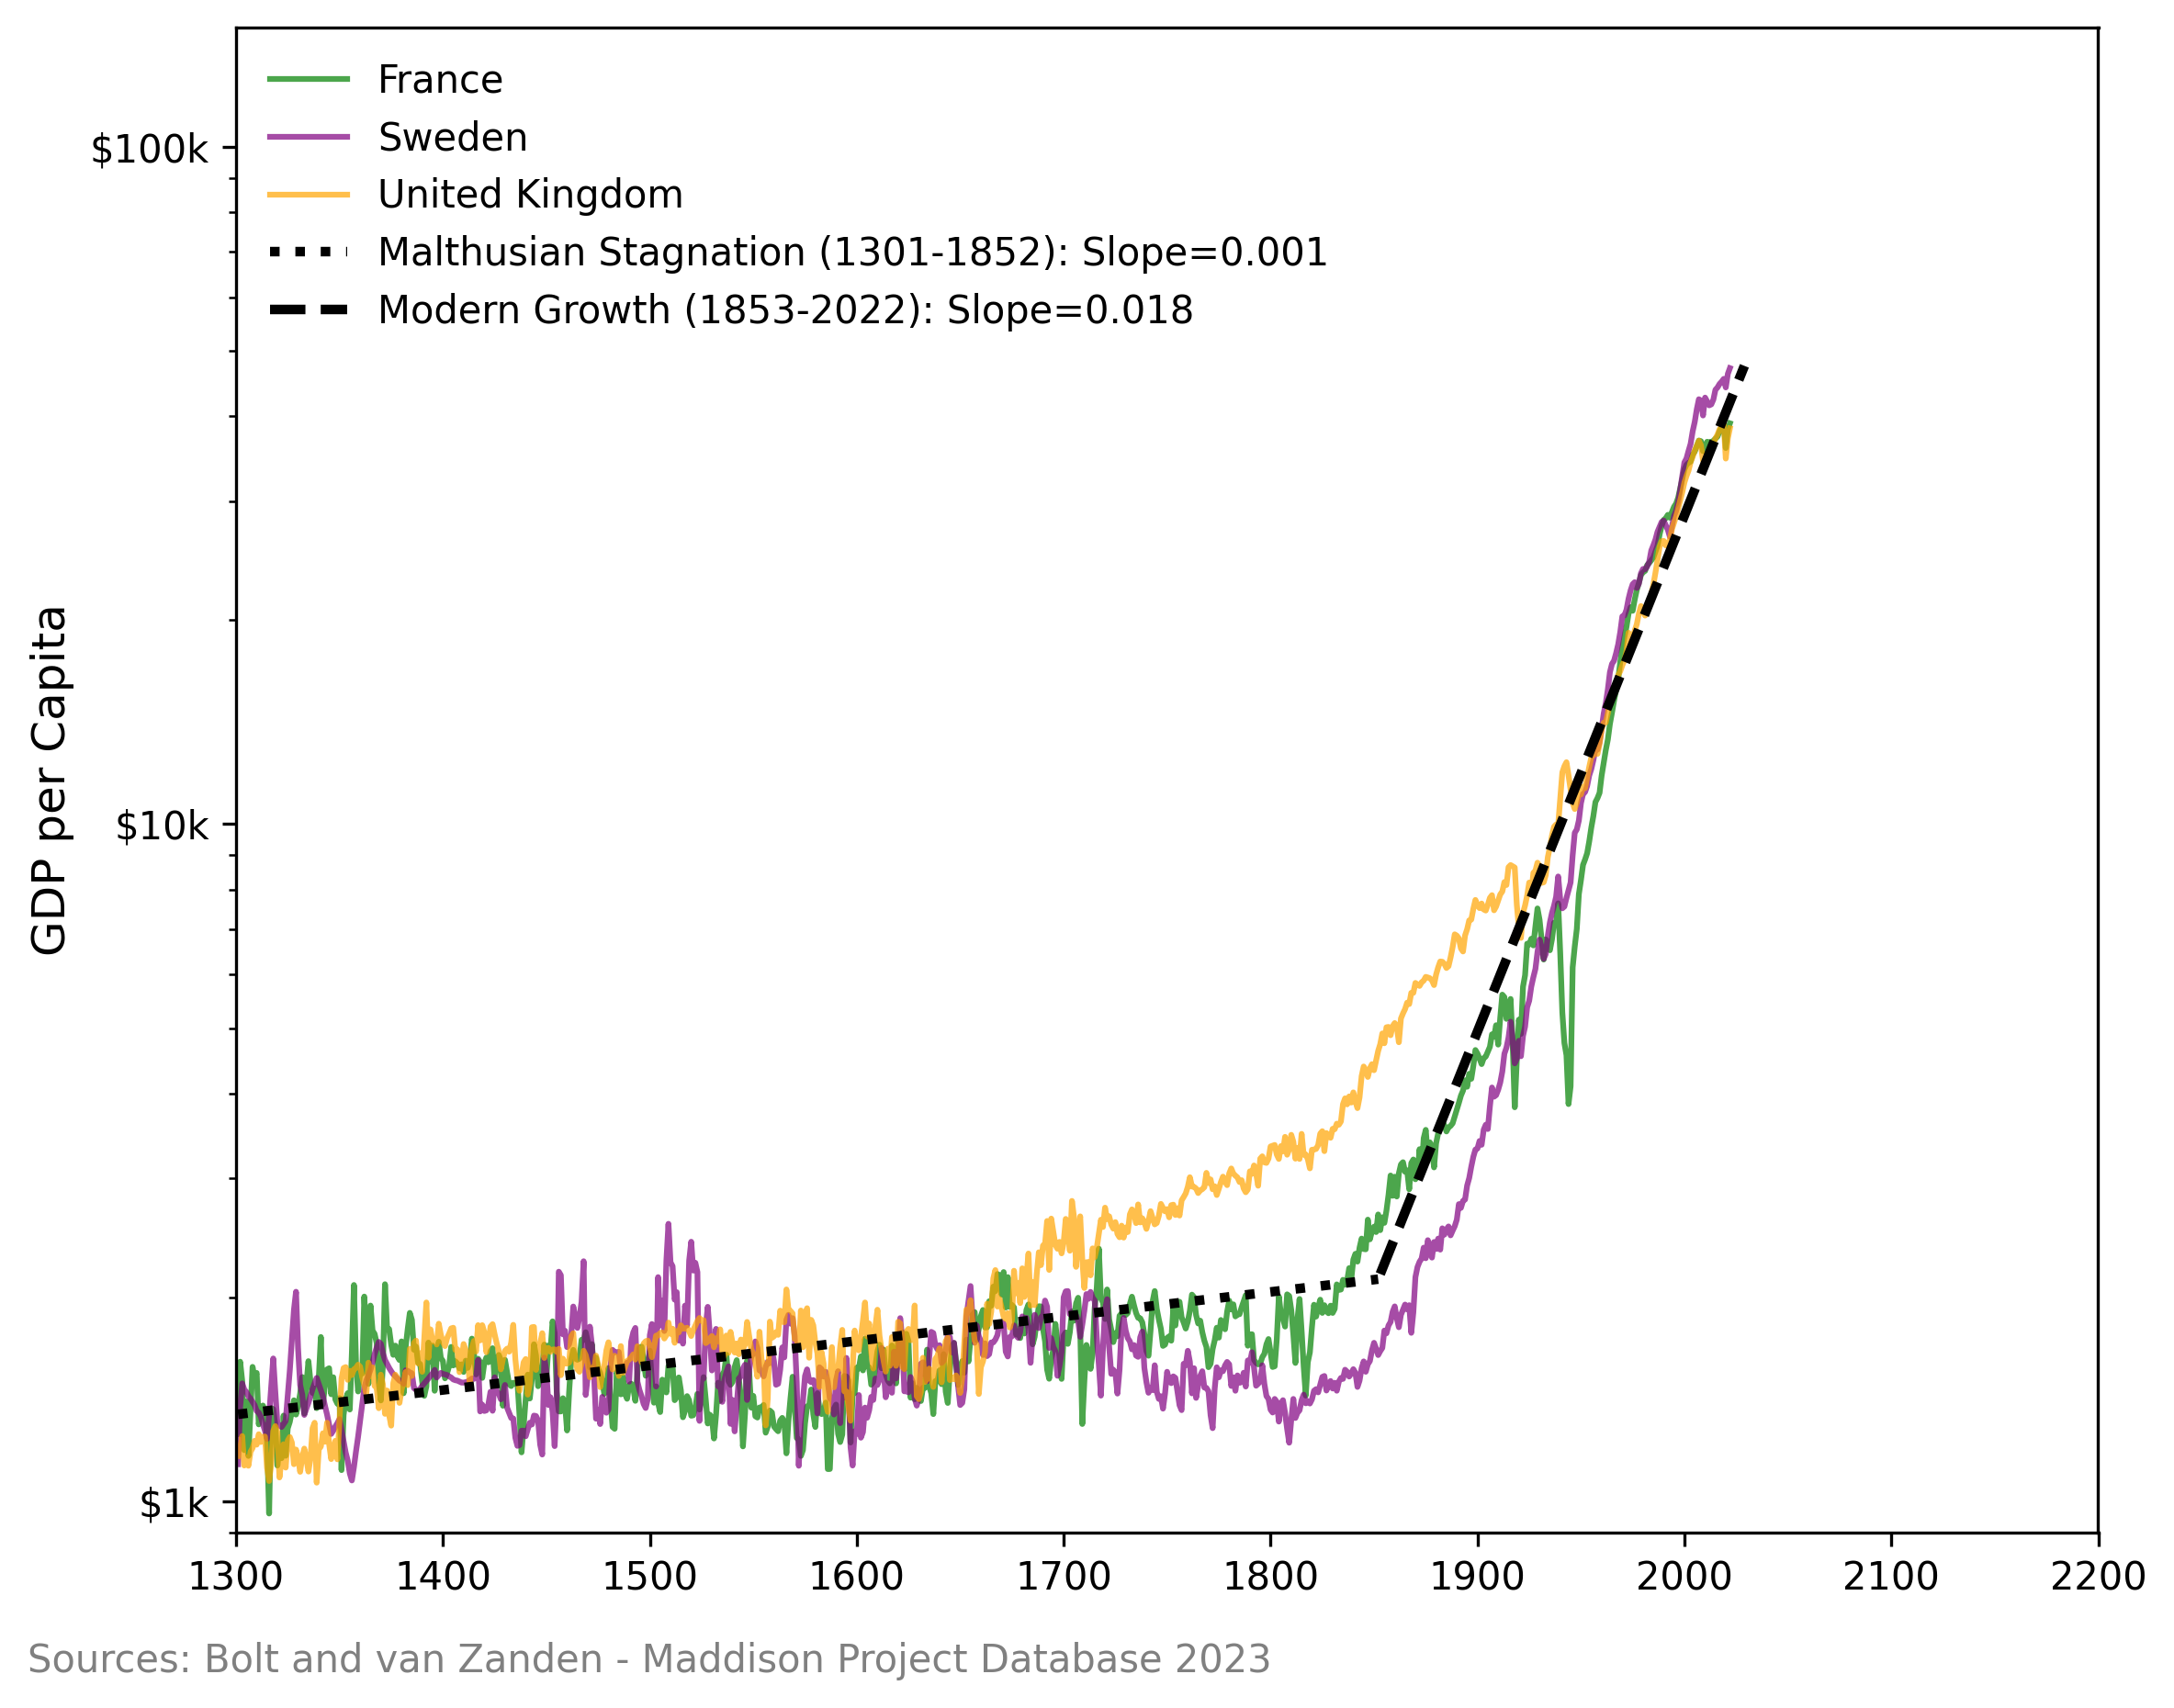
How Might Artificial Intelligence Affect the Economy?
The Next Business Cycle?
Less than a decade of productivity growth of 3%
Similar to dot-com bubble in late 1990s
The Next Technological Revolution?
Decades of productivity growth greater than 2%
Similar to Industrial Revolution
The Next Inflection Point in Economic Growth?
Permanently higher level of productivity growth
Similar to the birth of Modern Growth
Where Will Growth Go From Here?

Slide 5
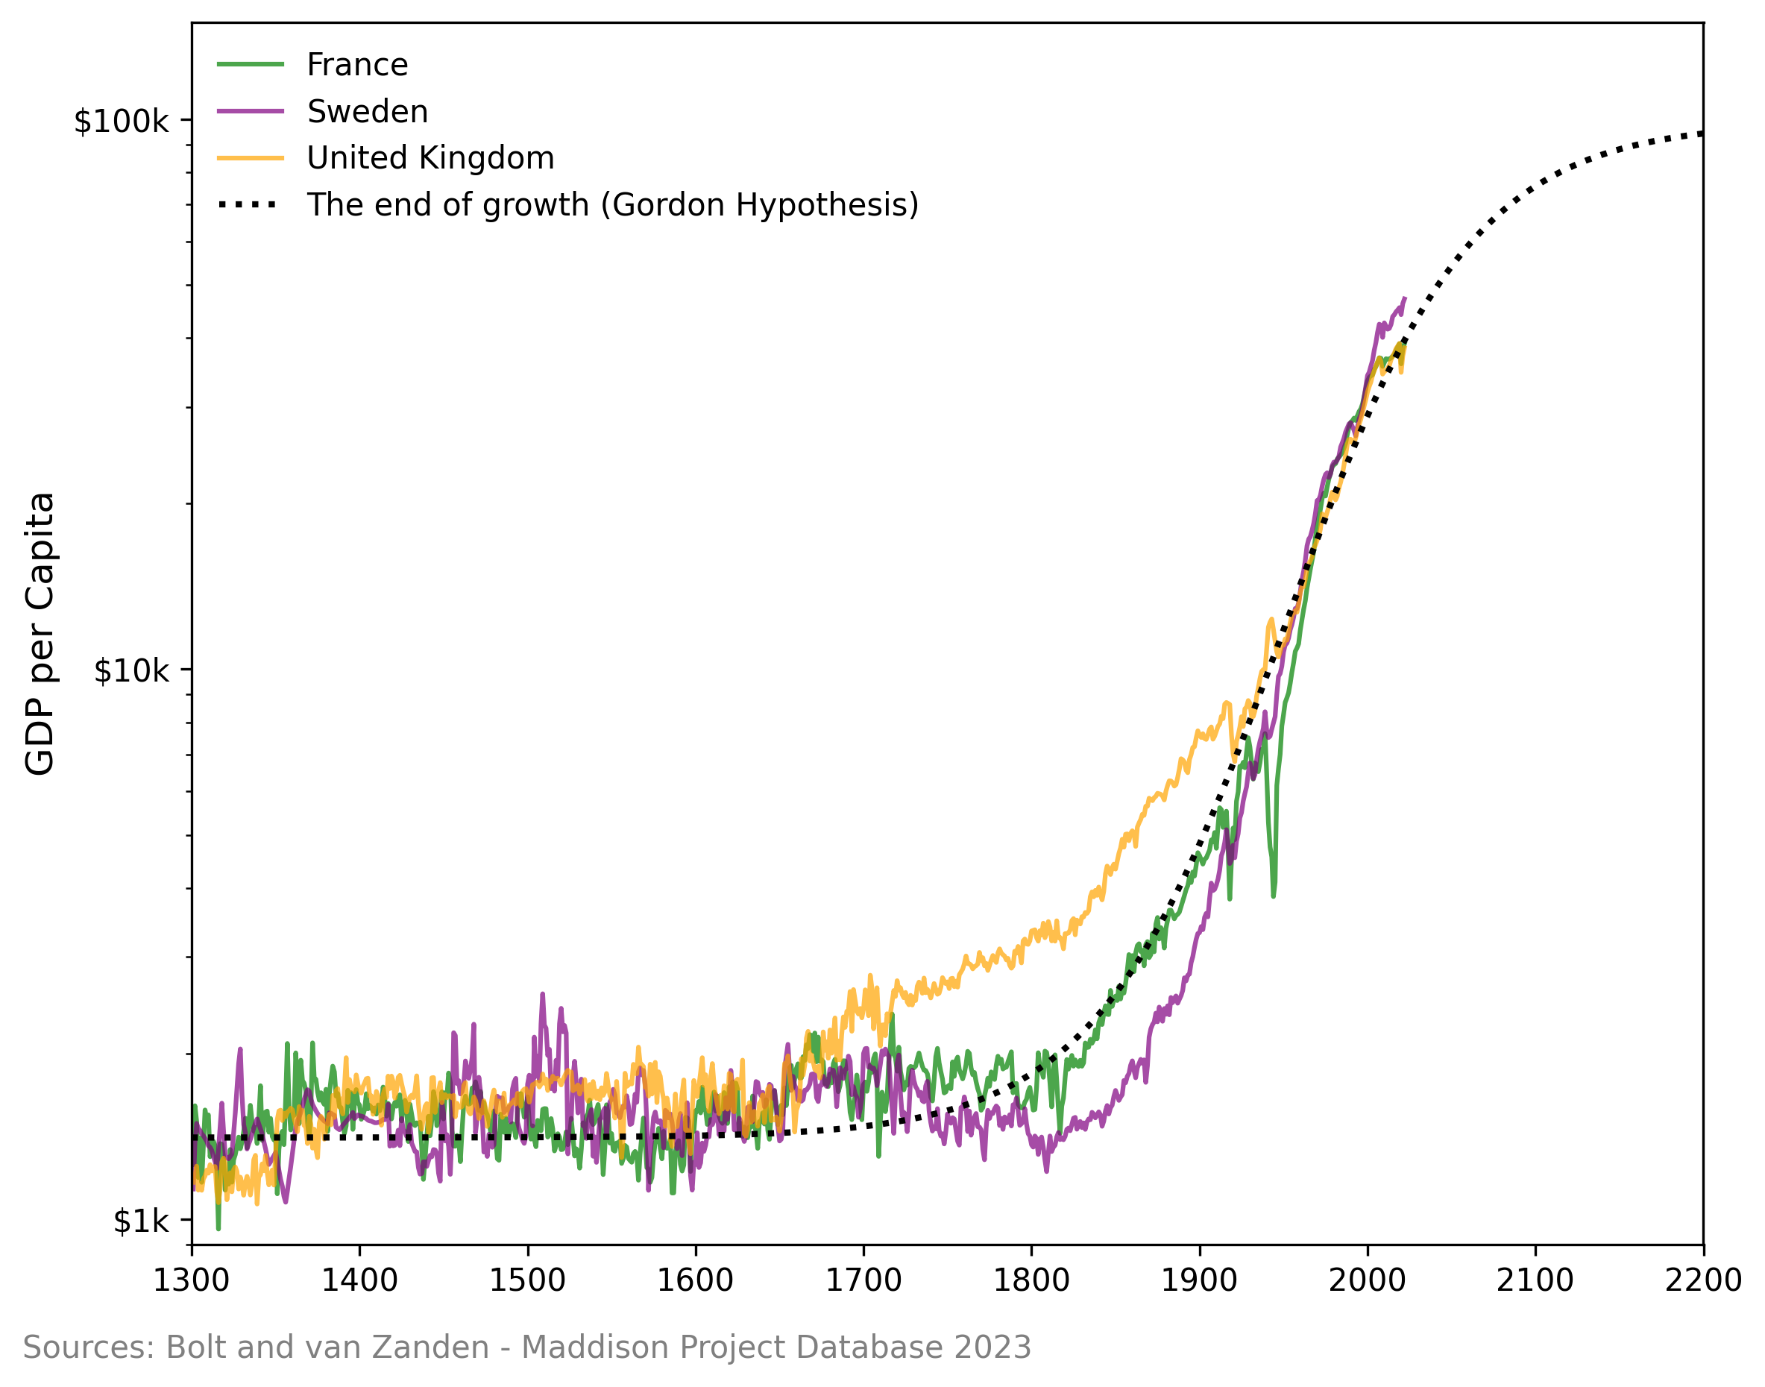
How Might Artificial Intelligence Affect the Economy?
The Next Business Cycle?
Less than a decade of productivity growth of 3%
Similar to dot-com bubble in late 1990s
The Next Technological Revolution?
Decades of productivity growth greater than 2%
Similar to Industrial Revolution
The Next Inflection Point in Economic Growth?
Permanently higher level of productivity growth
Similar to the birth of Modern Growth
Where Will Growth Go From Here?

Slide 6
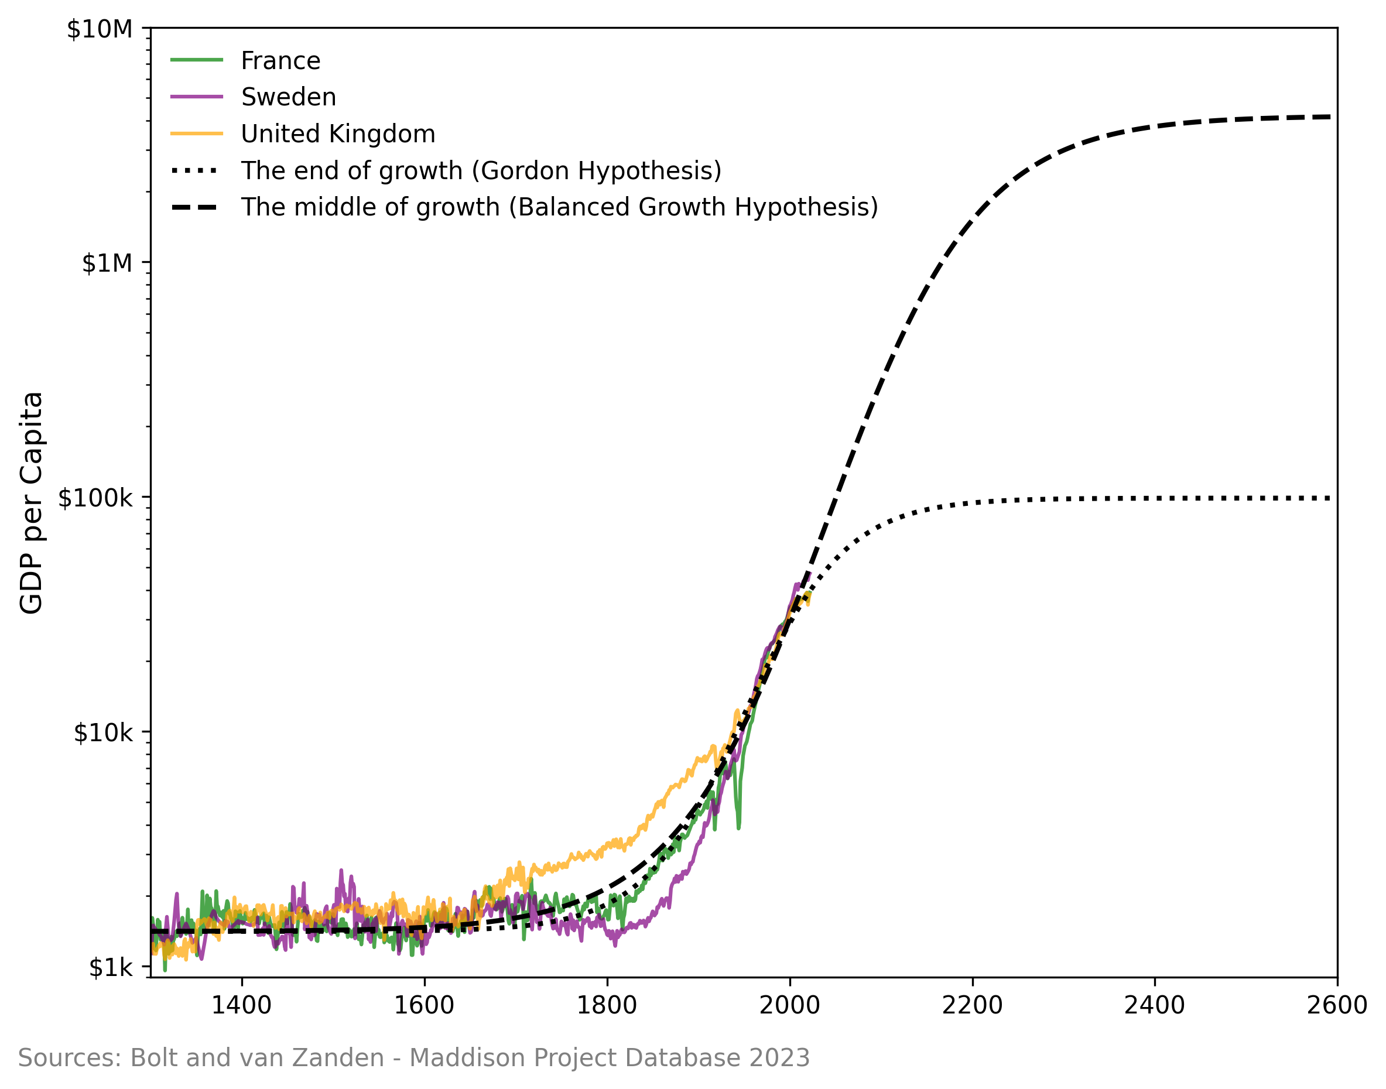
How Might Artificial Intelligence Affect the Economy?
The Next Business Cycle?
Less than a decade of productivity growth of 3%
Similar to dot-com bubble in late 1990s
The Next Technological Revolution?
Decades of productivity growth greater than 2%
Similar to Industrial Revolution
The Next Inflection Point in Economic Growth?
Permanently higher level of productivity growth
Similar to the birth of Modern Growth
Where Will Growth Go From Here?

Slide 7
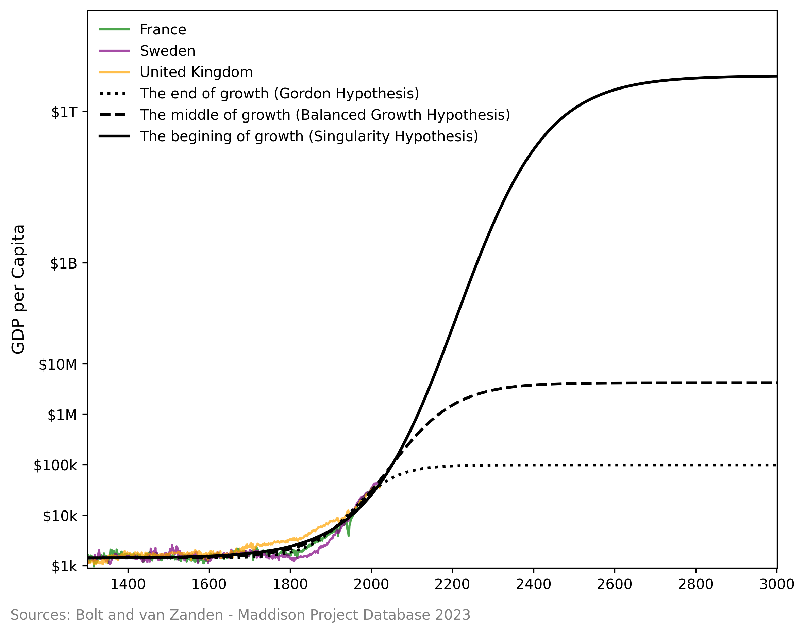
How Might Artificial Intelligence Affect the Economy?
The Next Business Cycle?
Less than a decade of productivity growth of 3%
Similar to dot-com bubble in late 1990s
The Next Technological Revolution?
Decades of productivity growth greater than 2%
Similar to Industrial Revolution
The Next Inflection Point in Economic Growth?
Permanently higher level of productivity growth
Similar to the birth of Modern Growth
Where Will Growth Go From Here?

Slide 8
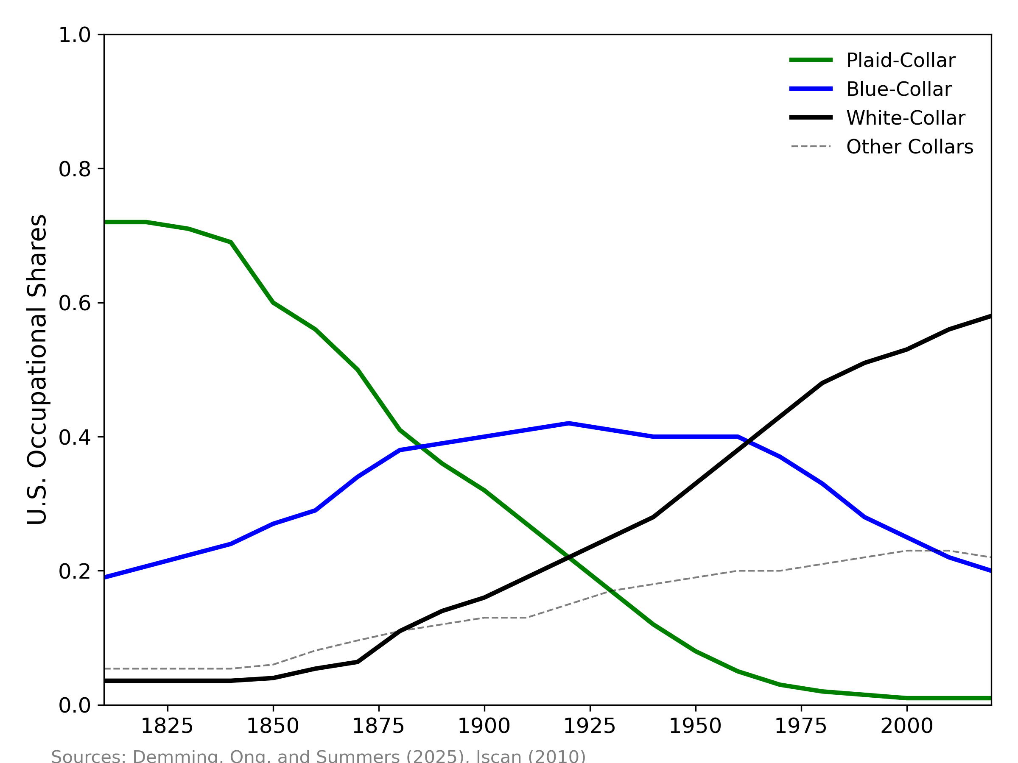
How Might Artificial Intelligence Affect the Economy?
The Next Business Cycle?
Less than a decade of productivity growth of 3%
Similar to dot-com bubble in late 1990s
The Next Technological Revolution?
Decades of productivity growth greater than 2%
Similar to 2nd Industrial Revolution
The Next Inflection Point in Economic Growth?
Permanently higher level of productivity growth
Similar to the birth of Modern Growth
White-Collar Job Share is Leveling Off

Slide 9
Artificial Intelligence as the
Next Phase of the Digital Revolution

Slide 10
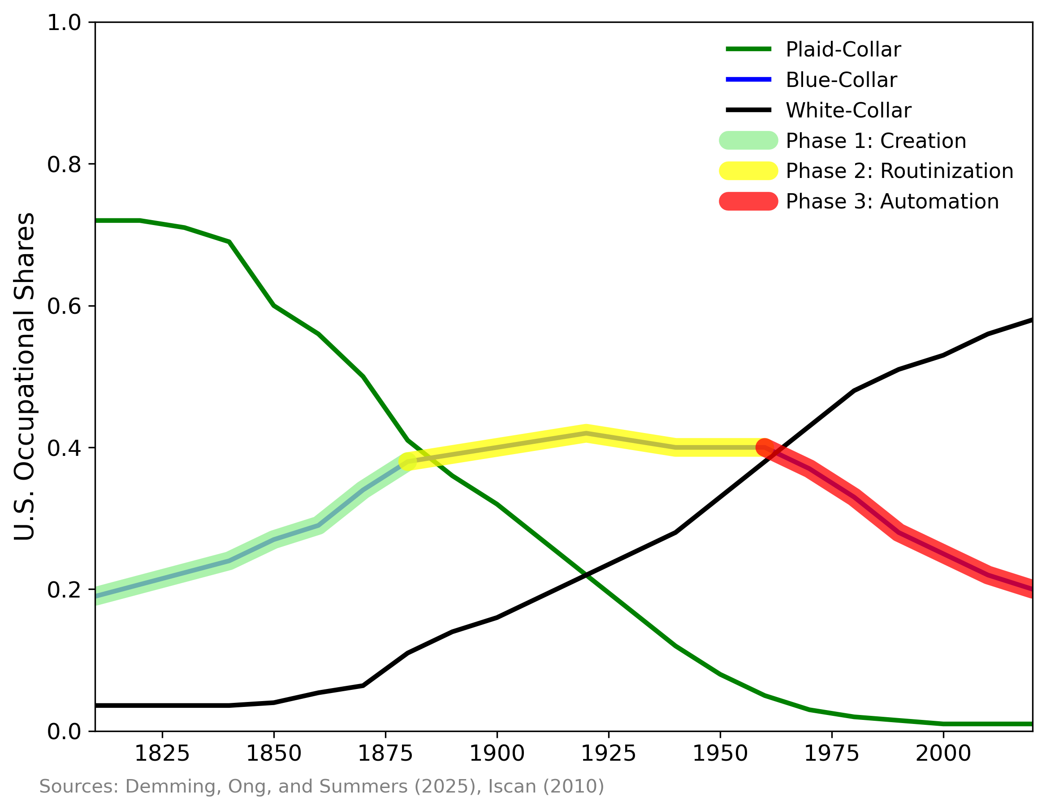
The Three Phases of a Technological Revolution
1. Creation
Technology requires high-skill, non-routine labor
Gains for high-income earners and consumers
2. Routinization
Enables low-skill labor, displacing high-skilled
Wide-spread gains
3. Automation
Displaces most labor completely
Gains mainly for capital owners
The Three Phases Of The Industrial Revolution

Slide 11
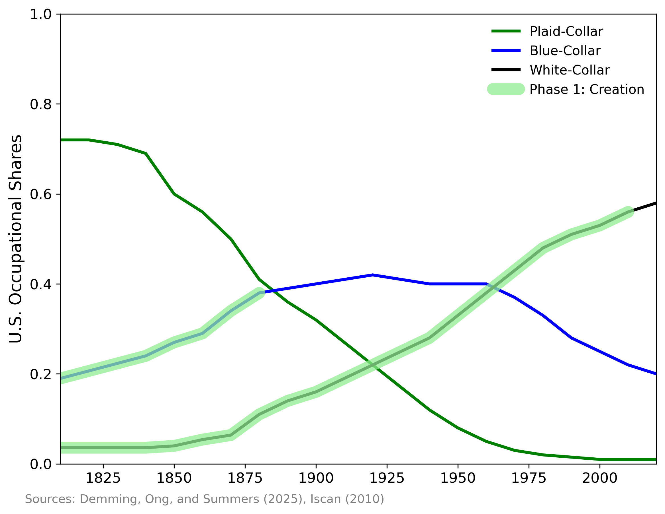
The Three Phases of a Technological Revolution
1. Creation
Technology requires high-skill, non-routine labor
Gains for high-income earners
2. Routinization
Enables low-skill labor, displacing high-skilled
Wide-spread gains
3. Automation
Displaces most labor completely
Gains mainly for capital owners
1st Phase Sees Rising Job Share

Slide 12
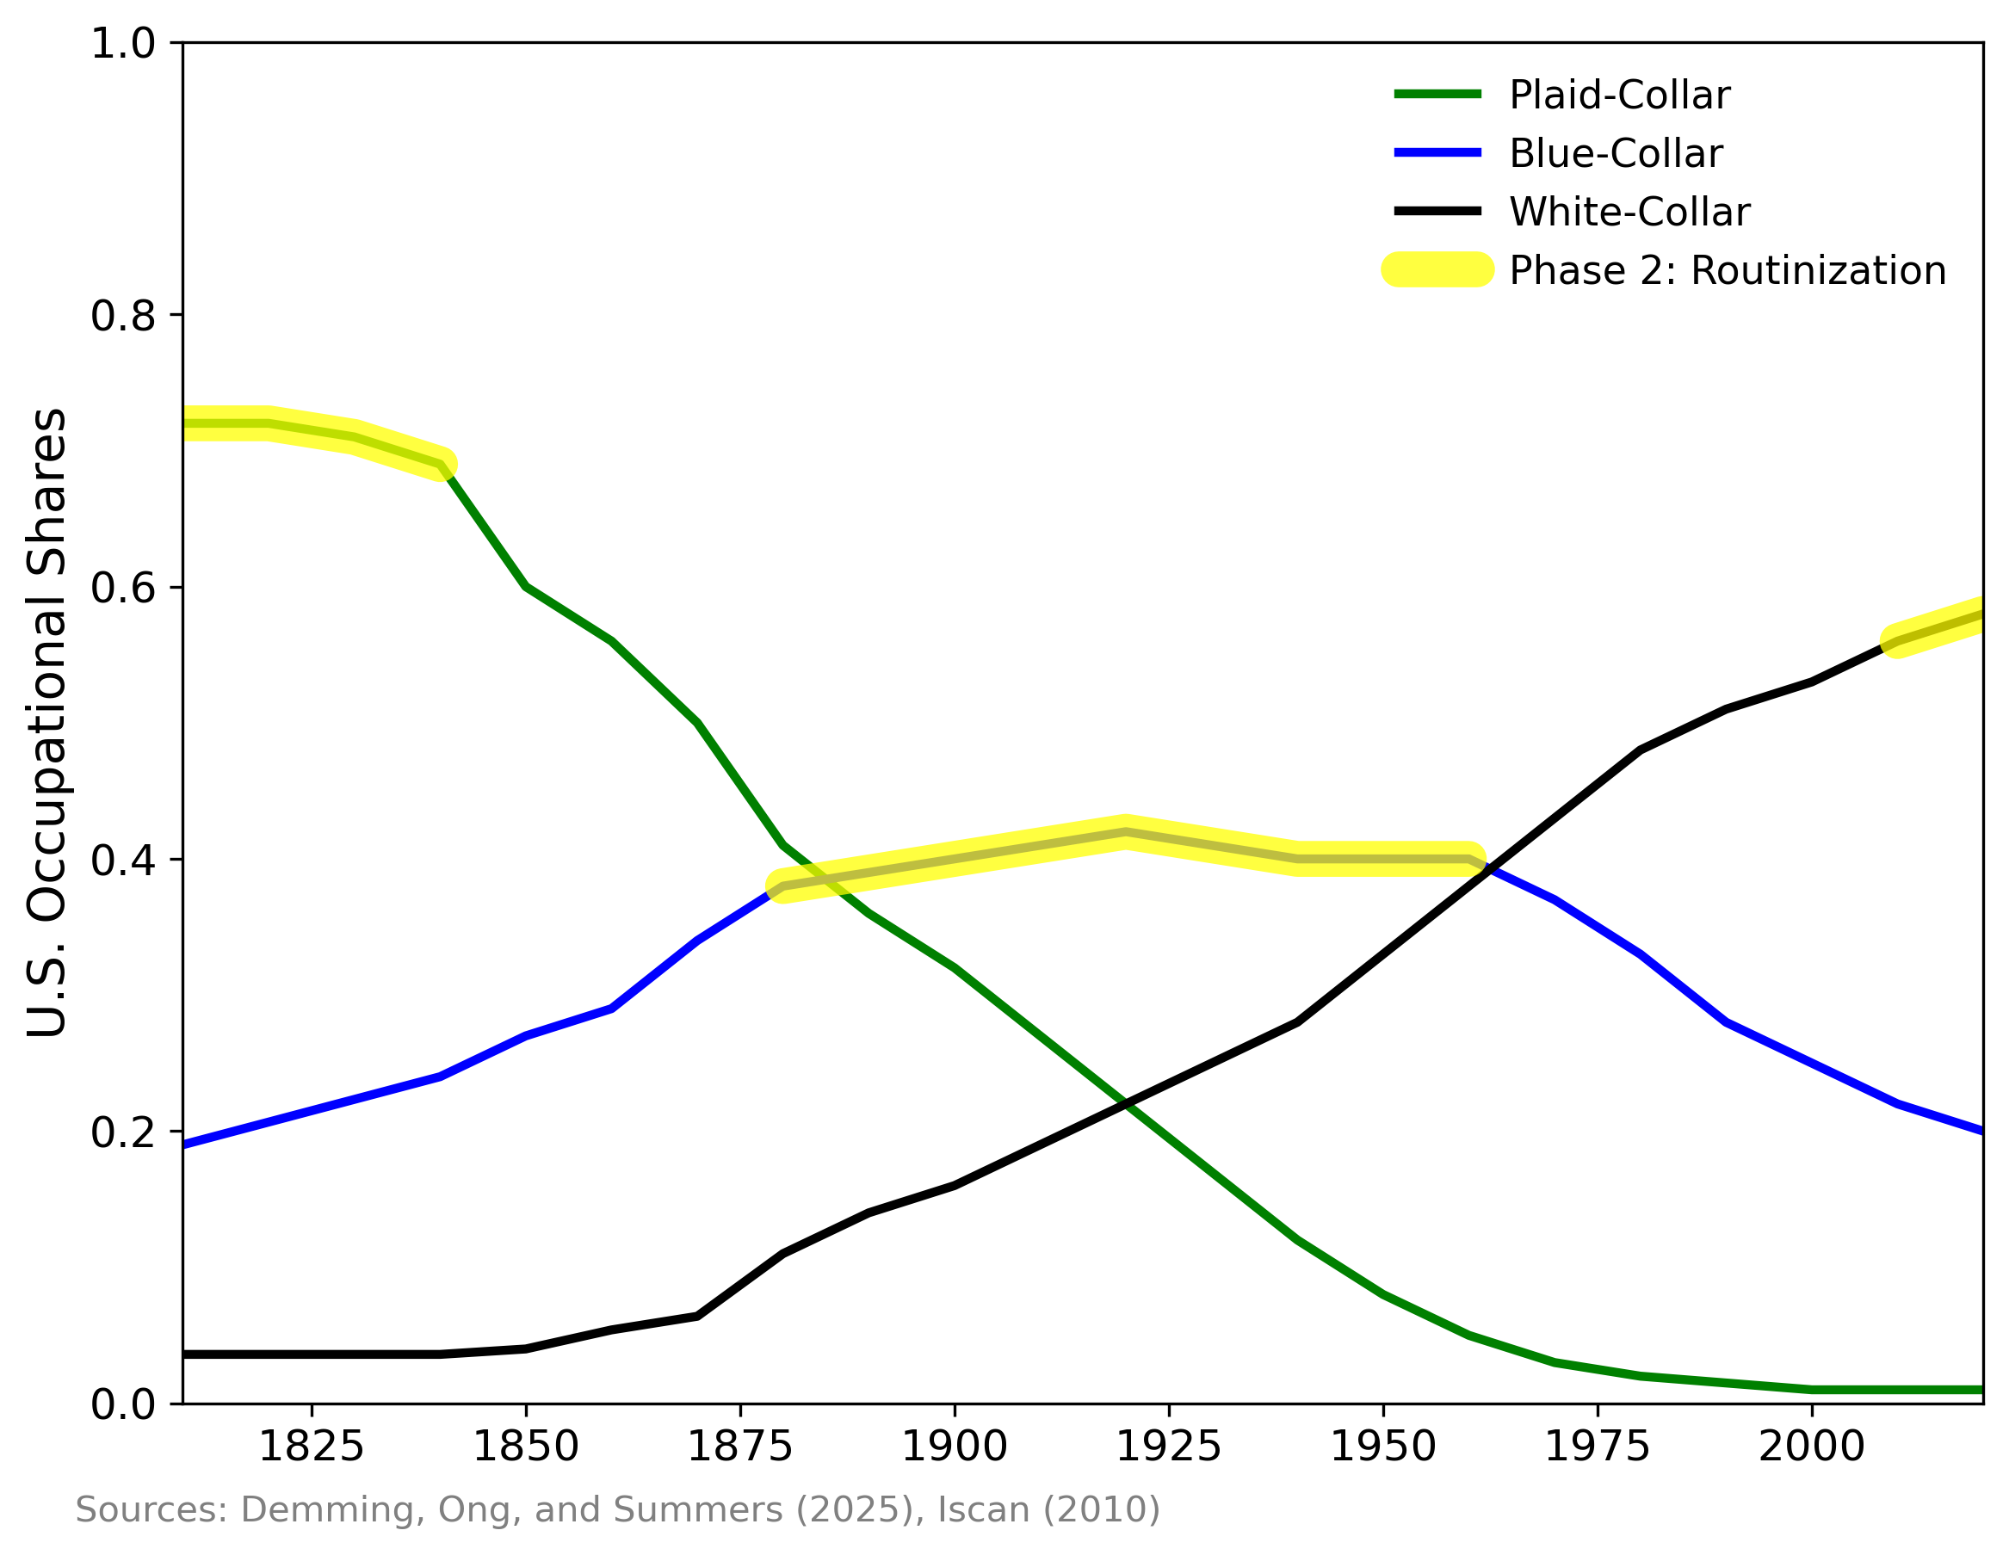
The Three Phases of a Technological Revolution
1. Creation
Technology requires high-skill, non-routine labor
Gains for high-income earners
2. Routinization
Enables low-skill labor, displacing high-skilled
Gains for low-income earners
3. Automation
Displaces most labor completely
Gains mainly for capital owners
2nd Phase Sees Stable Job Share

Slide 13
The Three Phases of a Technological Revolution
1. Creation
Technology requires high-skill, non-routine labor
Gains for high-income earners
2. Routinization
Enables low-skill labor, displacing high-skilled
Gains for low-income earners
Will AI routinize most white-collar work?
3. Automation
Displaces most labor completely
Gains mainly for capital owners
2nd Phase Sees Stable Job Share

Slide 14
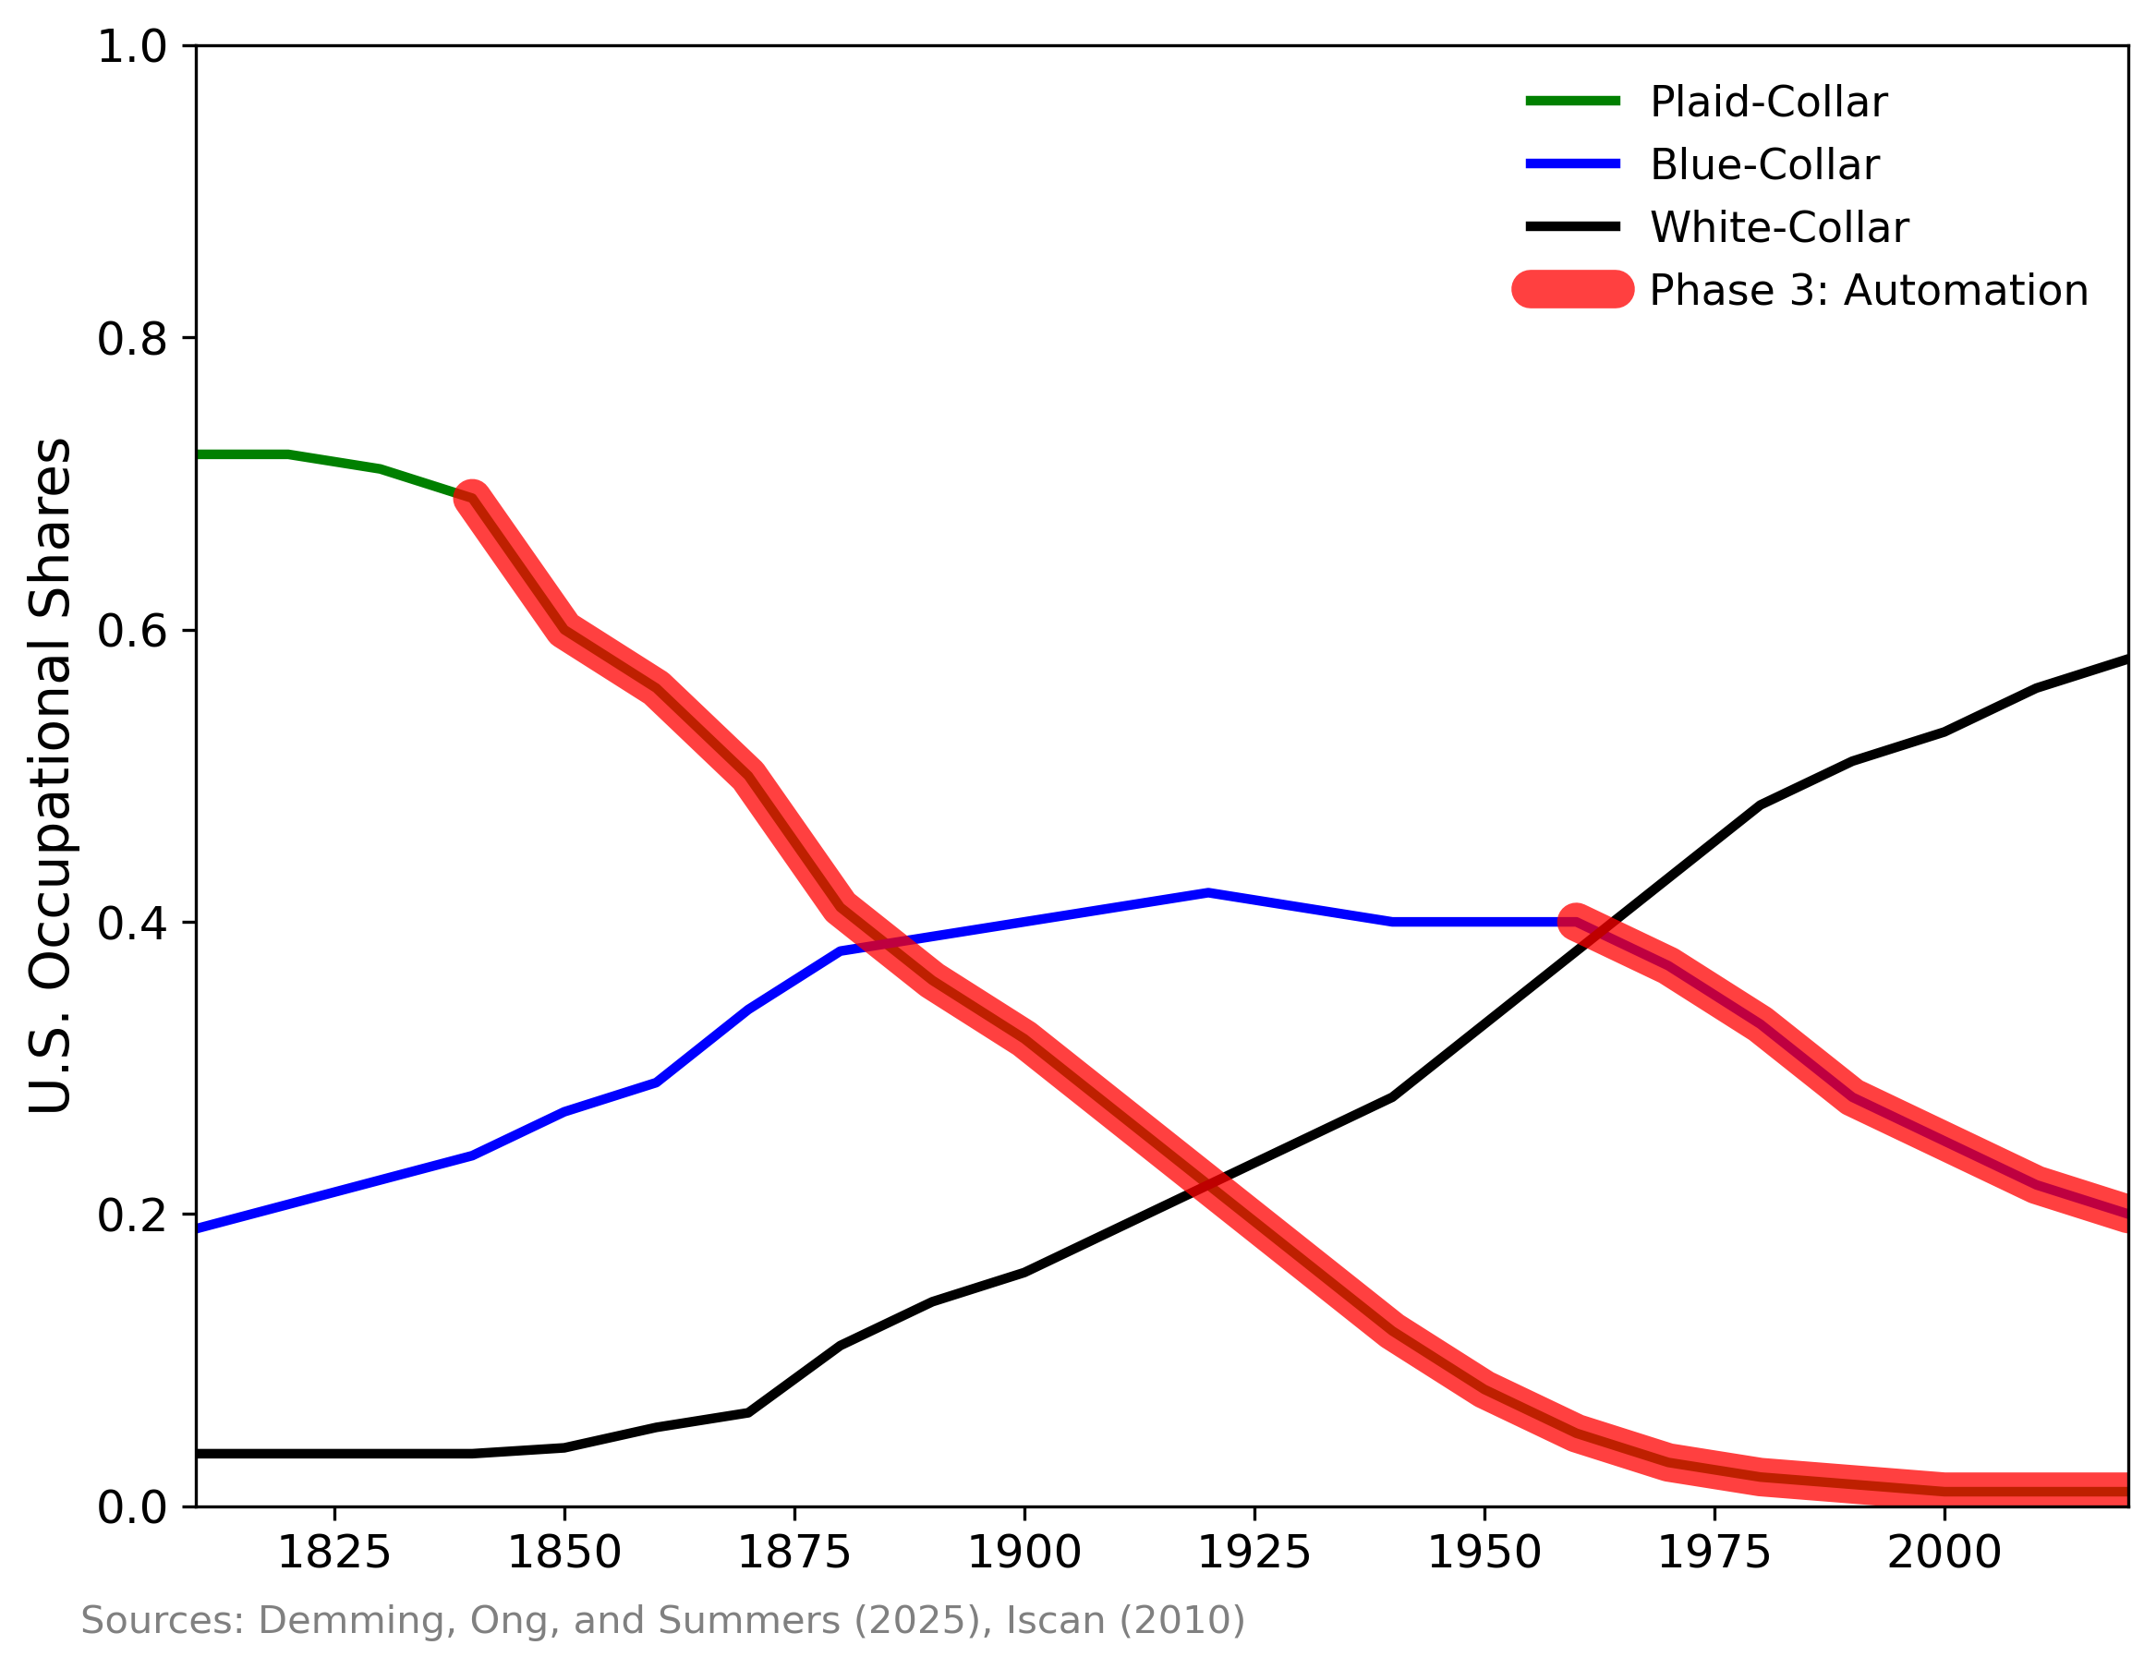
The Three Phases of a Technological Revolution
1. Creation
Technology requires high-skill, non-routine labor
Gains for high-income earners
2. Routinization
Enables low-skill labor, displacing high-skilled
Gains for low-income earners
Will AI routinize most white-collar work?
3. Automation
Displacement of most labor
Gains for owners of capital
3rd Phase Sees Declining Job Share…

Slide 15
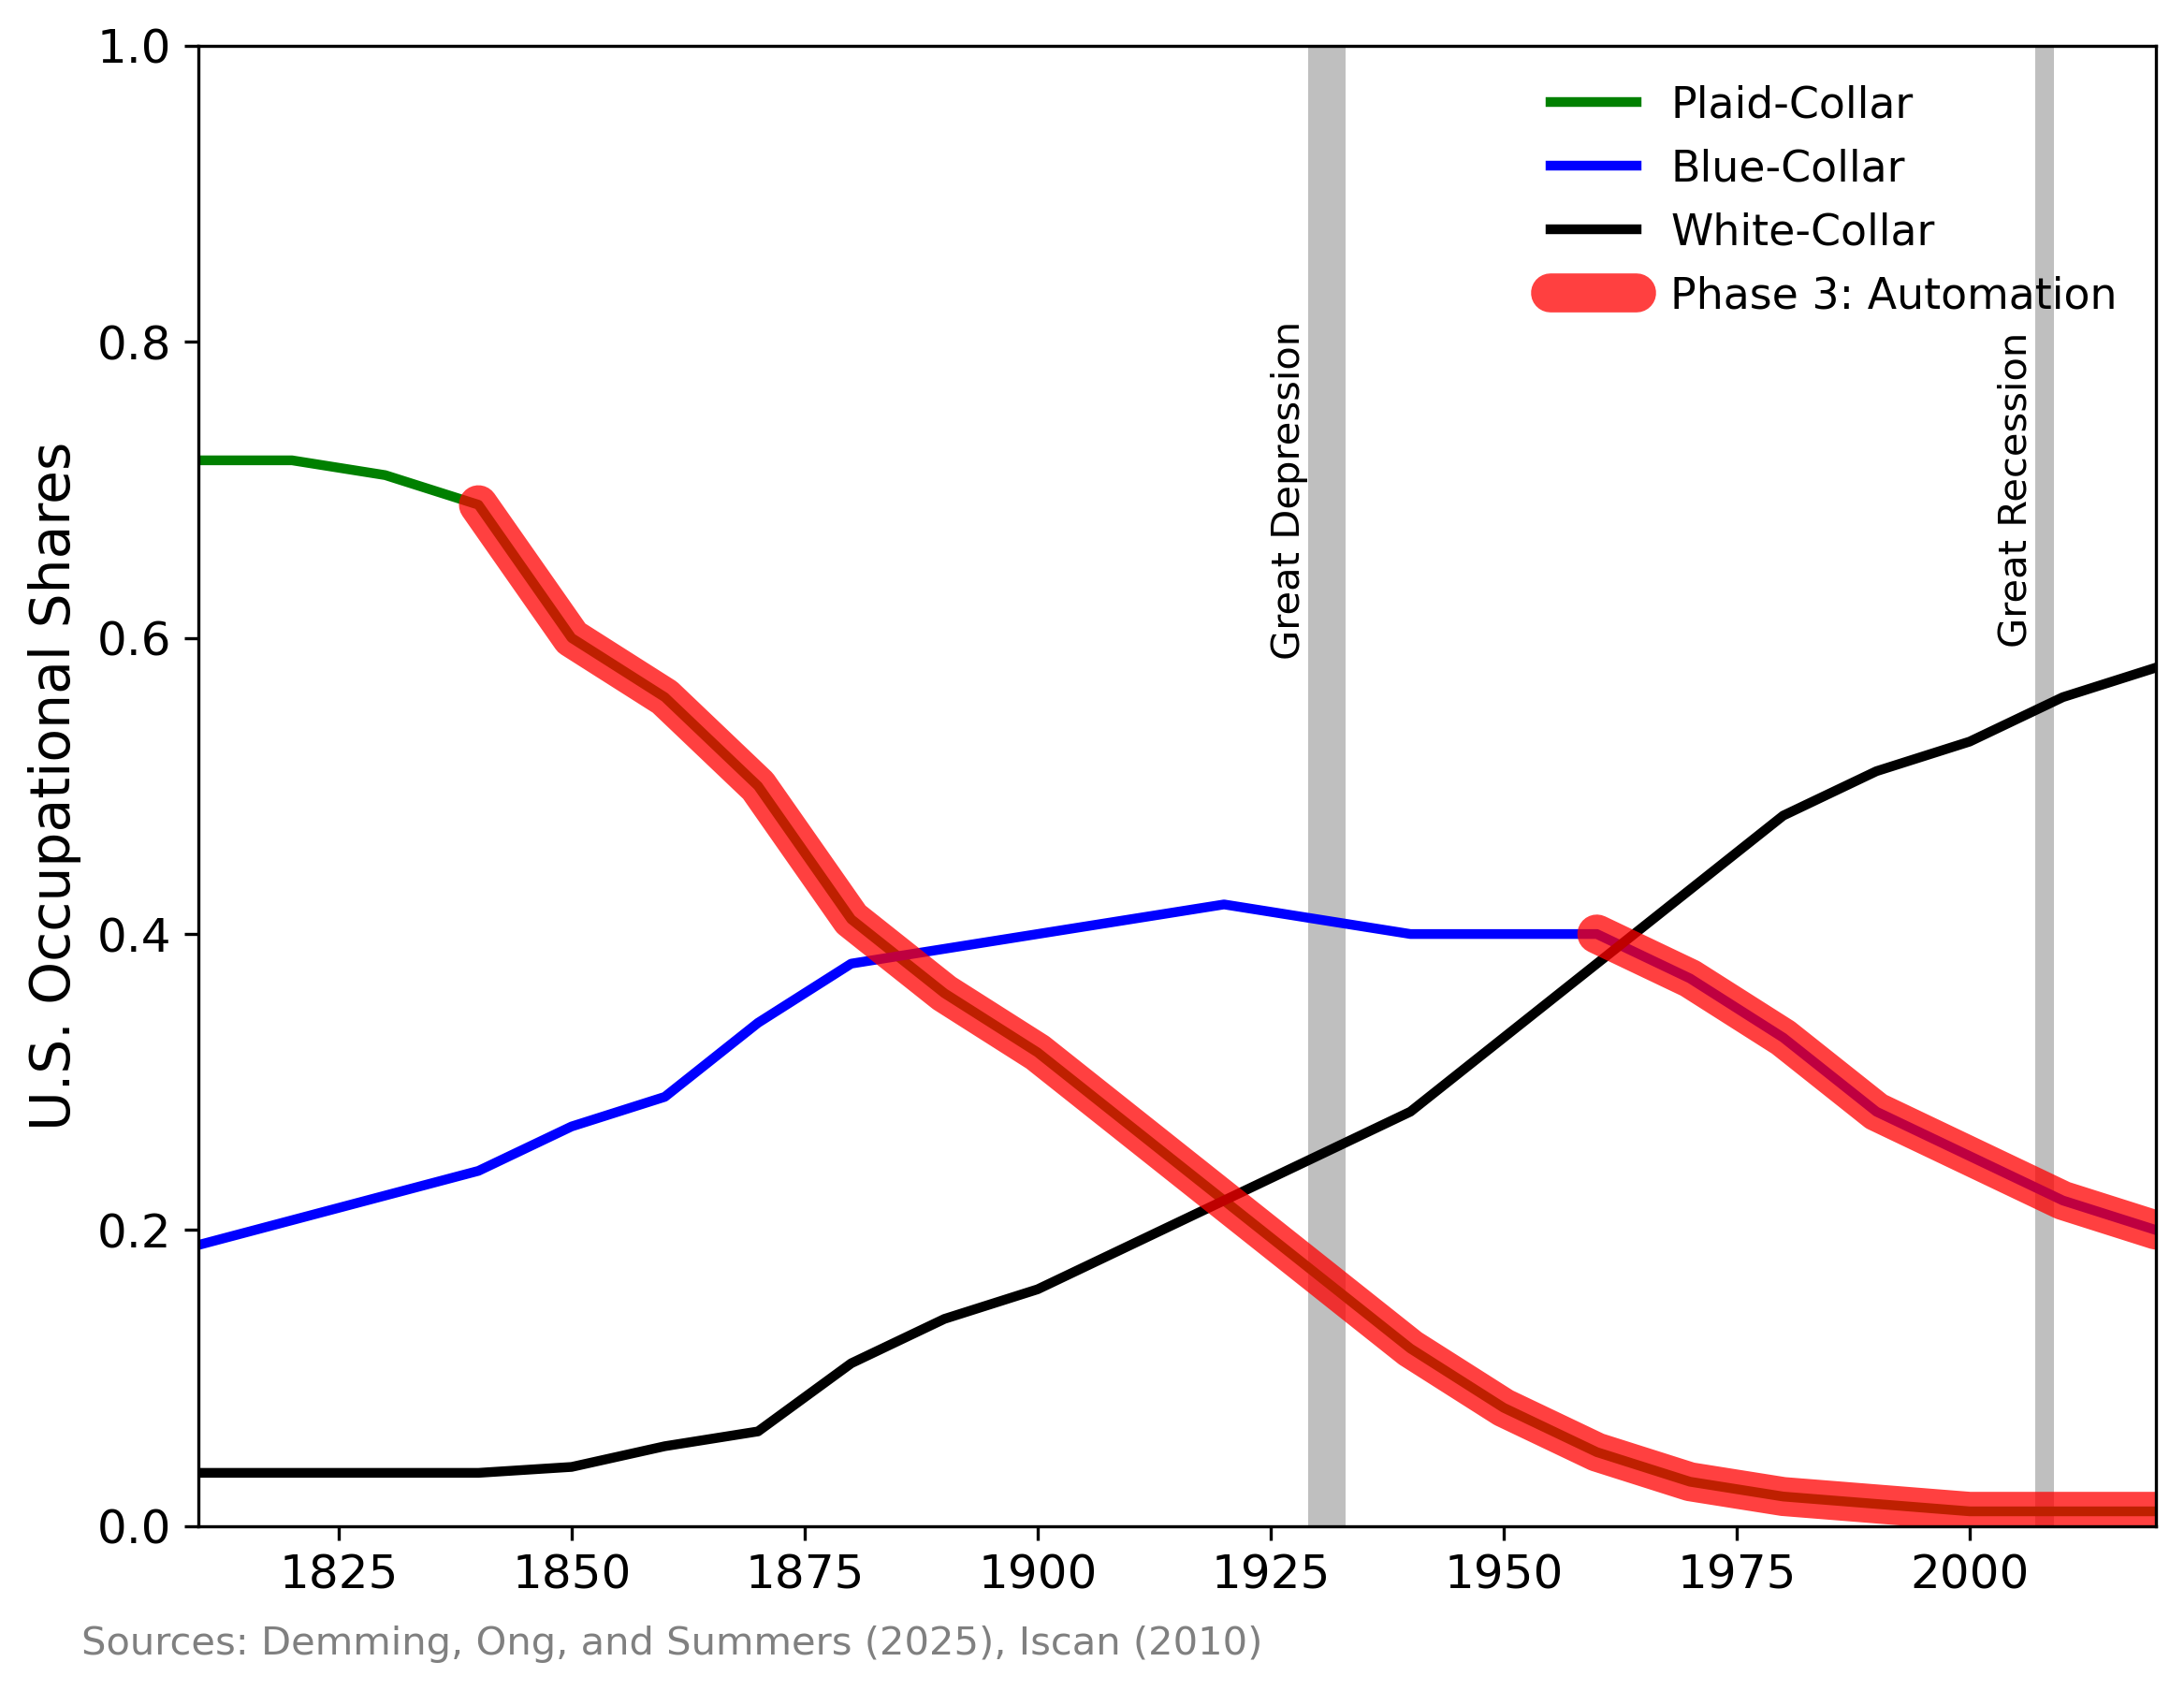
The Three Phases of a Technological Revolution
1. Creation
Technology requires high-skill, non-routine labor
Gains for high-income earners
2. Routinization
Enables low-skill labor, displacing high-skilled
Gains for low-income earners
Will AI routinize most white-collar work?
3. Automation
Displacement of most labor
Gains for owners of capital
3rd Phase Sees… and a Long Recession?

Slide 16
The Three Technological Revolutions So Far
 | Phase 1 Creation | Phase 2 Routinization | Phase 3 Automation
Agricultural | 10000 BC Neolithic Revolution Domestication and Cultivation | 1600 British Agricultural Revolution Systematic breeding and standardized crop rotations | 1850 3rd Agricultural Revolution Mechanization
Industrial | 1750 1st Industrial Revolution Craft production | 1870 2nd Industrial Revolution Mass Production | 1970 3rd Industrial Revolution Robots
Digital | 1950 1st Digital Revolution Telecommunication & computers | 2020 2nd Digital Revolution Artificial Intelligence | 2____ 3rd Digital Revolution ?

Slide 17
Conclusion
Should you believe the AI hype?
NO: “This time really is different” = “same old same old”
And YES: “Same old” growth of 2% is transformative!
Large potential benefits from AI on the horizon
Routinization of high-skilled work may raise incomes of lower class
Expensive professional services will become abundant and cheap

