Slide 1
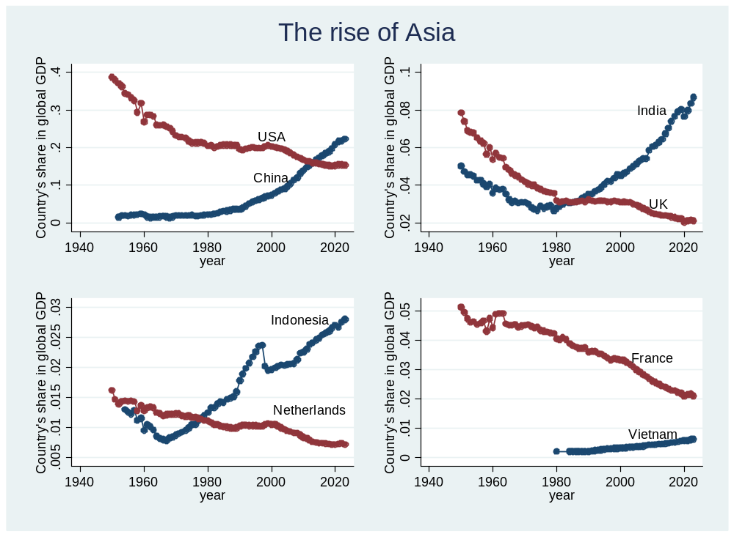
Shares in global output
defines.do in interyd/dofiles….

Slide 2
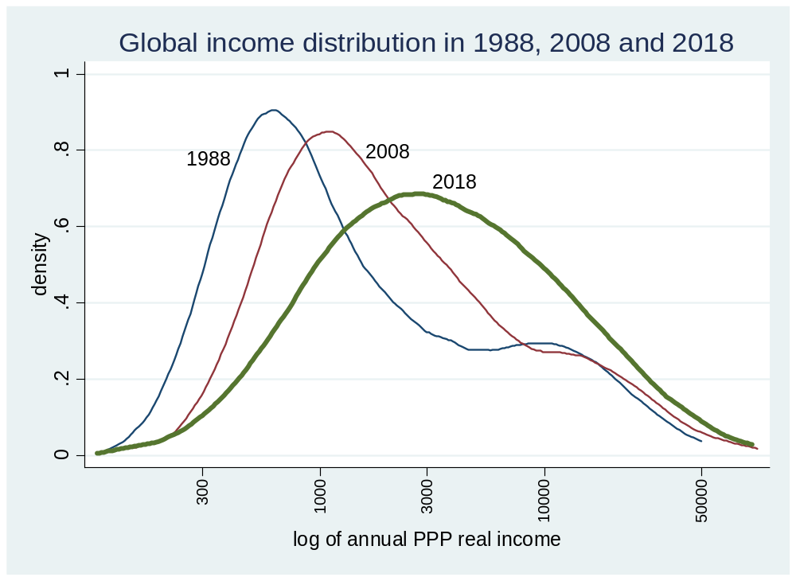
The emergence of the global median or middle class
For the first time in the past 2 centuries, global income distribution looks almost lognormal (with one mode)
twoway (kdensity loginc_11_11 [w=popu] if loginc_11_11>2 & bin_year==1988 & mysample==1, bwidth(0.14)) (kdensity loginc_11_11 [w=popu] if loginc_11_11>2 & bin_year==2008 & mysample==1, bwidth(0.14) title("Global income distribution in 1988, 2008 and 2018")) (kdensity loginc_11_11 [w=popu] if loginc_11_11>2 & bin_year==2018 & mysample==1, bwidth(0.2) lwidth(thick)) , legend(off) xtitle(log of annual PPP real income) ytitle(density) text(0.78 2.5 "1988") text(0.8 3.3 "2008") text(0.72 3.6 "2018") xlabel(2.477"300" 3"1000" 3.477"3000" 4"10000" 4.699"50000", labsize(small) angle(90))
Using combine88_18_deciles.dta“
Using \final18_china_lis.dta

Slide 3
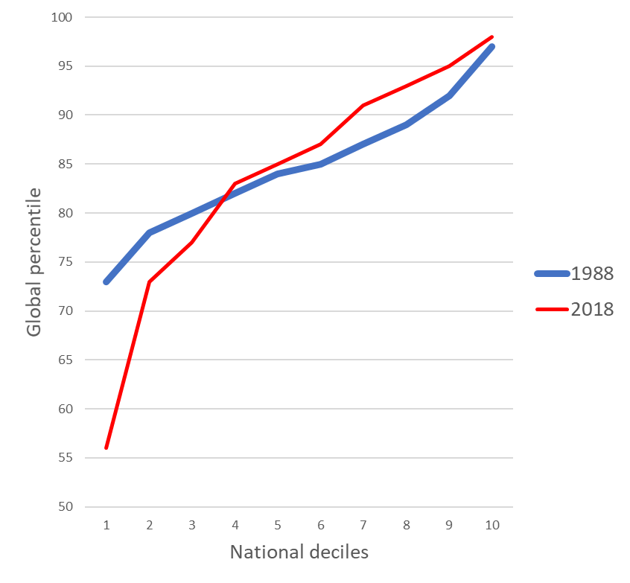
Urban China, 1988 and 2018
Italy, 1988 and 2018
Positional decline of lower parts of rich countries’ income distributions as they get overtaken by Chinese population

