Slide 1

The United States, the IMF and Special Drawing Rights
Mark Weisbrot

Slide 2
What are Special Drawing Rights?
Special Drawing Rights (SDRs) are an international reserve asset created by the International Monetary Fund (IMF) and distributed to member governments. They are not a currency, but under IMF rules, member countries that need hard currency (e.g. dollars, euros) can exchange them for these currencies.
Countries can also benefit from SDRs by simply keeping them in central bank accounts as international reserves. These reserves help countries stabilize their finances, grant more space for counter-cyclical fiscal policy and improve their overall economic situation.
SDRs also lower national borrowing costs and can substitute for other liquid reserve assets, freeing them up to be used for other purposes such as public investment. As a result, they both directly and indirectly bolster national demand.

Slide 3
The Decision: A new, record-size issuance of SDRs
On March 26, 2020, the Managing Director of the IMF, Kristalina Georgieva during a G20 Leaders’ Summit, asked for help:
  “[I]t is paramount we recognize the importance of supporting emerging market and developing economies to overcome the brunt of the crisis and help restore growth. They find themselves particularly hard hit by a combination of health crisis, sudden stop of the world economy, capital flight to safety, and – for some – sharp drop in commodity prices.”
She called for the IMF to “[b]oost global liquidity through a sizeable SDR (Special Drawing Right) allocation.”
A day earlier, she had said: “Our current estimate for the overall financial needs of emerging markets is 2.5 trillion dollars. We believe this is on the lower end.”

Slide 4
U.S. Treasury Vetoes the Decision
But this decision requires an 85 percent majority of votes at the IMF Board of Governors; the U.S. has 16.5 percent of the votes, thus giving it unilateral veto power.
The U.S. Treasury announced its opposition in a statement to the IMF’s steering committee a few weeks later, and that was the end of discussion.
Note that the 85 percent requirement does not apply to all votes at the IMF. In practice however, the United States has had a veto over almost any other decisions when it wants to, and has substantial and even determinative agenda setting power, since the other high income countries, mostly in Europe, almost always vote with the United States; together they comprise a 60 percent majority at the Fund.

Slide 5
U.S. House of Representatives Passes Legislation
U.S. House of Representatives proposed and passed legislation on July 31, 2020 that required the administration to propose, at the IMF, a new issuance of SDRs worth $2.8 trillion.
U.S. government support would have guaranteed its approval at the Fund.
The legislation was based on Georgieva’s appeal for a sizeable SDR allocation.
Why is this important?
The involvement of the US Congress was to prove decisive. It was the Congress that successfully pressured Treasury to support the new allocation.

Slide 6
This was not a substitute for the multilateral decision-making that the IMF is supposed to have; but the Congress allowed for the input of, and accountability to, organizations representing tens of millions of people, most of whom had a different view of a “rules-based international order”.
Result: SDRs are a life-saving instrument of harm reduction; and may also lead to important structural reform if they can become a regular occurrence.

Slide 7
The 2020 Recession Increased Mortality in Developing Countries
The pandemic recession saw the worst decline in global per capita GDP in 75 years.
We estimate that mortality among the 3.9 billion people living in EMDE (Emerging Market and Developing Economies) countries that fell into recession in 2020 would have been expected to increase by 1.94 million people, as a result of the recession.
It is also an underestimate; for example the impact of the recession of on the ability of public health measures, e.g. vaccines, to lower mortality from the disease, is not taken into account here.

Slide 8
A 2020 Issuance Could Have Saved Many Lives
The SDR issuance of approximately $650 billion was finally approved on August 2, 2021, and distributed to member countries on August 23, 2021.
Suppose they had been approved and distributed in March 2020, when Managing Director Georgieva, IMF economists, and almost all member governments were in favor of it.
More than 200,000 lives would be expected to have been saved.

Slide 9
The 2021 SDR Issuance saved lives in developing countries
In 2021, during the pandemic, some $209 billion of the $650 billion went to emerging and developing economies (EMDEs) not including China (which cannot use them because they have more than $3 trillion in reserves).
This provided more development aid than these countries received all year from other sources; and it came with no debt and no conditions.

Slide 10
Developing Countries used the allocation to pay back IMF debt
In its 2023 ex-post assessment of the 2021 general allocation, the IMF reported:
  Developing countries paid back a total of about $39 billion US dollars in IMF debt using SDRs.
  13 countries made GRA repurchases in SDRs totaling XDR 26.3 billion.
  42 countries made PRGT repayments totaling XDR 1.2 billion.
This is an underestimate of the IMF debt relief that resulted from the 2021 allocation, because the SDR issuance facilitated additional payments that reduced IMF debt.

Slide 11
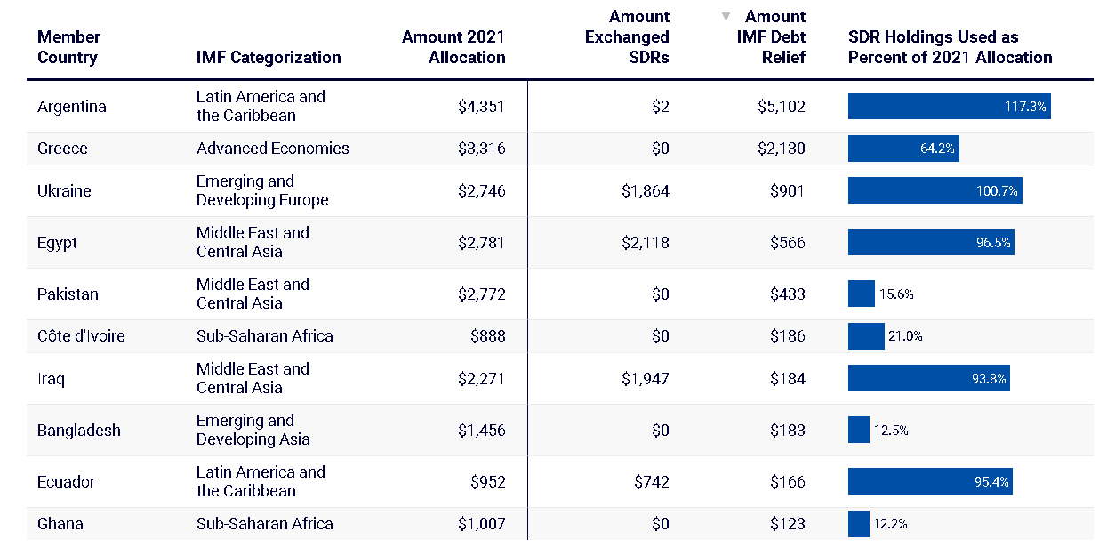
Developing Countries used the allocation to pay back IMF debt
IMF Member Countries that Exchanged SDRs or Used SDRs for IMF Debt Relief, August 2021–July 2022 (USD millions)
Cashman and Arauz (2022)

Slide 12
An issuance of SDRs creates jobs in the United States
EMDEs import about $1.1 trillion worth of goods and services from the United States. When they get SDRs, they have more international reserves and, as a result, their economies generally do better; for these and other reasons, they will import more from the US.
This creates export-related jobs in the US.
An allocation of the size approved by the House of Representatives ($2.8 trillion worth), would generate more than 160,000 US jobs.

Slide 13
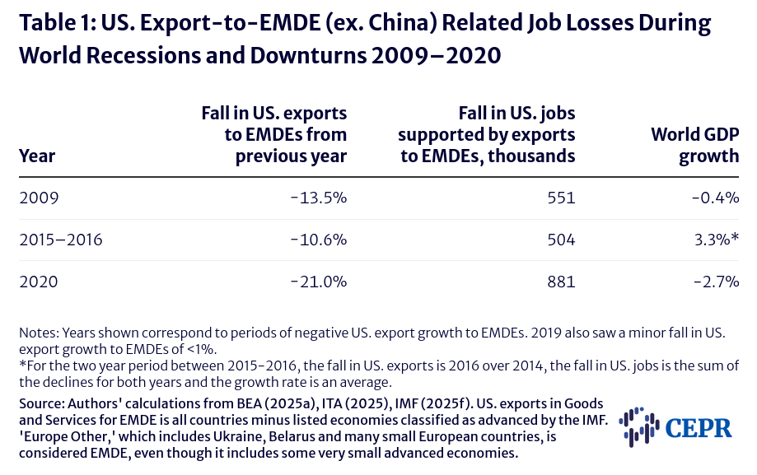
Loss of EMDE Imports from the US can cost many US jobs especially in economic downturns

Slide 14





How the SDRs in developing countries lead to more export-related jobs in the United States
Here are the steps in reaching this assessment:
Increase in EMDE reserves
SDR Issuance
Increase in EMDE Imports
U.S. job creation
Increase in EMDE GDP
Countries kept 60 percent of the 2021 SDR issuance as international reserves, which can increase GDP indirectly, and used the rest to boost GDP through policy actions (e.g. fiscal support). We assumed these proportions for the use of SDRs by developing countries, for all of the estimates here.

Slide 15
A new issuance of SDRs will not have any costs for the United States; and there are no downside risks for the United States or other countries
There is no cost to the US government, or any other government, of a new issuance of SDRs– now, or in the future.
It therefore makes no sense for the US government, at the IMF, to prevent this from happening.
There has not been any economic analysis or reasoning showing downside risks to the United States, or to any other country, of a new issuance of SDRs.

Slide 16
For the United States, there are two more advantages of the SDR issuance that make it important at this time, as compared with other policy changes that can increase employment
It does not require Congressional approval, which other policies to increase employment would require.
Once passed at the IMF, it can be distributed within weeks, as it was in 2021. There are few, if any, other policies that boost employment in the US that can be moved this quickly.

Slide 17
The Reasons for Blocking SDR issuances like that of 2021 are not clear
The United States, the Fund’s predominant power, benefits from an SDR allocation.
The politically powerful financial sector in the U.S., benefits quite a lot.
There are no costs or obvious downside risks to the US or its allies at the Fund.
Treasury has yet to put forth economic arguments against it.

Slide 18
Conclusion
SDRs can play an important role:
  Stabilizing the global economy.
  Reducing mortality especially in recessions and economic downturns.
  Reduction of IMF debt and conditionality.
  Reducing some of the disparities between the opportunities for counter-cyclical macroeconomic policy in developed countries versus the pro-cyclicality that plagues much of the developing world.
  Possible structural changes that could reform the IMF and therefore the international financial system.
There should be regular annual allocations.

Slide 19
Thank you.
cepr.net

