Slide 1
Political Economy of Rechanneling Special Drawing Rights for Climate Finance in Sub-Saharan Africa: Policy Insights from Nigeria
Olumide Abimbola|Africa Policy Research Institute, Germany
Olamide David|School of Business and Economics, Maastricht Graduate School of Governance, Maastricht University, Netherlands
Tunde Onitiri|Paula M. Trienens Institute for Sustainability and Energy, Northwestern University, Evanston, Illinois, USA
December 5, 2025| SIPA, Columbia University, New York

Slide 2
Why do SDRs Matter for Sub-Saharan Africa?
Why do SDRs Matter for Sub-Saharan Africa?
SDR allocations can ease structural constraints and provide significantly low-debt liquidity, helping stabilize economies during shocks (such as COVID-19, commodity price swings, and global tightening cycles).
Structural Constraints
Low reserve buffers
High debt-service burdens
Limited access to affordable external financing

Slide 3
SSA’s Allocation Gap and Disproportionate Share in the 2021 SDR Issuance
2021 Allocation
SSA received US$23.5bn (~3.6%) of the US$650bn global SDR issuance.
This ~3.6% ( ~US$23-24 billion) was shared among 46 Sub-Saharan African countries.
These 46 countries represent ~24% of all IMF members, yet received only a small fraction of the allocation.
SDR allocations can ease structural constraints and provide significantly low-debt liquidity, helping stabilize economies during shocks (such as COVID-19, commodity price swings, and global tightening cycles).

Slide 4
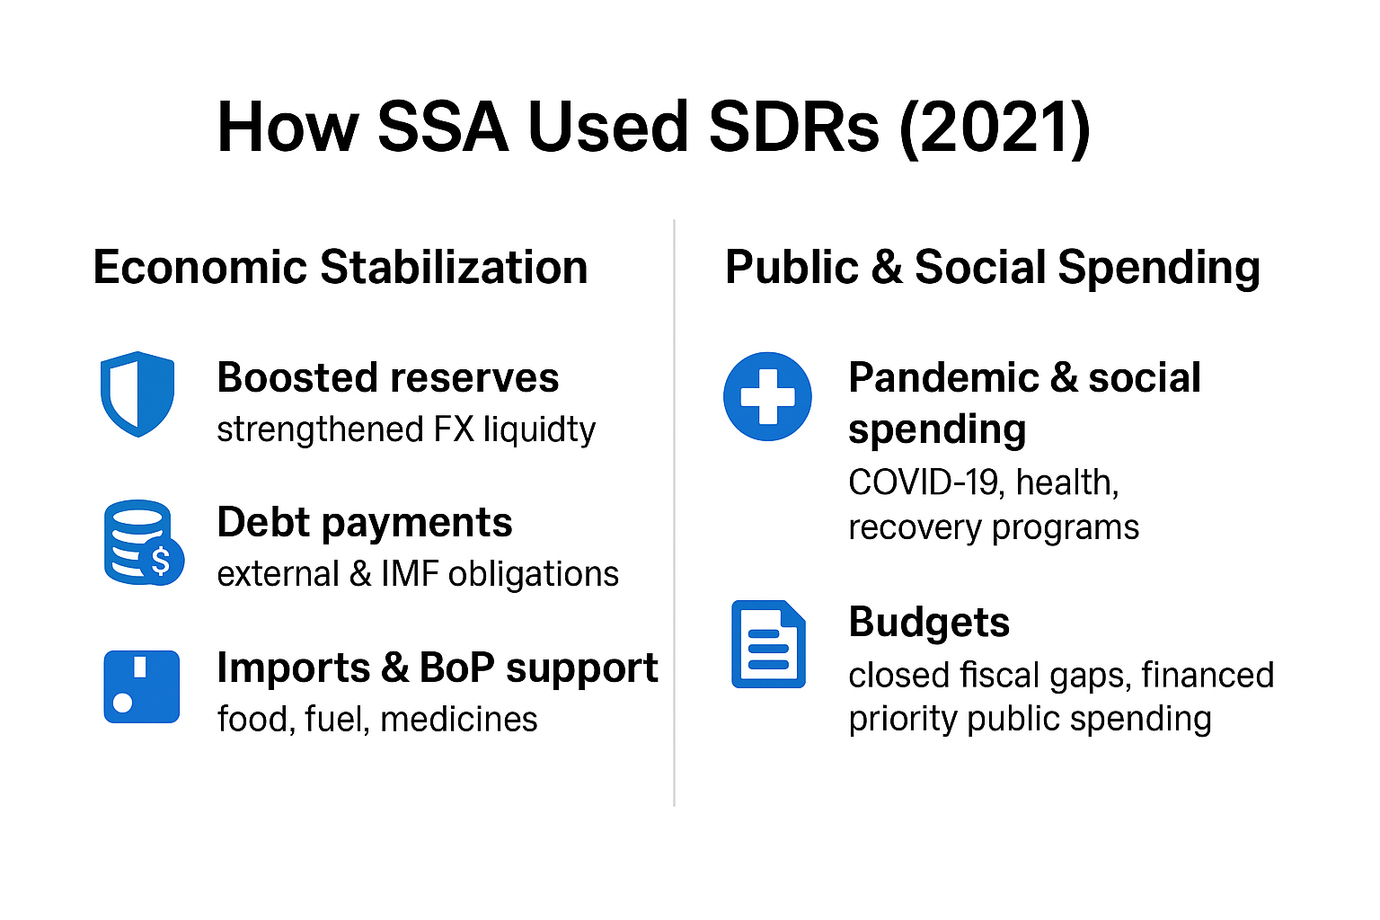

Slide 5
Why does Rechanneling SDRs for climate finance make economic sense for SSA?
Structural Imbalances (Gallagher et al., 2022): Rebalances IMF power dynamics and expands fiscal space for SSA.
High-Efficiency Investment: Unused SDRs = low cost for advanced economies, high climate impact in SSA.
Global Public Good (Stiglitz, 1999): Climate mitigation benefits all; rechanneling SDRs can close funding gaps.
Climate Justice: SSA emits <4% but faces severe risks-SDRs provide fair, non-debt finance.
More Inclusive Finance: Strengthens IMF legitimacy and supports equitable climate action.

Slide 6
What are the current arrangements for Rechanneling SDRs for Climate Finance in SSA?
Poverty Reduction and Growth Trust (PRGT) for concessional lending to low‑income countries,
Resilience and Sustainability Trust (RST); commonly used for climate finance initiatives in SSA

Slide 7
Key Constraints of the Resilience and Sustainability Trust (RST) for Climate Finance in SSA
Scale Mismatch of RST receipts: ~US$46.7 bn vs. climate needs in hundreds of billions (currently, over 300 billion is required per year, IMF 2025)
Design Limitations: Long-term, reform-linked loans → not rapid-disbursement; limited countercyclical value for shocks
Governance and Implementation: Resources not earmarked; impact depends on PFM, accountability, capacity, and partner coordination

Slide 8
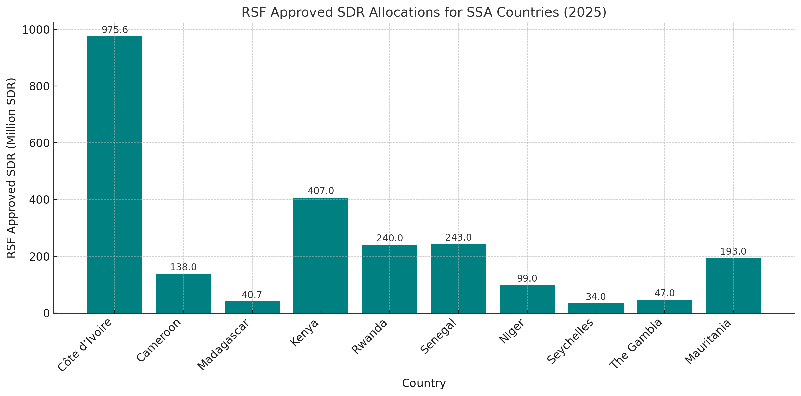
Current Context of RSF Approvals in SSA and SDR Allocations

Slide 9
Is rechanneling SDRs through RST sufficient for Climate Financing in SSA?
The RST is valuable but broadly insufficient. While they provide an essential complement to climate financing in SSA, their scale, design, and operational requirements alone cannot adequately meet SSA’s climate financing needs.

Slide 10
Hybrid Framework for Rechanneling SDRs for Climate Finance in SSA
Following Rodrik (2007), this paper adopts an analytically pluralist framework that integrates International Political Economy (IPE), Global Public Goods (GPG) theory, and climate justice to examine the constraints and opportunities of rechanneling SDRs for climate mitigation in SSA.
By emphasizing power relations, policy space, and institutional diversity, the framework adopts a problem-driven approach that evaluates SDR rechanneling under the political, institutional, and macro-fiscal conditions in which it would operate, rather than against abstract or universal policy benchmarks (Guzman et al., 2016).

Slide 11
Development Leverage Question:
How much additional climate finance impact can each SDR generate within the context of SSA when rechanneled through Multilateral Development Banks(MDBs) using a hybrid framework?”

Slide 12
Development Leverage of Rechanneling SDRs through MDBs
Conservative MDB balance sheet management means 1 SDR of hybrid capital → ~4 SDRs of development lending. The high-leverage impact can generate up to $80 billion for climate and development projects in low- and middle-income countries (IMF, 2024).
In contrast, 1 SDR lent to PRGT/RST = 1 SDR of final lending; ~ $1.35

Slide 13
Policy Insights from Nigeria: Pathways for Optimizing the Rechanneling of SDRs for Climate Finance in SSA
NSIA-Vitol Climate Finance Initiative
Proposed Framework for rechanneling SDRs in SSA
Outlook and Policy Implications

Slide 14
Nigeria and the NSIA-Vitol Climate Finance Initiative
Why Nigeria?
  Africa’s largest economy; 255.8m - 400m+ population by 2050
  High climate vulnerability + fiscal constraints
The Initiative
  $50m blended finance platform (NSIA $20m | Vitol $30m)
  Public capital de-risks projects and crowds in private finance
  200,000 clean-cooking & water-filtration devices (flagship)
Political Economy Mechanism
  Governance → hybrid capital mechanism → investment flows → climate mitigation outcomes
Key Constraints
Carbon-credit regulation delays | Institutional capacity gaps
Core Insight
Blended Finance + Strong Governance + SDR Liquidity = Scalable and Equitable Climate Investment

Slide 15
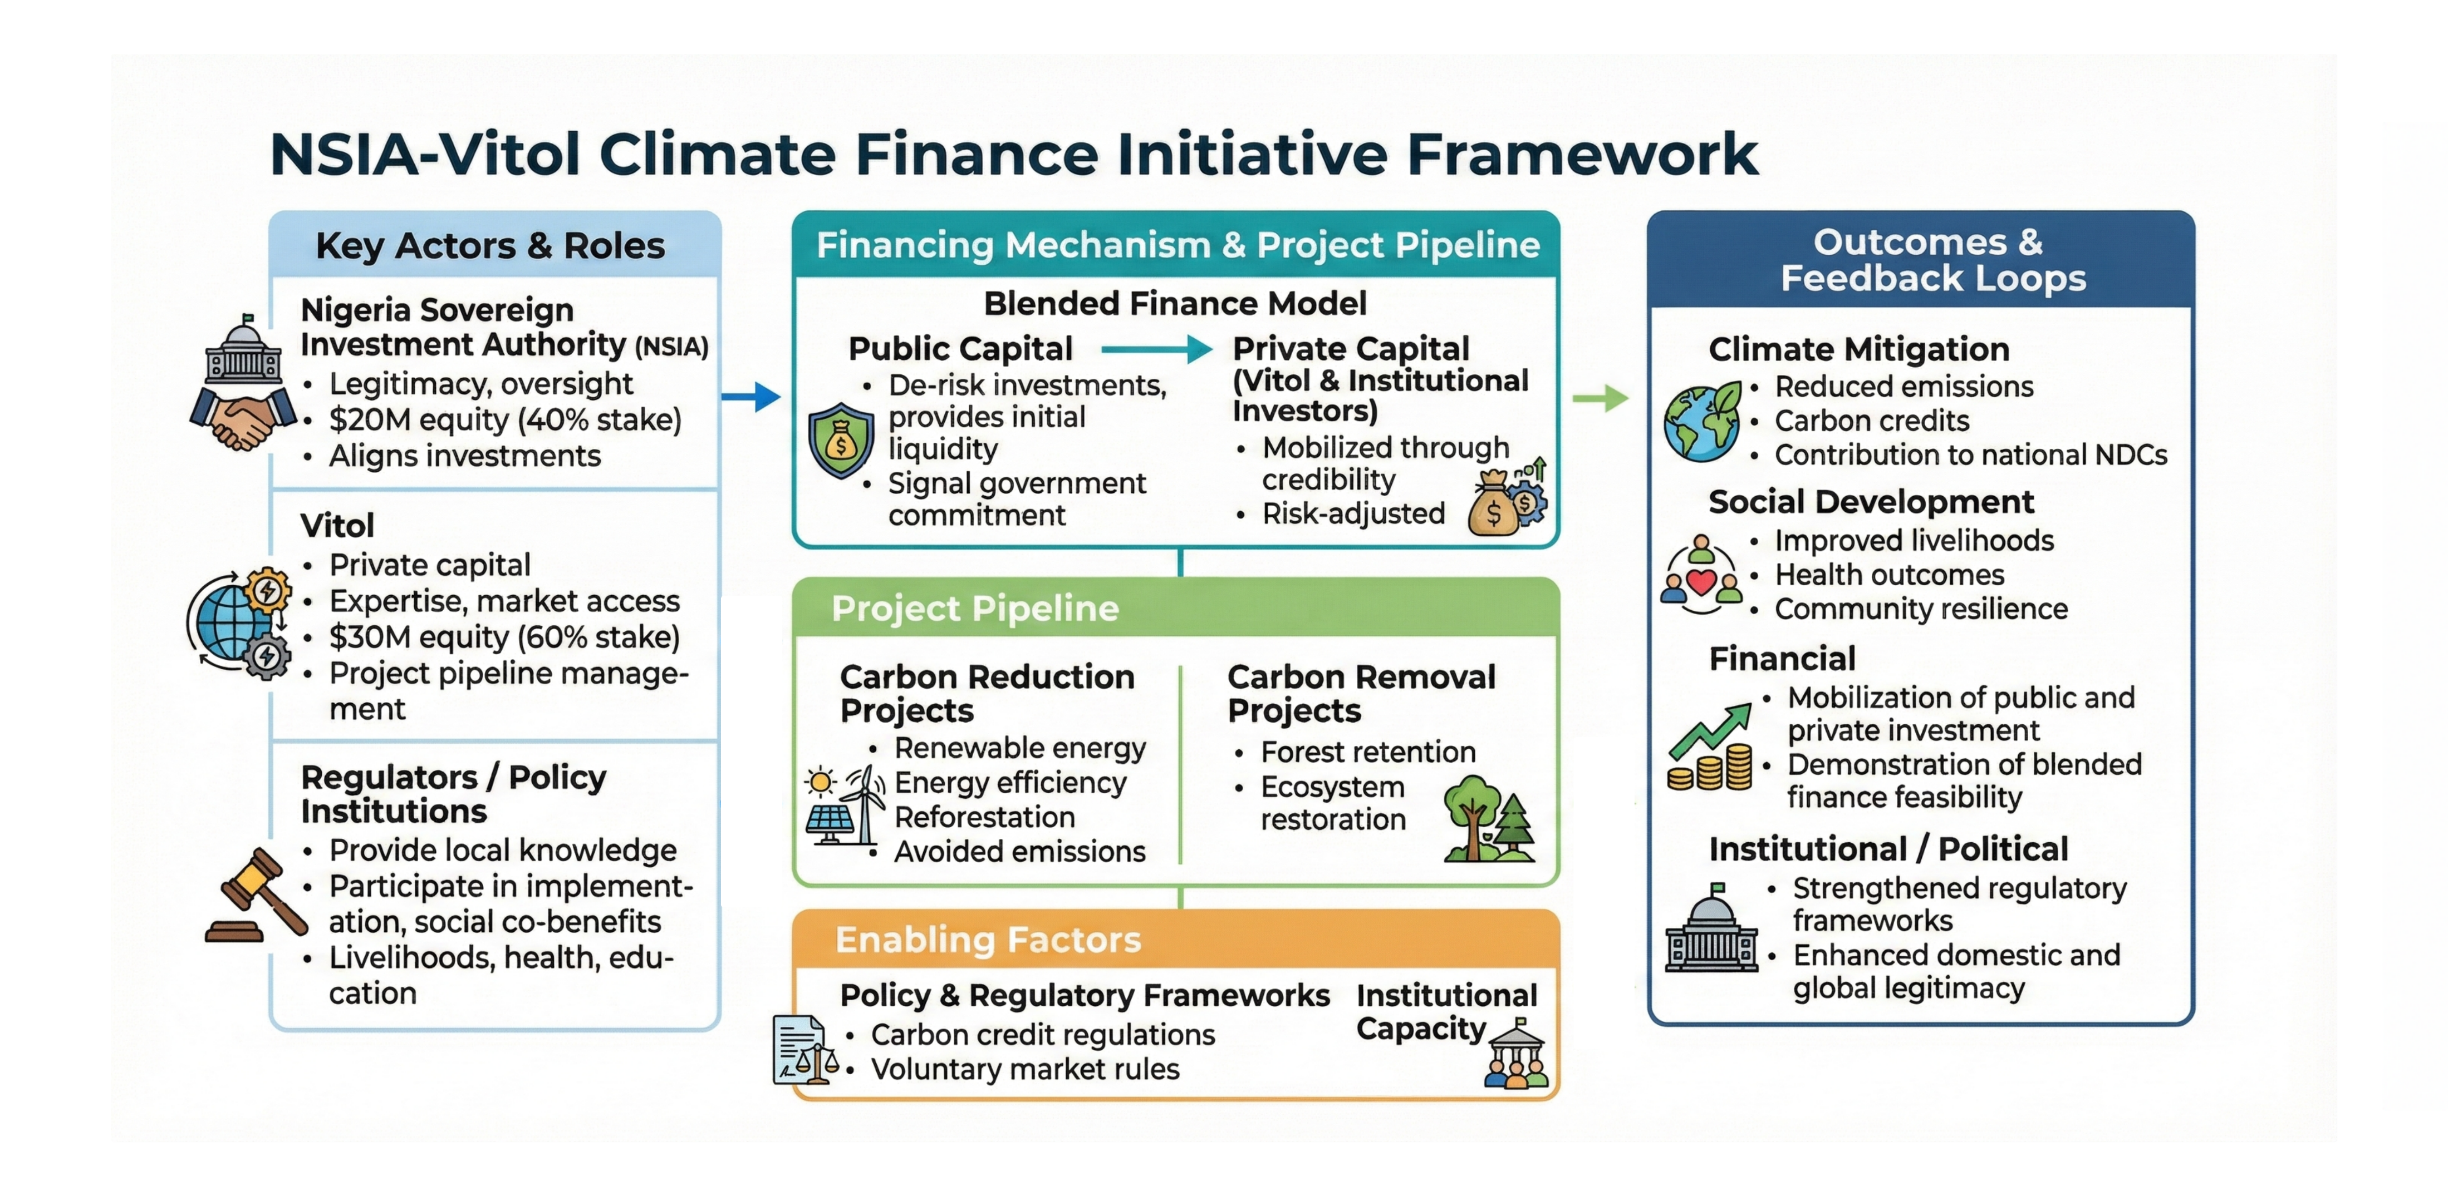

Slide 16
Contextual Veracity: Conceptual Foundations of the Proposed Framework for Rechanneling SDRs for Climate Finance in SSA
The framework develops and applies the concept of contextual veracity as an analytical lens for evaluating policy options, theoretical approaches, and institutional arrangements for rechanneling SDRs. Rather than assessing these mechanisms against abstract, universal, or idealized benchmarks, it examines their alignment with the political, institutional, historical, and macroeconomic conditions specific to SSA countries (David, 2025).
In contrast to approaches that ask, “Does this rechanneling mechanism conform with the pre-existing institutional arrangements?”, contextual veracity asks: are there workable improvements to pre-existing institutional arrangements that are equitable, feasible, and effective, given the actual constraints, incentives, and power relations in this setting?”

Slide 17
Framework for Rechanneling SDRs for Climate Finance in SSA
Core Logic: The paper advances an integrated framework that can be employed to rechannel unused SDRs into scalable climate finance through investment de-risking mechanisms tailored to SSA’s institutional and political-economy constraints.
Six Operational Pillars: From SDRs to Climate Impact
  Strategic SDR Reallocation: Voluntary transfer of SDRs to MDBs with explicit climate mandates
  MDB Intermediation & Governance: Due diligence, underwriting, and joint MDB–SWF accountability frameworks
  SWF Climate Deployment: Domestic investment in renewable energy, infrastructure, and resilience
  PPP Leverage: Blended finance structures to crowd in private capital and expertise
  Reimbursement Facility: Preservation of SDR reserve-asset status and macro-financial stability
  Recycling & Reinforcement: Reinvestment of returns and carbon revenues to scale impact and sustain financing
Outcome: An institutionally credible pathway that aligns SSA’s climate priorities with the rechanneling of SDRs, safeguarding reserve assets, supporting long-term investment, and social sustainability.

Slide 18
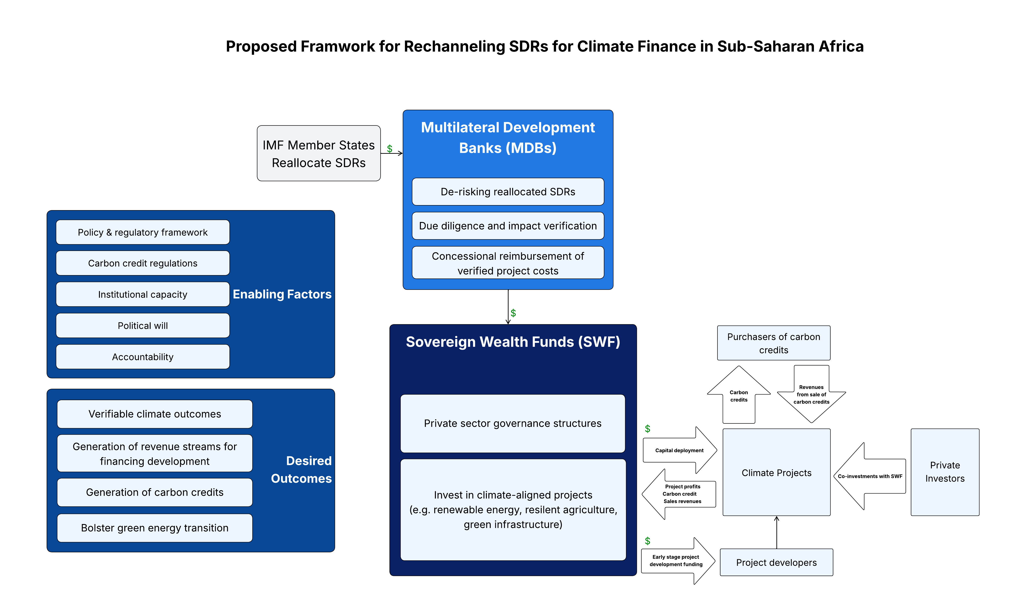

Slide 19
Outlook and Policy Implications
Integrate Finance Channels: Coordinate SDRs, MDBs, and SWFs to create unified climate-finance pathways that strengthen liquidity, fiscal stability, and development outcomes across SSA.
Test Rechanneling Models: Conduct empirical evaluations of SDR rechanneling mechanisms, including reimbursement facilities, to identify scalable, financially secure solutions tailored to regional contexts.
Enhance SWF Governance: Strengthen oversight to ensure transparency, fiduciary integrity, and alignment with national climate-finance mandates.
Regulate Carbon Markets: Leverage lessons from Nigeria’s Carbon Vista to develop robust carbon-market frameworks that maintain credit integrity, investor confidence, and market liquidity.
Build Resilient Financial Architecture: Establish stable structures for voluntary carbon markets to generate long-term revenue, attract institutional investment, and enhance SSA’s role in global climate-finance governance.

Slide 20
References
David, O., 2025. Toward a theory of contextual veracity: Reconceptualizing the policy and practice gap in socioeconomic sustainability initiatives in Sub-Saharan Africa. Working paper. School of Business and Economics, Maastricht Graduate School of Governance, Maastricht University, Netherlands.
Gallagher, K.P., Ocampo, J.A. and Volz, U., 2022. Rechanneling special drawing rights to advance global health and climate goals. Boston: Boston University Global Development Policy Center, Task Force on Climate, Development and the IMF.
Guzmán, M., Ocampo, J.A. and Stiglitz, J.E., 2016. Too little, too late: The quest to resolve sovereign debt crises. New York: Columbia University Press.
Rodrik, D., 2007. One economics, many recipes: Globalization, institutions, and economic growth. Princeton, NJ: Princeton University Press.
Stiglitz, J.E., 1999. Knowledge as a global public good. In: I. Kaul, I. Grunberg and M.A. Stern, eds. Global public goods: International cooperation in the 21st century. New York: Oxford University Press.

