Slide 1
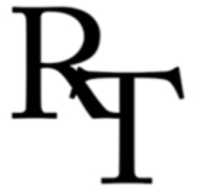
Columbia University
The Role of SDRs for Global Stability and Sustainable Economic Transformation
SDR-Anchored Stablecoins to Restore Multilateralism
Robert Triffin International
5th December 2025
Bernard Snoy (& C. Ghymers)
Chairman of Robert Triffin International (RTI)
Professor, UCLouvain, Belgium

Slide 2

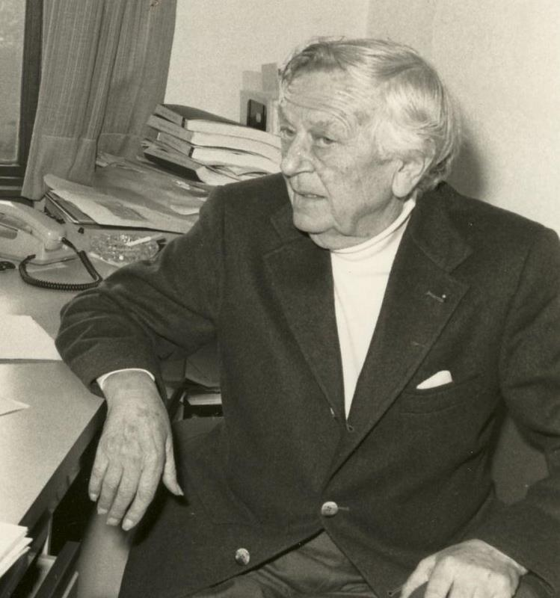
Robert Triffin 1911-1993

Slide 3
Robert Triffin (1911-1993)
Belgian-American economist, taught at Harvard, Yale, Louvain, served in IMF, FED, Marshall Plan, Kennedy Administration, European Commission, etc.
Key contributions to European Payments Union, conception of the SDR and European Economic and Monetary Union.
Denounced the Bretton Woods System incoherence: the «built-in destabilizer» (Testimony at US Congress October 1959) and publications predicting the collapse of this System
Enunciated the Triffin Dilemma (TD) : « it is impossible for a national currency used as a world currency to serve properly both the needs of the national economy of the country issuing that currency and the needs of the international economy »

Slide 4
Successive forms of the Triffin Dilemma
Unresolved trade-off between domestic stability and global stability
« exorbitant privilege »: no US external constraint at the cost of US $ overvaluation, linked to role of lender/consumer of last resort + weaponization option.
« Built-in destabilizer » : asymmetry in impact of US monetary policy on other countries creating global liquidity waves=>pro-cyclical spillovers and financial instability
=> absorption of savings of Emerging Economies =>hindering financing of decarbonization & SDGs
Growing scarcity of dollar-safe assets (shrinking relative US size facing fast growing demand, e.g. demand of Non Bank Financial Intermediaries (NBFI) for dollar collaterals in repo markets) => financial fragilities .

Slide 5
Yet there is a solution : IMF issuing a multilateral currency as single monetary base
In 2010 RTI supported Palais Royal Initiative (PRI) on reform of International Monetary System (IMS) launched by Camdessus, Lamfalussy, Padoa-Schioppa; report in 2011 endorsed by 18 high level officials, including Paul Volcker, highlighting the link between the 2008 crisis and un-addressed TD
Solution: IMF as a supranational bank, issuing a mulilateral currency – a revamped SDR – a liquid liability that would not be a debt of any individual country but an (n+1)th currency providing a tool for managing global liquidity. Why? Need for a global single monetary base, exogenous to national currencies (as is the case at national level with a two-tier system: Central Bank and Deposit Bank moneys)
2014 RTI report promoting concrete steps to enhance development of official and private SDR.
2016 Camdessus & Singh: three stages Roadmap to implement PRI report
Now RTI proposes a second-best approach: a «private» SDR stablecoin as a common multilateral safe asset

Slide 6
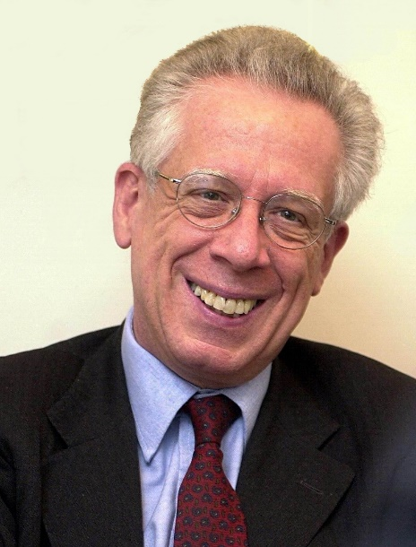
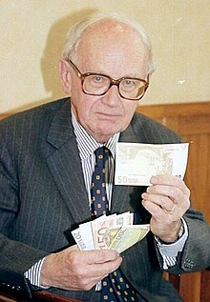
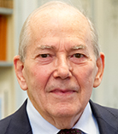
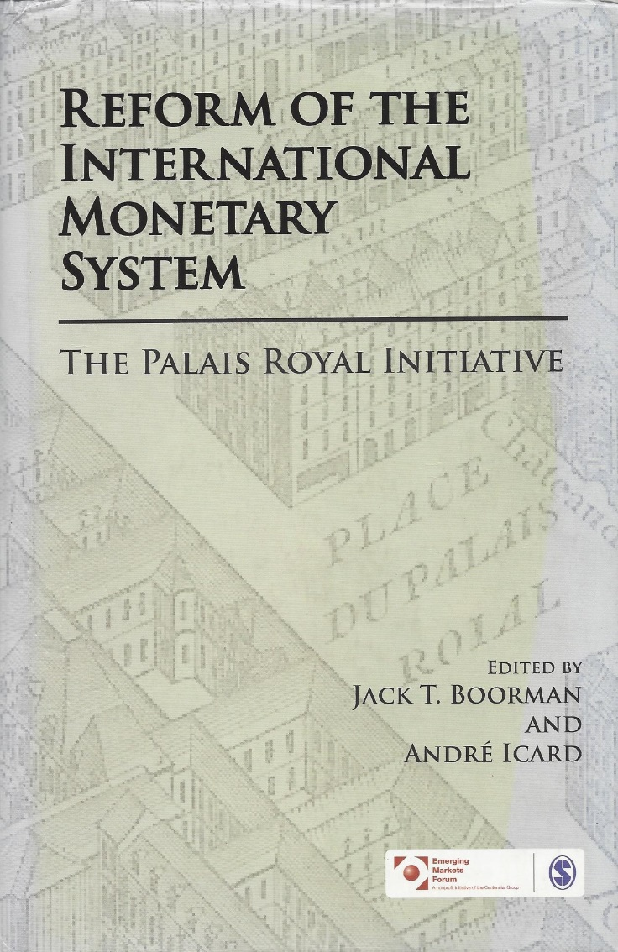
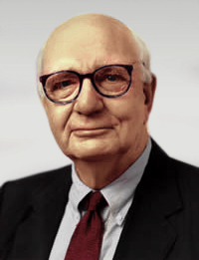
The blueprint is available in the
Palais Royal Initiative
(1940-2010)
Member of the Executive Board of ECB 1998-2005, Minister of Finance of Italy 2006-2008
Alexandre Lamfalussy
(1929-2015)
Managing Director of the Bank for International Settlements 1985-93,
President of European Monetary Institute 1994-97
Chairman of RTI 2000-14
Michel Camdessus
Born in 1933
Governor of Banque de France 1984-87, Managing Director of IMF 1987-2000
Paul Volcker (1927-2019)
Chairman of Federal Reserve
USA 1979-87

Slide 7
The present situation involves high risks of global financial crisis
Trump Administration’s determination to maintain/enhance $ dominant role and weaponization despite the TD (Stephen Miran’s paper); conditioning of access to US market, financial and military protection to accepting US unilateral requests.
US policy-mix unable to balance budget and external deficits and threats to independence of Federal Reserve raising doubts on $ role as safe haven.
Worsening scarcity of US safe assets, getting used as collateral in booming wholesale money markets, increasing procyclical global liquidity and financial instability
Emerging financial fragmentation leading to a multi reserve currency world, which could end up in high exchange rate instability, even currency wars, as even small divergences in policy mixes could generate brutal portfolio reallocations.
Multi-reserve currency system implies competition either to incur wide external deficits or to play the world banker, but lack of singleness of reserve currency perpetuates the TD
Emergence of private crypto-assets, challenging monetary sovereignty, and rapid development of $ stablecoins which could divert and absorb world savings to finance US unsustainable deficits

Slide 8
but also new opportunities
Resuscitated attention to TD, realization of high cost involved in lack of response or distorted response as proposed by US Administration (Stephen Miran) .
Aggressive US policies motivate partners to seek to limit costs the US is trying to impose on them. Search for alternative trade and monetary arrangements as well as for possible regional or interregional « coalitions of the willing » and to keep alive multilateral arrangements: SDR is one among other potential instruments to escape $ domination.
Realization that Multi Reserve Currency System is not a promising solution as it destroys the singleness of the international monetary base and entails high risks of exchange rate and monetary policy instability.
Most promising development : Distributed Ledger Technology (DLT) behind Central Bank Digital Currencies (CBDCs) and stablecoins, reducing transaction costs and allowing interoprability.
RTI’s proposal : using DLT for costless bundling and unbundling of « private » SDR as a potential instrument to organize a soft-dedollarization through a defacto (n+1)th reserve currency, resolving the scarcity of dollar safe assets.

Slide 9
Regional Approach Towards Keeping Alive Multilateralism and Developing the Role of the SDR
Regional monetary arrangements to reduce countries’ dependence on the $ : ASEAN, Chiang Mai Initiative, Latin American Reserve Fund (FLAR), Western Africa Economic and Monetary Union, etc.
Limited de-dollarization for cross-border payments, regional safety nets, trend towards economic convergence and monetary integration but so far limited use of common safe assets.
But the $ domination relies on safe assets role in private markets. Therefore, solution requires to provide an alternative to $-safe assets. SDR basket safe assets could provide such an alternative; but creation and wider use of official SDRs are frozen.
Second best solution: drawing on regional and private markets reaction dynamics, a joint adoption of private SDR assets, through swapping of central bank reserves, used for regional and interregional transactions, would provide an alternative for issuing more stable safe assets
Creation of a de facto multilateral safe asset could provide the basis upon which IMS/IMF reforms could progressively be achieved with cooperation of central banks, in a groping process

Slide 10
How would this work?
Countries of a particular region would pool by swaps part of their national central bank reserves, held in the 5 currencies composing SDR, and create a Regional Monetary Fund(RMF) in which these reserves would be deposited.
Each RMF would convert these reserves to extent needed to get at regional level exact proportions of key currencies composing official SDR basket; swap system within and between regions should make this adjustment easy by transferring excess of one currency to those missing it.
Each RMF could then issue same SDR-Stablecoin, backed one-for-one by pooled key currency safe assets, making sure that MiCA and/or other equivalent stablecoin regulation are respected.
Setting up of a regional collegial monitoring, involving both national Central Banks and Treasury authorities, entrusted to set up objective criteria for exploiting potential use of common SDR-crypto safe assets. Possible decentralization of IMF function.
Process to be repeated for interregional cooperation.
DLT technology allowing for bundling and unbundling of SDR Stablecoin costless at any time, e.g. into dollars ( 44.38% of SDR basket) or euro (20.31%) or other SDR component.
= a soft de-dollarization allowing for dealers to work in $ but eradicating its present asymmetry and reducing exchange-rate risk as SDR by definition more stable than its components.

Slide 11
How regional creation and use of common private SDR Stablecoins could launch a smooth de-dollarization
Crisis tool for resisting possible political blackmail or potential dollar liquidity crunch.
Tool to achieve and maintain regional financial credibility, with possible leverage to create « regional public goods »
Under strict conditions, creation of additional liquidity by borrowing reserves cheaper on financial markets in SDR Stablecoin and using these external resources to buy member States T-bills.
Extending swaps to other regions and issuers of non-dollar currencies
Ultimately merging official SDR with «private» SDR Stablecoin, transforming IMF into a Global Monetary Fund that would cover different RMFs and play the role of genuine multilateral LOLR.
Concomitant benefits in terms of trust and institution building, promoting better macroeconomic governance at national, regional and global levels, spurring regional integration.

Slide 12
Annex: the basic instinct of monetary order
An efficient monetary system requires to ensure the singleness of money
This was enforced at national level through the institutionalization of a two-tier structure of money: the need for a (n+1)th currency = the central bank money, necessary for making compatible and giving the same value to all national deposit bank moneys (transfert of reserves and managing liquidity (LoLR).
At the international level this systemic progress has not yet have been possible and the dollar has been using this role in a more and more imperfect manner (Triffin Dilemma = growing scarcity of dollar-safe assets + US weaponization of the dollar => financial fragilities)
The emerging trend towards dedollarization has been limited to trade payments and invoices, but not in its key-role in the interbank transactions and private reserves in safe assets: the currency hierarchy remains a dollar monopolistic position in global finance through the global role of dollar-safe assets, since markets needs a single instrument

Slide 13
Annex: the basic instinct of monetary order
The necessary reform of IMS needs to satisfy this «basic instinct»
It ensures the need for the singleness of global monetary base
The dollar cannot satisfy efficiently this basic need because it is national currency i.e. it cannot provide the missing degree of freedom in a system of «n» currencies (asymmetry-scarcity of safe assets-risks)
A multi-currency world cannot either: likely to degenerate in currency war
Only an exogenous currency - a (n+1)th one, like gold in the past - can do it, restablishing «n» degrees of freedom and sovereignties
This (n+1)th currency does exist with the SDR if it would be issued by IMF as a multilateral safe asset created against buying key-currency safe assets (national T-Bills issued by the 5 components of the SDR basket)
The institutional paralysis at IMF could be bypassed with the help of ECB (and supported by other regional monetary agreements) by promoting the issuance of private SDR-safe assets or SDR-stablecoins for using them as the vehicle for clearing their payments, making it the single monetary base

