Slide 1
Financing Development In A Higher-for-Longer World
The Evolution of the World Bank’s Funding Model,
the Challenge of Elevated Interest Rates,
and a Role for Special Drawing Rights
Stephen Paduano | University of Oxford, Finance for Development Lab
Brad Setser | Council on Foreign Relations

Slide 2
An Overview of the Problem: The IDA Cliff
The World Bank’s financial model has undergone continuous change since 1947, adapting to challenges and opportunities as they arise.
The most recent evolution was the establishment of IDA’s market borrowing program in 2018, which has enabled a 230% increase in IDA’s annual gross disbursement volumes.
However IDA’s market borrowing program was established for the low-for-long interest rate environment: it came into effect when the weighted average coupon on IDA’s bonds was 0.6%.
The global monetary tightening of 2022 and the apparent departure from the low-for-long environment has upended IDA’s market borrowing program — creating a widening asset-liability interest rate mismatch — and depleted IDA’s Deployable Strategic Capital.
The World Bank requires another evolution to insulate IDA from its market borrowing pressures, stabilize lending volumes, and identify new ways to scale up concessional financing capacity.
Notes:
To be fair, the 1959 IBRD GCI was done as 0% callable because the objective was to raise funding from markets – IBRD had already issued bonds, but the callable was a signal of IBRD’s reliability as a borrower. This doesn’t apply to IDA of course

Slide 3
An Overview of the Solution: The SDR Bond
The world’s pool of SDR 660bn ($900bn) is mostly idle and held by rich countries that neither need nor use them. The G-20 sit on SDR 461bn ($629bn).
The G-20 pledged to rechannel $100bn of those SDRs in 2021 — however the existing SDR rechanneling infrastructure (PRGT and RST) only has absorptive capacity for $63bn in SDRs.
This leaves the G-20 pledge unfillable and 90% of the G-20’s SDRs functionally unusable.
Rechanneling SDRs as hybrid capital hit a wall due to the reserve management rules of key SDR holders
An SDR-denominated, cash-settled bond issued by IDA — a senior debt instrument issued by a AAA-rated entity — would satisfy reserve management rules and trade as a conventional reserve asset
In turn, SDR funding would provide IDA lower-cost and longer-tenor debt than what markets can provide, insulating it from market borrowing pressures and closing its interest rate and duration mismatches
Notes:
To be fair, the 1959 IBRD GCI was done as 0% callable because the objective was to raise funding from markets – IBRD had already issued bonds, but the callable was a signal of IBRD’s reliability as a borrower. This doesn’t apply to IDA of course

Slide 4
Agenda
A (brief) history of the World Bank’s funding models
The emergence of the “IDA cliff”
The mechanics of the SDR bond

Slide 5
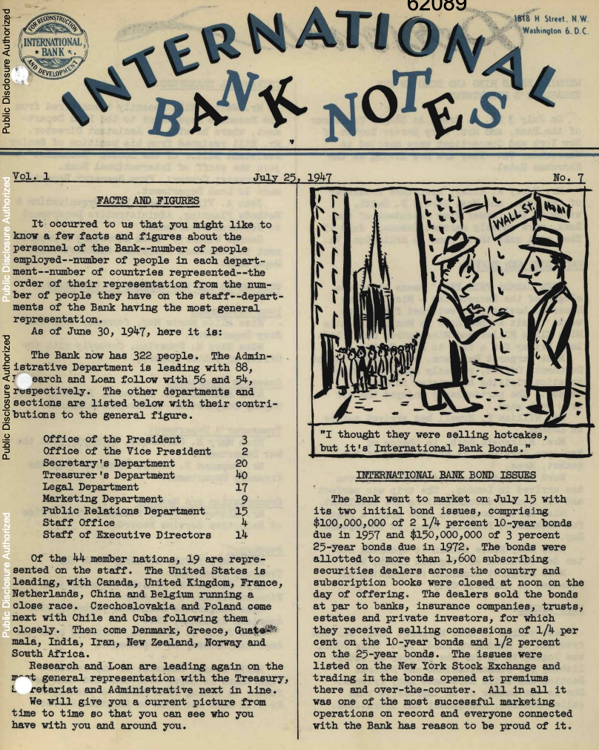
A Brief History of the World Bank’s Funding Model: The Launch
IBRD’s first loan: June 1947, $250 million 30-year at 4.25% to Crédit National (France)
IBRD’s first bond issues: $100 million 10-year at 2.25% and a $150 million 25-year at 3%
With a weighted funding cost of 2.7%, IBRD was lending at 155 basis points above its borrowing costs.
Notes:
To be fair, the 1959 IBRD GCI was done as 0% callable because the objective was to raise funding from markets – IBRD had already issued bonds, but the callable was a signal of IBRD’s reliability as a borrower. This doesn’t apply to IDA of course

Slide 6
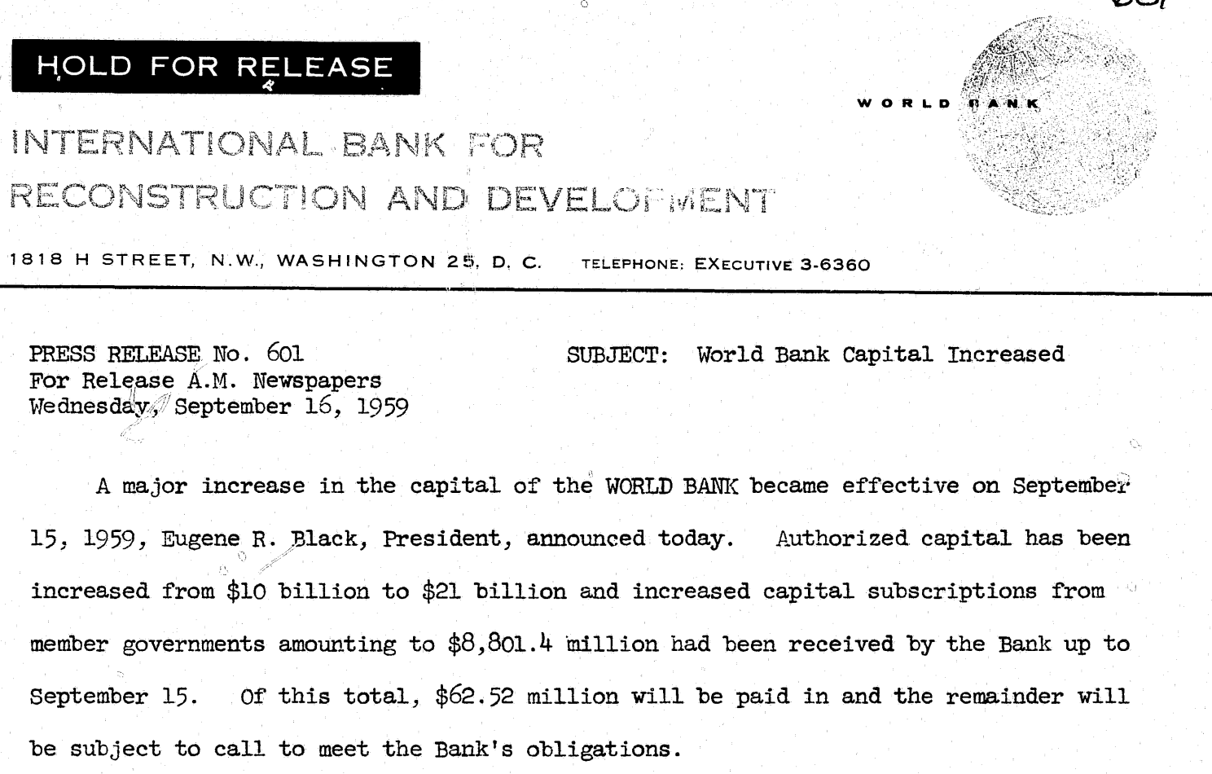
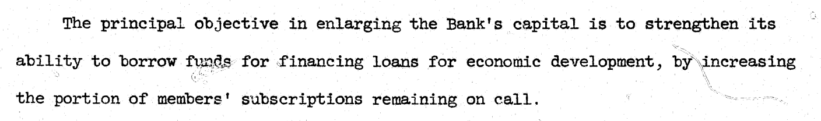
A Brief History of the World Bank’s Funding Model: Expanding the Market Borrowing Program
1959 — First General Capital Increase
Raised $11bn — 99.5% callable capital, 0.5% paid-in capital
Why?
Notes:
To be fair, the 1959 IBRD GCI was done as 0% callable because the objective was to raise funding from markets – IBRD had already issued bonds, but the callable was a signal of IBRD’s reliability as a borrower. This doesn’t apply to IDA of course

Slide 7
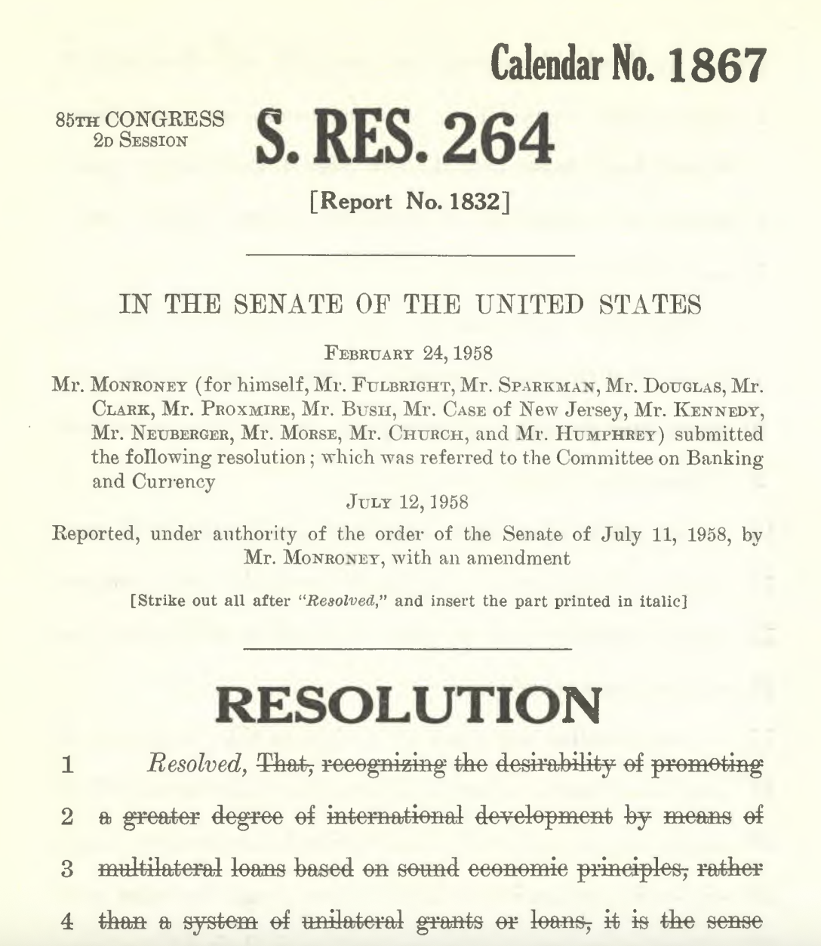
A Brief History of the World Bank’s Funding Model: The Creation of IDA
Momentum building in 1958-59 for a low-income lending arm
  Senator Mike Monroney (D-OH) joined by JFK and others in proposing a working group to accelerate support to countries that cannot afford IBRD’s lending terms
IDA established in September 1960
  IDA quickly disburses $101 million in 50-year, zero coupon development credits to Honduras, Sudan, Chile, and India
Market borrowing not possible to finance credits
  Articles of Agreement envision reviews of resource adequacy and capital increases every 5 years
Notes:
They tried again to stretch IDA-1 to 5 years, but they committed and earmarked all available funds by 1966 – kicking off IDA-2. It took a while to get IDA-2 fully committed, so in 1967 IDA’s lending volume collapsed to $106.6 million (from $353m the year before). IDA-2 was operationalized in 1968, covering 1968-1971. Then IDA-3 rolled around in 1971, covering 1971-4. https://timeline.worldbank.org/en/timeline/eventdetail/2971

Slide 8
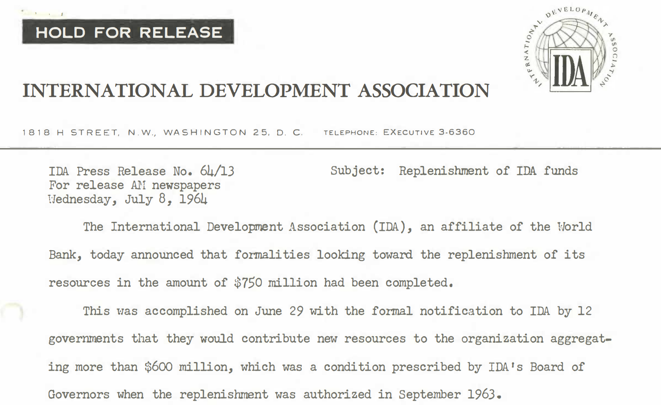
A Brief History of the World Bank’s Funding Model: The Evolution of IDA Replenishments
After just 3 years IDA needed to initiate its first replenishment (IDA-1)
They tried to stretch IDA-1 for 5 years, but committed and earmarked all available funds by 1966 — kicking off IDA-2
This has created a quasi-tradition of IDA replenishments every three years
  An exception was made during Covid – IDA-20 pulled forward by a year
Notes:
They tried again to stretch IDA-1 to 5 years, but they committed and earmarked all available funds by 1966 – kicking off IDA-2. It took a while to get IDA-2 fully committed, so in 1967 IDA’s lending volume collapsed to $106.6 million (from $353m the year before). IDA-2 was operationalized in 1968, covering 1968-1971. Then IDA-3 rolled around in 1971, covering 1971-4. https://timeline.worldbank.org/en/timeline/eventdetail/2971

Slide 9
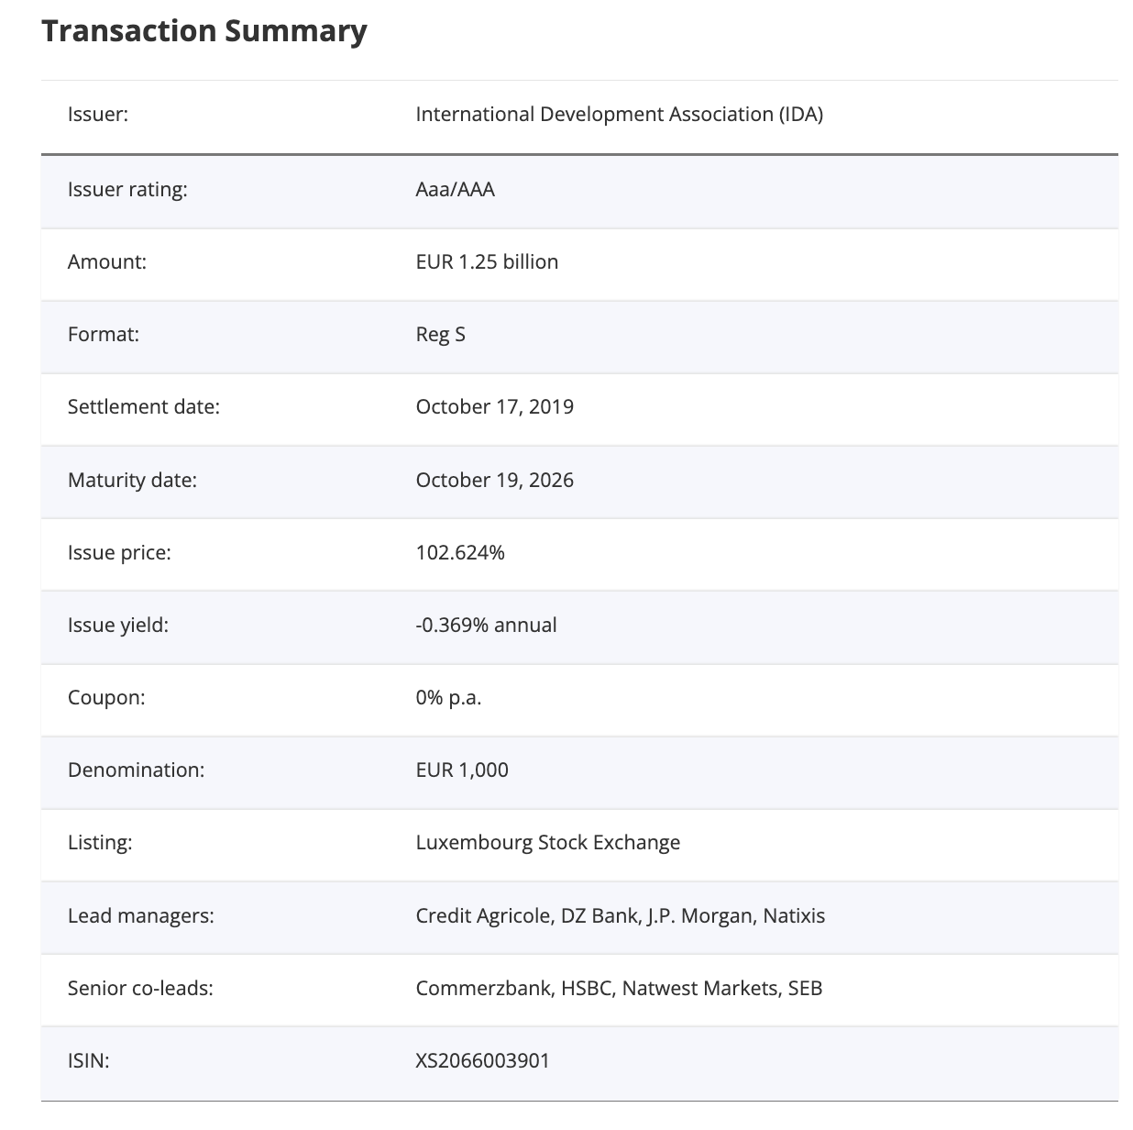
A Brief History of the World Bank’s Funding Model: The Evolution of IDA Replenishments
What’s in an IDA replenishment?
Shareholder contributions (equity), loan reflows, carry-over
IBRD net income transfers (starting in 1964)
MDRI contributions (starting in 2007)
IFC retained earnings transfers (starting in 2007, discontinued 2018*)
Concessional Partner Loans (starting in 2014)
Market borrowing (starting in 2017)
  Debut issuance a $1.5bn, 5yr USD bond at 2.75% in 2018
  Returned to the market in 2019 with €1.25, 7yr EUR bond at 0.0%
  Launches program in earnest in 2020-21 with weighted average coupons of 0.6%
Notes:
2. IBRD net income transfer – it’s totaled $17.3 billion since 1964
3. The Multilateral Debt Relief Initiative was established in 2005 and IDA authorized participation in it in 2006. IDA would provide debt cancellation for Heavily Indebted Poor Countries, which would be compensated for by additional contributions from shareholders. Those “MDRI Contributions” are intended to fully compensate IDA’s debt forgiveness under MDRI. The first MDRI contributions were scheduled for IDA-14 in 2007.
MDRI contributions are projected to total $24.8bn and run through 2044 – we’re in the belly of MDRI contributions now (from FY21-FY30 they are $1-1.2bn)
4. There was another IFC transfer done in 2021 for $213m. World Bank Board voted to authorize the IFC net income transfer in 2007 as part of IDA-15: https://documents1.worldbank.org/curated/en/715591468338348090/pdf/41281.pdf. This was discontinued to create the IDA Private Sector Window under IDA-18. This was a very bad deal for IDA — not only did it deprive IDA of a meaningful grant contribution source ($3.89bn total), it also consumed a portion of IDA’s balance sheet — the IDA “set aside” that was the equity base for the IFC’s PSW investments.
5. IDA created CPLs in 2014 as part of IDA17: IDA introduced long term borrowings through concessional partner loans for the first time under IDA17, which commenced on July 1, 2014. The borrowing terms of the concessional partner loans aim to match the concessional features of IDA’s loans. These borrowings are unsecured and unsubordinated fixed rate debt in SDR component currencies. IDA may prepay some or the entire outstanding amounts without penalty. These borrowings are carried and reported at amortized cost…. It constituted 7% of the IDA-17 envelope. IDA’s current outstanding CPLs at amortized cost are $7.6bn — relative to market borrowings at amortized cost of $18.1bn, and total fair value borrowings of $45.1bn. IDA’s CPL’s have a weighted average coupon of 1.9%.
6. In 2017 as part of IDA-18, IDA introduced a market borrowing program

Slide 10
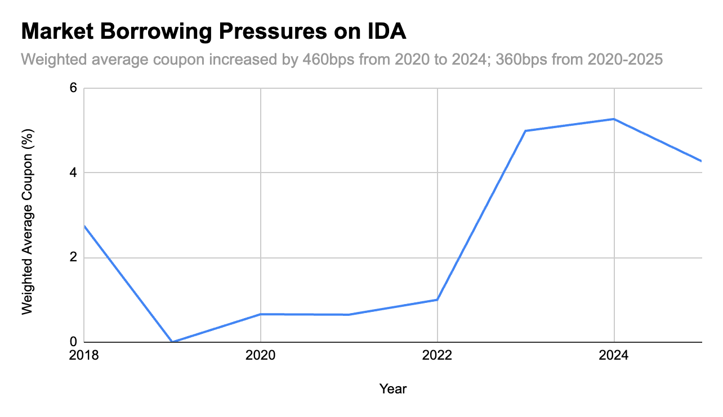
2. The Emergence of the “IDA Cliff”: A Market Borrowing Crisis
Global monetary tightening of 2022 locks IDA out of international capital markets for 13 months
When IDA returns, its weighted average coupons have been:
  2023: 4.99%
  2024: 5.27%
  2025: 4.27%
Growing WB concern to IDA’s asset-liability interest rate mismatch
Notes:
Weighted average coupon on IDA bond was 1.25% in 2019, which was really when the hybrid finance model got going (only one issue in 2018)
Then it dropped to 0.66% and 0.65% in 2020-2021.
The weighted average coupon of just 1% in 2022 masks the fact that IDA was essentially entirely locked out of international capital markets that year – did not issue
When it returned in 2023 it was 4.99%, climbing to 5.27% in 2024, before settling at 4.27% last year
IDA can blend down a coupon of 0.6-1% to lend at SDR equivalent of 75bps … can it do the same for coupons of 4-5%? Not without quickly burning through equity

Slide 11
2. The Emergence of the “IDA Cliff”:
Added Pressures
The hybrid finance models has an embedded interest rate mismatch, which external and internal resource channels are meant to cover
  IDA borrows at market rates but lends at a fixed-rate service charge of 75bps SDR equivalent
  Internal and external resources cover the difference
However there have been significant shortfalls in those resource channels
  External resource shortfall: declining equity share of replenishment
  Internal resource shortfall: discontinuation of the IFC, collapse in IBRD transfer share
Notes:
Weighted average coupon on IDA bond was 1.25% in 2019, which was really when the hybrid finance model got going (only one issue in 2018)
Then it dropped to 0.66% and 0.65% in 2020-2021.
The weighted average coupon of just 1% in 2022 masks the fact that IDA was essentially entirely locked out of international capital markets that year – did not issue
When it returned in 2023 it was 4.99%, climbing to 5.27% in 2024, before settling at 4.27% last year
IDA can blend down a coupon of 0.6-1% to lend at SDR equivalent of 75bps … can it do the same for coupons of 4-5%? Not without quickly burning through equity

Slide 12
2. The Emergence of the “IDA Cliff”: The Collapse in the Equity Share of IDA Replenishments
Headline replenishment figures are going up, but the equity share is collapsing
This requires more funding through IDA’s market borrowing
  Reflects fewer grant resources to blend down IDA’s widening rate mismatch
Replenishment | Total ($ bn) | Equity ($ bn) | Equity Share (%)
IDA18 | 75 | 23.1 | 30.8
IDA19 | 82 | 23.5 | 28.7
IDA20 | 93 | 23.5 | 25.3
IDA21 | 100 | 23 | 23
Notes:
It was $800m in 2007 when the IFC net income transfer was introduced… cruising at $800m to $600m until 2015, before collapsing to $123m in 2017 and hovering in the $2-300 range for the next few years. In 2022 when IDA was locked out of capital markets it collapsed to $117m. Terrible!
Worth remembering that IDA 15 (which covered 2007-2010) was $41.6 billion. The IBRD transfers over that period were $1.98 billion. So it covered 4.75% of the replenishment figure which is pretty significant. Compare that to IDA 18 (which covered 2017-2020) and was $75bn. The IBRD transfers totaled $630m, just 1.4% of the total replenishment.

Slide 13
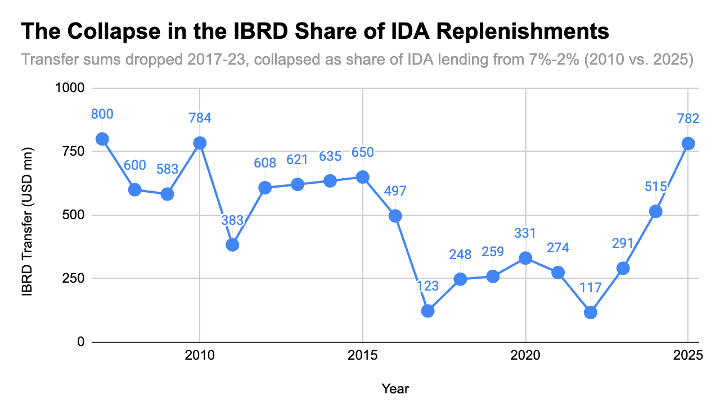
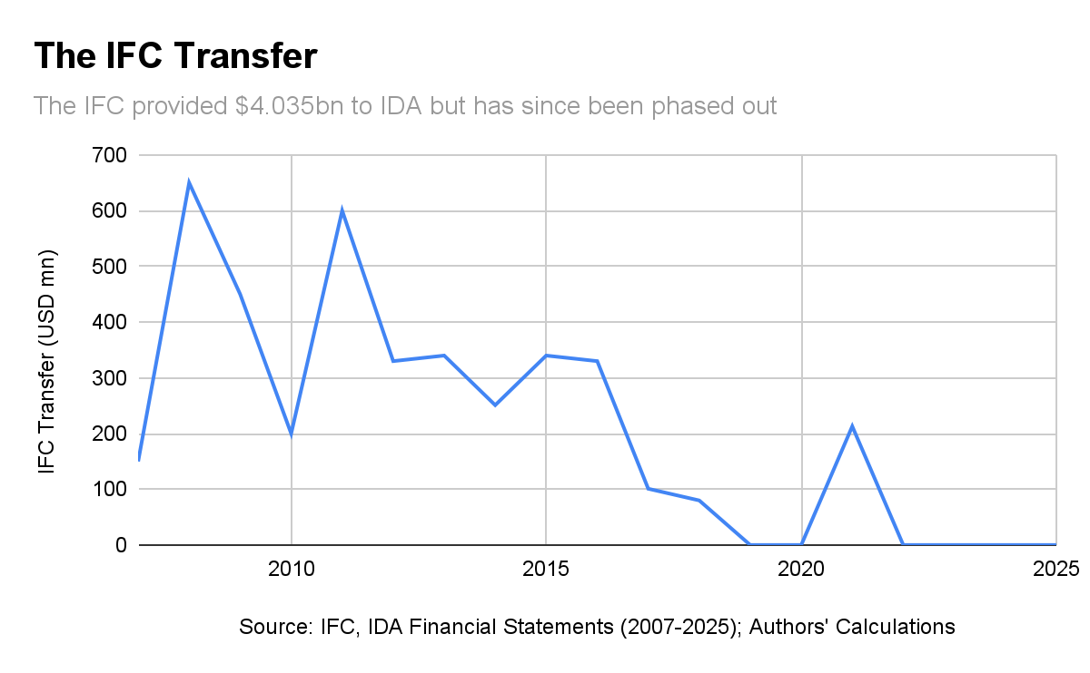
2. The Emergence of the “IDA Cliff”: The Collapse of IBRD and IFC Internal Transfers
The internal resources that can blend down IDA’s funding cost to enable lending have collapsed
  IBRD transfer fell from $650m to $123m as the market borrowing program was launched
  IFC transfer phased out before being discontinued in 2018, when market borrowing program was launched
Notes:
This is a very unattractive chart
IFC transfers hit $650 in 2008 and $600 in 2011. They were steady in the ~$300m range from 2012 to 2016 before being yanked down to $101m in 2017 and $80m in 2018, discontinued altogether, brought back as a one-off in 2021, and discontinued again.
It’s worth noting that in 2008 and 2011, combined IBRD/IFC transfers to IDA were roughly $1bn. That would have been more than any shareholder contribution during those years.

Slide 14
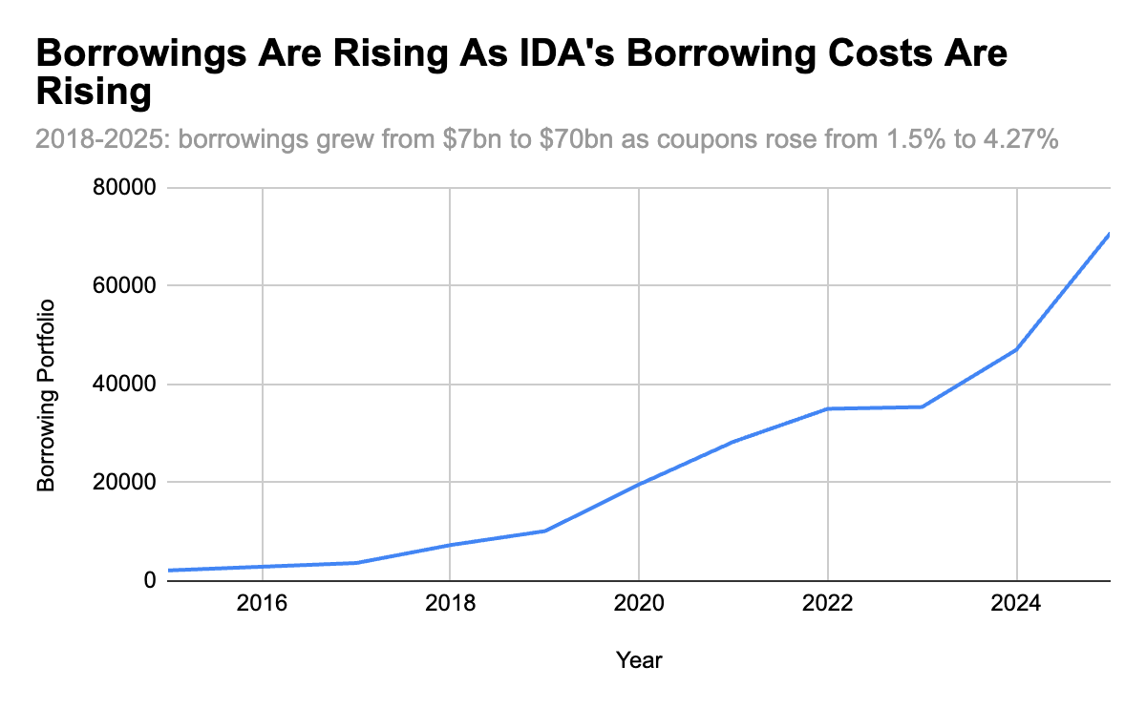
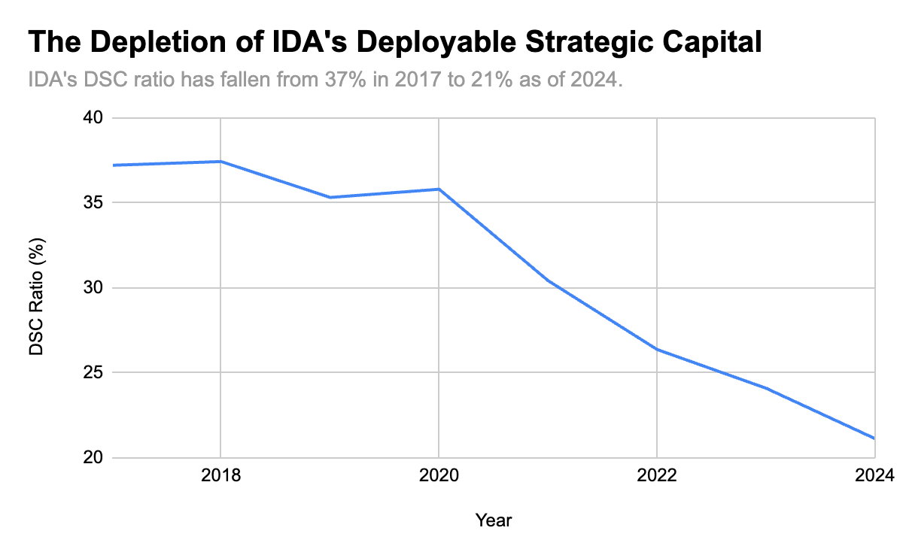
2. The Emergence of the “IDA Cliff”: Rising Borrowings, Rising Borrowing Costs, and the Depletion of IDA’s DSC
IDA’s ability to continue growing its financing to meet global concessional financing needs under severe strain
World Bank officials speak of a 40% decline in IDA’s financing volumes starting in 2030

Slide 15
3. The Role of an SDR-Denominated Bond: The Mechanics
IDA would issue a series of SDR-Denominated, cash-settled bonds
  By virtue of being SDR denominated, they can only be purchased in the primary market by SDR holders and they would come at the SDR interest rate
      Advantages: tap a large pool of low-cost, long-duration funding
  By virtue of being cash-settled (USD, EUR, etc.), they can be liquidated for USD, EUR, etc. by selling them into the liquid secondary market for IDA bonds
      Advantages: satisfy key SDR holders reserve management requirements

Slide 16
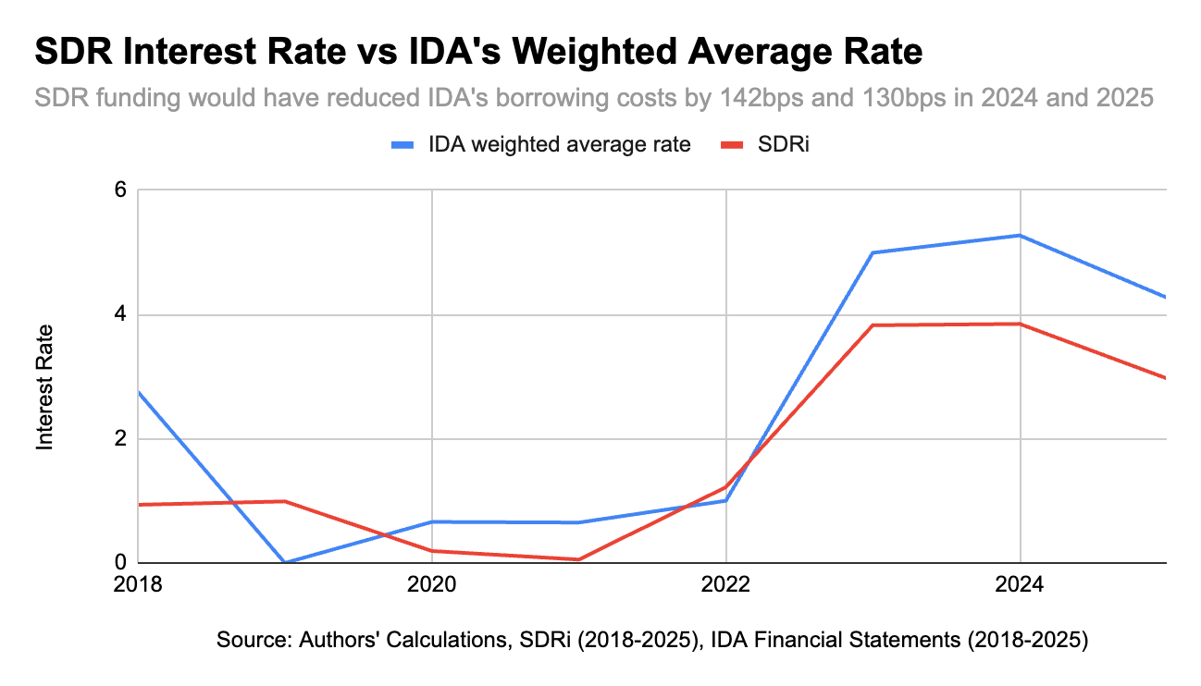
3. The Role of an SDR-Denominated Bond:
IDA’s interest-rate mismatch
An SDR-bond can help close IDA’s asset-liability interest rate mismatch
The SDRi has always offered a nominal improvement over IDA’s funding costs
  This has grown to 130-140bps in FY24-25
  Refinancing IDA’s outstanding borrowings would generate $1bn in savings
An SDR bond raises at the risk-free rate for SDRs
  This provides spread of 0, relative to IDA’s current spreads of ~70bps on longer-dated bonds

Slide 17
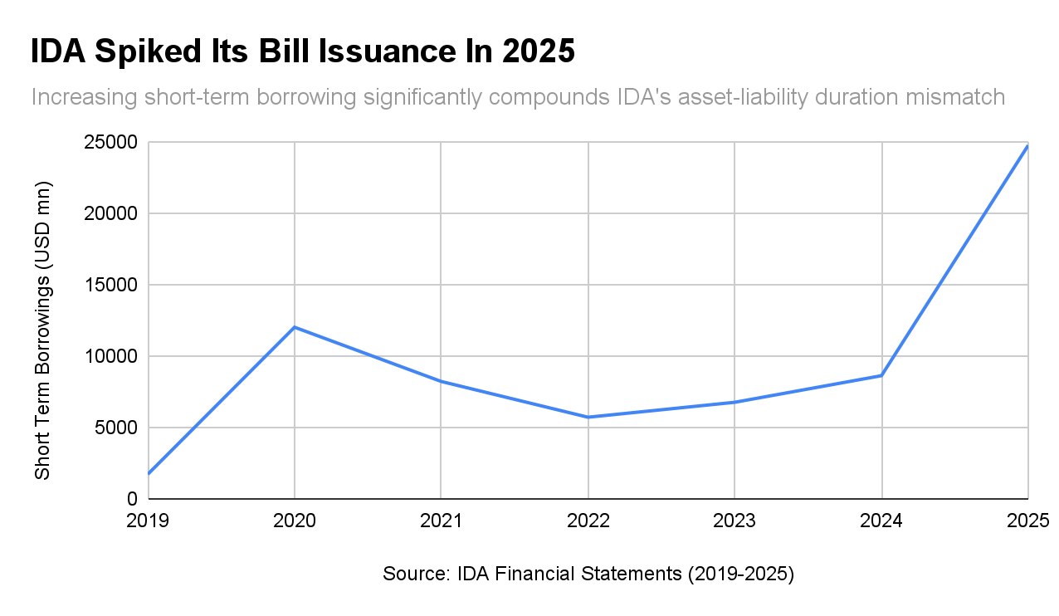
3. The Role of an SDR-Denominated Bond:
IDA’s duration mismatch
An SDR-bond can help close IDA’s asset-liability duration mismatch
IDA borrows at market tenors but lends for up to 50 years
  This creates a natural duration mismatch, which requires IDA to retain more capital than it otherwise would
  This duration mismatch has been exacerbated by IDA surging short-term funding
As an IMF member’s SDR allocation is booked as a perpetual liability, members are incentivized to hold very long-term SDR assets against them
  This enables much longer term SDR funding than what markets can affordably provide

Slide 18
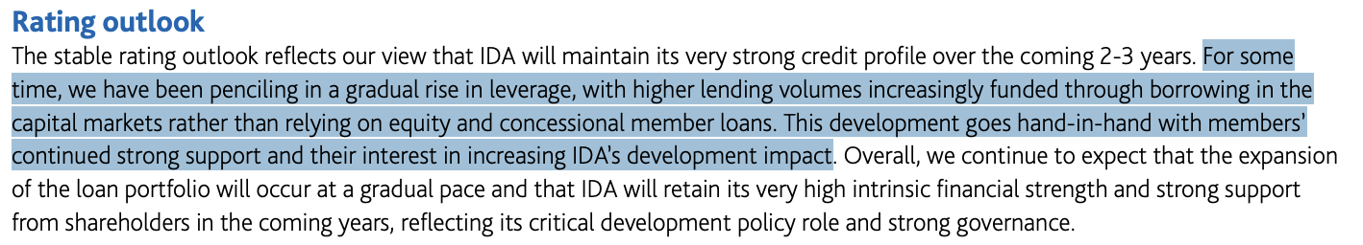
3. The Role of an SDR-Denominated Bond:
Providing scale
An SDR bond can enable IDA to expand its market borrowing program to expand its financing
IDA is technically under-leveraged, and it is the only MDB that credit rating agencies have been actively encouraging to increase its leverage in order to increase its lending volumes
While IDA can theoretically increase its leverage, as noted it cannot do so without a faster depletion of its capital
There appears to be no other available funding source to enable this scaling up besides the large pool of SDRs ($629bn in the G-20)

Slide 19
3. The Role of an SDR-Denominated Bond:
Satisfying SDR holders reserve management rules
There is a mistaken notion that the IMF’s ruling on the reserve asset eligibility of SDR hybrid capital mattered. It did not — because countries’ reserve management rules are set by legislatures, not by the IMF.
  The $208bn in SDRs under the jurisdiction of the eurosystem can not be rechanneled as hybrid capital
    Violates the TFEU prohibition on monetary financing to provide equity financing to an MDB
    Reserve accounts of eurosystem NCBs not authorized to hold assets with equity content
  The $173bn in SDRs held in the US’ Exchange Stabilization Fund cannot be rechanneled as hybrid capital without securing Congressional authorization
    The ESF does not have standing authorization to hold equities (it can only deal freely in “gold, foreign exchange, and other instruments of credit” that are standard reserve assets)
    It would constitute equity financing for the issuing MDB, which requires authorization under the Bretton Woods Agreement Act
  The $41bn in SDRs held in the UK’s Exchange Equalisation Account cannot be rechanneled as as hybrid capital because the EEA is only authorized to hold highly liquid senior debt securities and gold

Slide 20
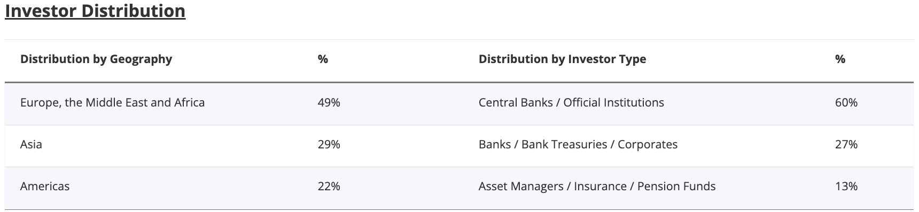
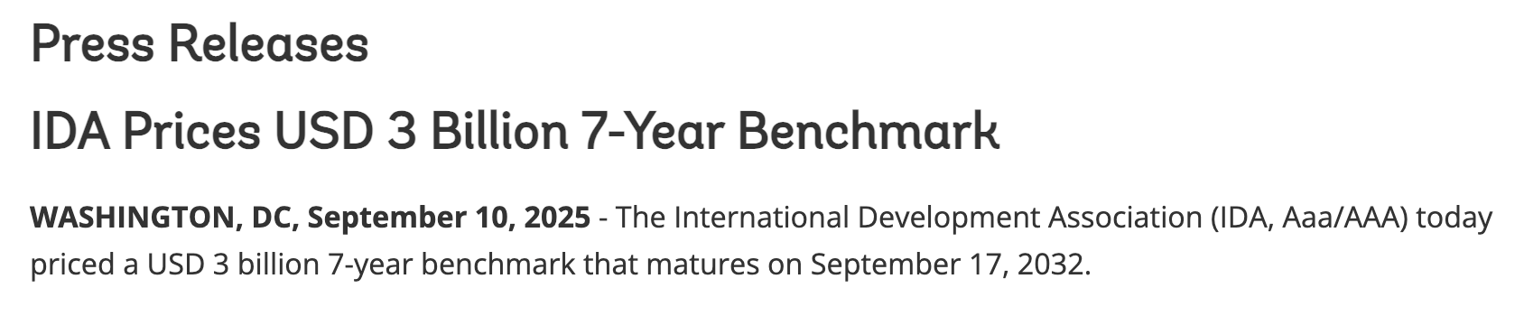
3. The Role of an SDR-Denominated Bond:
Satisfying SDR holders reserve management rules
By contrast: an SDR-denominated, cash-settled bond would function as a standard reserve asset and can be purchased as a conventional reserve management operation by key stakeholders
  Rather than requiring an encashment regiment (RST/PRGT) or liquidity support agreement (AfDB/IDB hybrids), the reserve asset status of an SDR bond would be intrinsic
  Being cash-settled, it can be liquidated at any time in the secondary market for IDA bonds
World Bank bonds are standard reserve assets for NCBs and the EEA — ECB/BoE does not police denomination

Slide 21
Conclusions
When IMF members ratified the SDR amendment to the Articles of Agreement, they voted to “make the special drawing right the principal reserve asset in the international monetary system.”
Among the reasons why that never occurred was being the SDR was never turned into a conventional reserve asset — a senior bond issued by a highly rated entity
The SDR bond supports the evolution of the SDR system, while enabling a much-needed evolution for the MDB system
MDBs — IDA and ADF, but also core lending arms — need to be insulated from asset-liability mismatch pressures in order to scale up low-cost, long-term lending
There is no other funding pool that can achieve this for MDBs beyond the world’s idle SDRs

