Slide 1
The Costs of Conditionality
IPCEIs and the Constrained Politics of EU Industrial Policy
Luuk Schmitz – Max Planck Institute for the Study of Societies
Timo Seidl – University of Vienna
Tobias Wuttke – Bard College Berlin
01 November 2024 – New Thinking in Industrial Policy, Columbia University
t.wuttke@berlin.bard.edu · www.tobiaswuttke.com

Slide 2
Overview
Paper available as preprint: https://osf.io/preprints/osf/f63gd
IPCEIs as one core instrument of EU industrial policy (in addition to EIB, Chips Act, TCTF...)
Case study of the use of conditionality in industrial policy
Methodology:
  18 interviews with policy officials (EU Commission & member states) and representatives of firms who were involved in the IPCEI process, conducted in 2023 and early 2024
  Analysis of official documents (Strategic Forum on IPCEIs; Joint-European Forum on IPCEIs; published states aid decisions)
  Descriptive statistics based on the data from the official documents
Notes:
Chips Act and TCTF as equivalents of Chips Act and IRA in the US

Slide 3
Industrial Policy & Conditionality
Conditionality as the tool to make industrial policy conform with public goals (Bulfone et al. 2023, Bulfone et al. 2024, Mazzucato and Rodrik 2023, Rodrik 2004)
  ‘reciprocity—linking carrots to sticks’ (Meckling and Strecker, 2023)
South Korea’s use of reciprocal control mechanisms (Amsden 2001), policy support in exchange for export success [sidenote: their importance for SK’s development success is debatable]
The challenges/costs of implementing conditionality, which requires:
  breaking down abstract goals into measurable and/or legally viable indicators
  demonstrating and assessing compliance, often by making informed assumptions about counterfactual scenarios, and
  reconciling the rigidities required by a credible instrument with the equally necessary flexibilities demanded by an uncertain and fast-changing world (Molica, 2024).
Industrial policy & conditionality are not implemented in a political vacuum: political economy factors determine whether, which and how conditionalities are implemented and enforced (Bulfone et al. 2024; Juhász and Lane 2024).

Slide 4
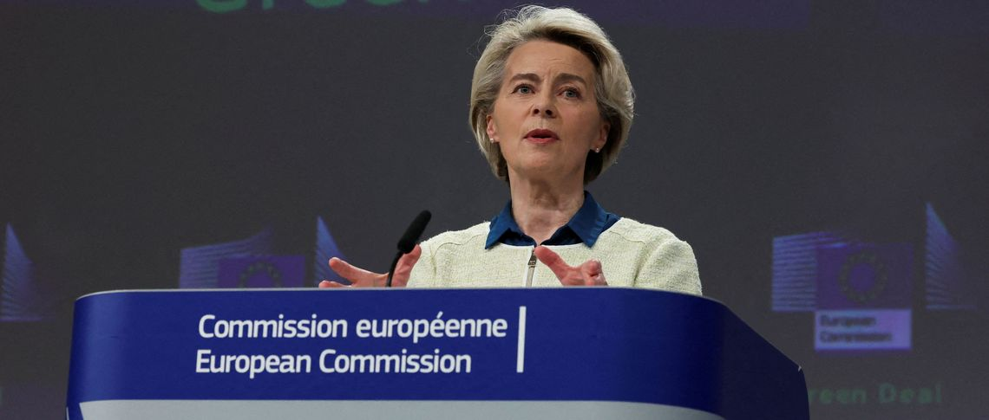
EU Industrial Policy/State Aid
Member state money, EU state aid governance (true for IPCEI, Chips Act, TCTF)
Governing agency for state aid: DG Competition (EU Commission)
State aid rules are enshrined in the Treaty of 1957 (forbidden in principle, but exceptions)
The rules are open to interpretation by DG Competition (guidelines; enforcement), and have been interpreted differently over time
  Pre-1980s: very lenient;
  late 1980s until mid-2010s: very strict;
  since mid-2010s: a bit more lenient again
Generally, the main principles for state aid governance are primarily efficiency-oriented (based on a restrictive understanding of market failure & government intervention)
  Recent exposition: Piechucka et al. (2023) “Industrial Policies, Competition, and Efficiency: The Need for State Aid Control”
Principles for good state aid (assessment criteria): necessity; appropriateness; incentive effect; proportionality; positive effects outweigh negative effects of distortion of competition
But DG Competition does not operate in isolation. Influenced by external pressure (other DGs; member states): New industrial policy instruments (IPCEI, Chips Act, TCTF) are results of that bargaining.
Notes:
Cristina Caffarra and Nathan Lane on VoxEU in April 2024: The paper mentions “efficiency” over 100 times, “efficiency-enhancing” over 30 times, and “market failure” 80 times.
The ideological constraint in Europe:
In a recent academic paper, three DG COMP officials explicitly argue that one should be able and try to reformulate each industrial policy intervention ‘in terms of the market failures they address. Even when industrial
policies are presented as aiming at political objectives, like open strategic autonomy or leading the digital transition, they can be re-formulated in terms of market failures, helping us identify the actual need for support
and determine the best design for such support’ (Piechucka et al., 2023, 506).

Slide 5
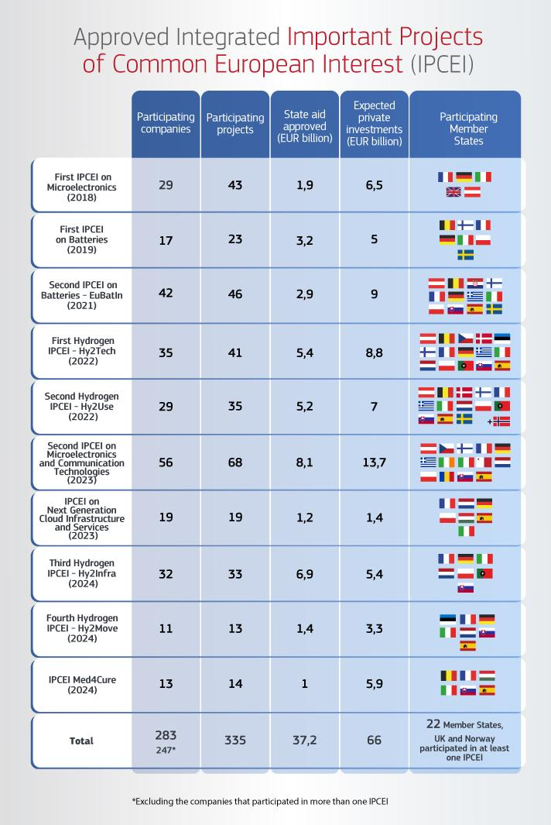
Important Projects of Common European Interest
€37bn in state aid, €66bn in expected private investment, 283 firms in 22 member states
IPCEIs are a state aid exception found in 107(3)(b) in TFEU (dormant since 1957; activated in 2014)
“The following may be considered to be compatible with the internal market: (b): aid to promote the execution of an important project of common European interest or to remedy a serious disturbance in the economy of a Member State.”
Aid up to 100% of the funding gap for first industrial deployment (not mass production) of global-frontier innovation
Allows more state aid than before (not just plain R&D)
Format of state aid decided by member state (usually grants)
Approval criteria:
  The five general principles for good state aid
  IPCEI-specific criteria

Slide 6
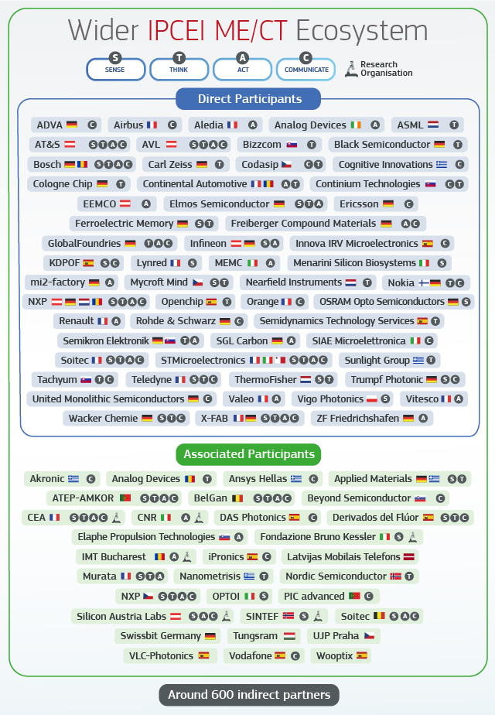
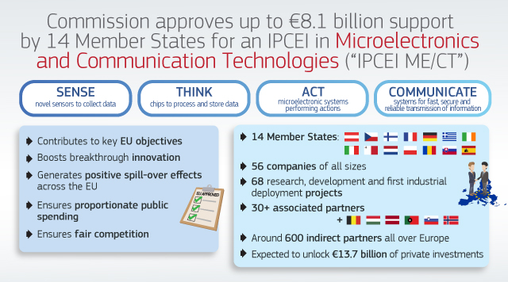
Exemplary IPCEI

Slide 7
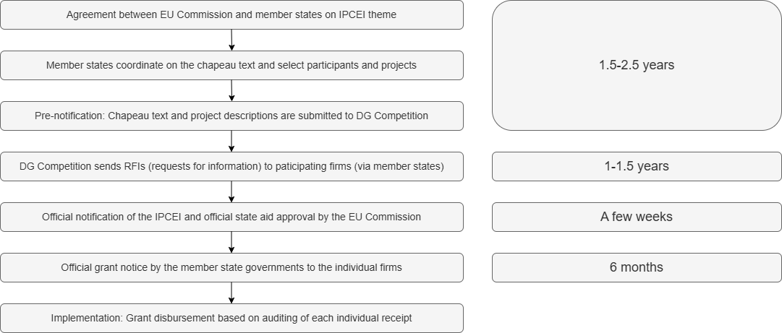
Process of IPCEI design & approval
Authors’ elaboration based on interview data, specifically on the two microelectronics IPCEIs, and official member state documents
Notes:
A lot of the complexity / process length is simply a reflection of the fact that there is no EU industrial policy in the sense of the word (two layers: member state money, EU Commission governance)
And the overall IPCEI is only as fast as its weakest project

Slide 8
General state aid criteria/conditionalities
Necessity of aid and incentive effect Companies need to provide counterfactual scenario (i.e. case of no aid) with evidence
Appropriateness of aid DG Competition assesses if IPCEI is the most suitable instrument; participants (member states and firms) argue their case
Proportionality of aid Companies submit detailed funding gap analyses (expected positive and negative cash flows over the lifetime of a project) Claw-back mechanism (if a project is more profitable than forecasted in the funding gap analysis)
Positive effects outweigh negative effects of distortion of competition DG Competition conducts ‘balancing test’
IPCEI-specific criteria/conditionalities
Addresses important market or systemic failure Member states negotiate with EU Commission
Concrete, clear and identifiable contribution to the Union’s objectives and strategies Chapeau text written by participating firms
Involves at least four member states
Generates positive spillover effects across the EU Firms suggest and negotiate with DG Competition
Needs to be of ‘major innovative nature’ in the light of the global state of the art in the sector EU Commission assesses project description
Only eligible costs [First industrial deployment (subsequent to the pilot line), incl. testing & brining batch production to scale, but not mass production] Member states assess receipts before disbursing money
Notes:
Examples of positive spillover effects: organizing summer schools for students; opening a semiconductor foundry for start-up customers (companies pay; costs not eligible)
The innovation at the global frontier criterion: If TSMC gets IPCEI funding, it needs to do something more innovative than what it is doing in Taiwan (was a problem with Tesla)
Eligible costs for the funding gap: feasibility studies, instruments and equipment, building, infrastructure and land, materials and supplies, or personnel and administrative costs
Each participating company needs to contribute to chapeau text, submit a project description and a funding gap analysis (Excel template)

Slide 9
The costs of conditionality
Perverse outcomes
  The time it takes from emergence to approval and disbursement of funds is much too long in the fast-moving technologies that IPCEIs address
  Mass production cannot be supported
  The innovativeness-at-the-global-frontier requirement repels the companies that IPCEIs aim to attract (Tesla; TSMC)
Adverse selection
  The complex application and review processes for IPCEIs create a significant administrative burden
    We document cases where companies dropped out because of this burden and/or because of the lengthy duration of the process (even though they were otherwise suitable to be part of an IPCEI)
  The administrative burden disproportionately affects smaller companies and member states with less experience navigating EU funding mechanisms
    Overrepresentation of larger companies or those from member states with more administrative capacity and experience
    Larger member states can afford to outsource to consultancies (e.g. Germany) [implications for state capacity?]
Workarounds
  Companies opt for subsidy instruments with less stringent requirements (no requirement for cross-country collaboration and spillover effects) and where their investment is assessed individually (EU Chips Act; TCTF)
  Some companies have invested elsewhere where conditionalities are less strict (e.g. US IRA or a semiconductor firm investing in Singapore instead)
Notes:
Perverse outcomes occur when conditionalities lead to (unintended) consequences that run counter to the original goal of the instrument.
Adverse selection occurs when only actors—be it governments or companies—with high administrative capacities can fulfill the IPCEI conditionalities even though these capacities are unrelated
to the substantive goals behind the conditionalities.

Slide 10
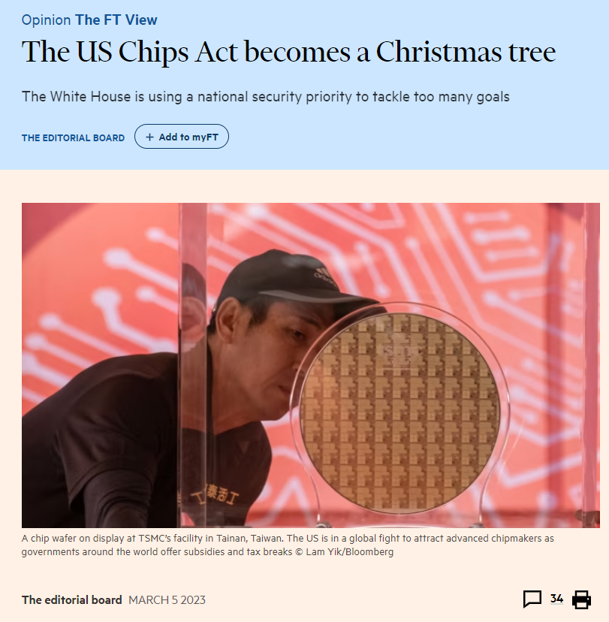
Conclusion
We don’t question the if of conditionalities, but the what/how. Since conditionalities also have costs, one needs to be smart about which conditionalities to attach.
Conditionalities are not created in a political vacuum but are shaped by the political, institutional, and ideational constraints in which they are introduced and enforced.
  In the case of IPCEI and in EU industrial policy more broadly, conditionalities are designed excessively in line with the efficiency-oriented principles of its state aid regime.
Conditionalities that IPCEIs do not attach: limits on stock buybacks; requirements to use renewable energy; employment commitments; local content requirements.
Notes:
There are also benefits to the IPCEI review process: DG COMP prides itself on having saved €9bn in EU taxpayer money in the context of the first seven IPCEIs because of its thorough reviews of the state aid
applications
The perfect can be the enemy of the good and overly strict conditionalities may prevent too many false negatives (investments not made or made elsewhere) at the expense
of minimizing false positives (allocating subsidies to investments that would be made anyway).

Slide 11
References
Amsden, Alice H. 2001. The Rise of "the Rest": Challenges to the West from Late-Industrializing Economies. Oxford ; New York: Oxford University Press.
Bulfone, Fabio, Timur Ergen, and Manolis Kalaitzake. 2023. “No strings attached: Corporate welfare, state intervention, and the issue of conditionality.” Competition & Change, 27, 253–276.
Bulfone, Fabio, Timur Ergen, and Erez Maggor. 2024. “The political economy of conditionality and the new industrial policy.” MPIfG Discussion Paper.
Juhász, Réka, and Nathan Lane. 2024. “The Political Economy of Industrial Policy.” w32507. Cambridge, MA: National Bureau of Economic Research.
Mazzucato, Mariana, and Dani Rodrik. 2023. “Industrial Policy with Conditionalities: A Taxonomy and Sample Cases.” UCL Institute for Innovation and Public Purpose, Working Paper Series (IIPP WP 2023-07).
Meckling, Jonas and Jesse Strecker (2023), “Green bargains: Leveraging public investment to advance climate regulation.” Climate Policy, 23, 418–429.
Molica, Francesco. 2024. Regional innovation policies and directionality: exploring the role of conditionality*. European Planning Studies, 32(8), 1653–1670.
Piechucka, Joanna, Lluís Saurí-Romero, and Ben Smulders. 2023. “Industrial Policies, Competition, and Efficiency: The Need for State Aid Control.” Journal of Competition Law & Economics 19 (4): 503–26.
Rodrik, Dani. 2004. “Industrial Policy for the Twenty-First Century.”
The paper is available as a preprint:
https://osf.io/preprints/osf/f63gd
Tobias Wuttke
Postdoctoral Researcher
Bard College Berlin
t.wuttke@berlin.bard.edu
www.tobiaswuttke.com

