Slide 1
Remaking Industrial Policy: Avoiding Pitfalls, Meeting New Challenges
Dani Rodrik
November 2024

Slide 2
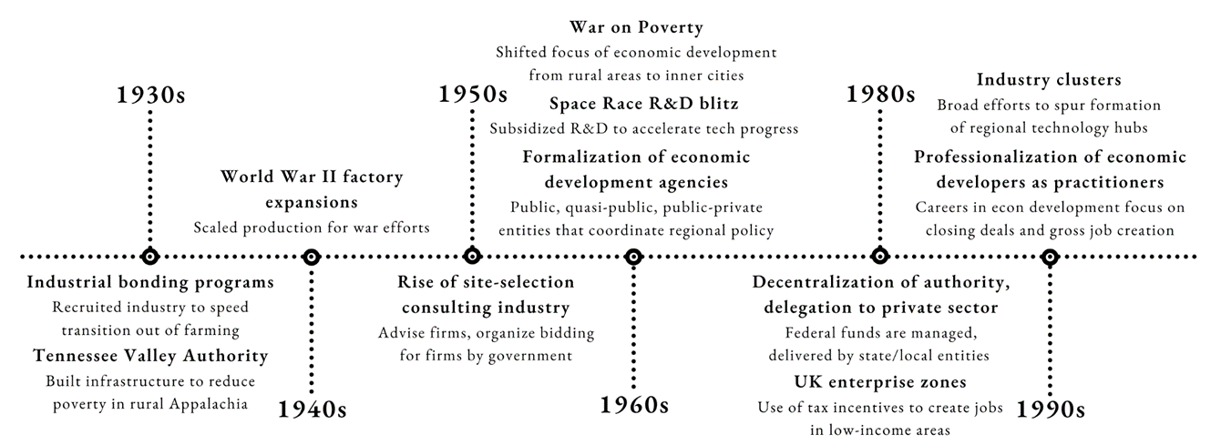
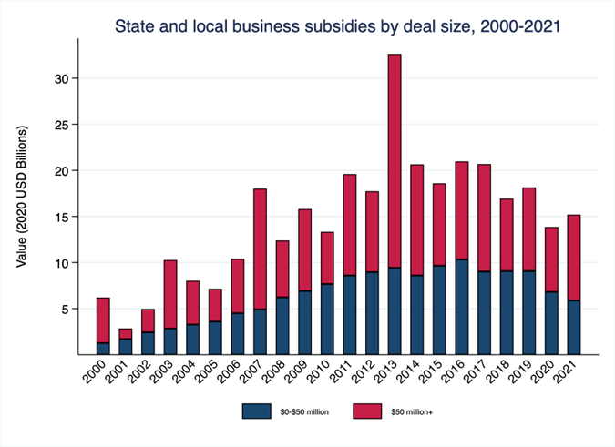
Industrial policy has a long history, and never went away
In the US, “industrial” policy goes back to Alexander Hamilton (1791) and land-grant colleges (1862)
Reagan, Thatcher, Pinochet all practiced IP, despite their free-markets rhetoric
Today, it is carried out self-consciously, in pursuit of multiple objectives
Source: Hanson et al. (2024)

Slide 3
What is industrial policy?
Definition: government policies that explicitly target the transformation of the structure/productivity of economic activity in pursuit of some public goal
  “we promote X but (implicitly) not Y”
What’s not industrial policy?
  “Horizontal” policies that do not have much effect on structure of economic activity
    fiscal and monetary policies, social policy
  Or policies that do not explicitly target structural change (even when they have that effect)
    e.g., funding of engineering education, tax credits for R&D in general, social transfers to poor families that may be concentrated in lagging regions

Slide 4
Economists’ caricature of industrial policy…
Objective: internalizing learning, innovation spillovers
Remedy: Pigovian subsidies
Focus on manufacturing, hi-tech sectors
Risks
  Lack of information (“governments cannot pick winners”)
  Political capture (Solyndra)
Pre-requisites
  Good information
  Arms’-length relationship with firms
  Strict conditionality/discipline (East Asian exception: “hard” states)
Evidence
  Rarely works
…is out of date

Slide 5
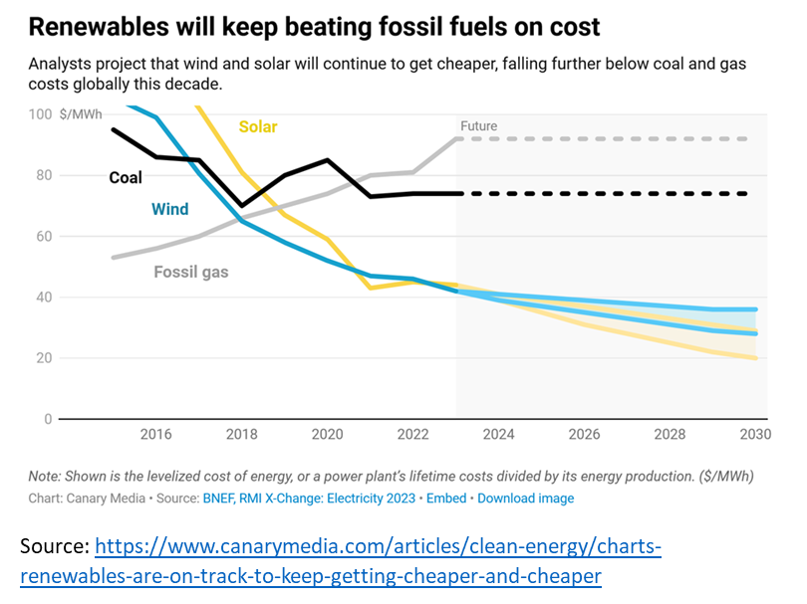
Example: The renewables success story
Industrial policy + learning curve:
heavy subsidies =>
capacity increase =>
learning by doing =>
cost reduction =>
price reduction =>
market expansion =>
capacity expansion =>
  …

Slide 6
China’s green industrial policies
More than subsidies
  variety of instruments: directed credit, public investment in R&D and infrastructure, government procurement, demonstration programs, public VC, regulatory changes, industry consolidation
  explicit, self-conscious experimentation
  mutually supportive (and occasionally competing) roles of national, provincial, and municipal government
  collaborative approach (both with local governments and businesses)
  revision and flexibility in implementation (as in redesign/removal of incentives or consolidation efforts)
Formal evidence: cities that provided production subsidies experienced increases in innovation and production in solar panels (synthetic diff-in-diff, Banares-Sanchez et al., 2024)
Political economy
  Driven by a mix of motives: recognition that fossil-fuel driven model unsustainable; commercial/competitive advantage
  Second-best motives: Fighting climate change by creating winners (carrots) rather than losers (sticks)

Slide 7
Political advantages of green subsidies
Carrots instead of sticks
  creates winners
Create national advantages
  competitive, geopolitical
  overcomes free riding incentives
Enlarge coalition in favor of green transition
Reduce costs of phasing out fossil fuels
=> Green subsidies as path to carbon pricing

Slide 8
The broader case for industrial policy, beyond spillovers
Technological (and other) externalities
  E.g., dynamic learning externalities, spillovers
Coordination failures
  E.g., upstream-downstream linkages with IRS, agglomeration, clusters
Missing public inputs
  E.g., particular infrastructure, specialized workforce skills, sector-specific legal/admin frameworks
Second-best factors
  E.g, under-pricing of carbon emissions
  ==> optimal policy depends on specific rationale + political/admin. considerations

Slide 9
Industrial policies don’t always work: what does Solyndra’s failure show us?
A case of (very public) failure, after having been touted by Obama administration as flagship of green industry promotion
Inevitability of supporting some ventures that will fail
  cf. venture capital
Question is: how does overall portfolio perform?
  Tesla also received a similar loan from govt
Impossibility of picking winners
But letting losers go is feasible
Solyndra was a failure only to the extent that (a) it could have been avoided with what was known ex ante; and/or (b) was allowed to persist for too long
  public debate makes too little distinctions of this kind

Slide 10
Negative reputation among economists is due to practical arguments
Inadequate information: governments lack knowledge about where market imperfections are
  “governments cannot pick winners”
Bad politics: governments are prone to political capture by powerful insiders
Thus, debate on IP revolves not around its theoretical merits, but around sharply conflicting views regarding the relative importance and pervasiveness of these obstacles
  “look at how difficult it all is…”
  “but look at countries in East Asia who have done it …”

Slide 11
The debate on industrial policy
The unproductive debate: “whether”
  regardless of the arguments in favor and what economists/technocrats say, governments will practice it anyhow
The productive debate: “how”
  in all other areas of government policy (such as education or macro stabilization), it is recognized that the market-failure arguments for intervention can be exploited by powerful insiders and overwhelmed by informational asymmetries
  but debates revolve around how to improve policy, not on whether governments should intervene
What do history and current challenges imply about the “how”?

Slide 12
Example: Place-based policies
UK: Criscuolo et al. (2019), “Some Causal Effects of an Industrial Policy” (AER 2019)
  causal effects on employment (and other outcomes) of regional investment subsidies in UK
  identification through changes in eligibility criteria for regions, set by EU
  Positive employment effects, especially for SMEs
Italy: Cingano et al. (2022); Incoronato & Lattanzio (2023)
  regional subsidies had a positive effect on job creation, increasing employment by 17% over a 6-year period.
  Subsidies aimed at jump-starting development in the South succeeded in creating increased agglomeration of workers and firms locally in the long run, increasing further after the policy was terminated.
Local economic development coalitions in U.S.
  E.g., “The Right Place” in Western Michigan
  What works: customized public inputs (training, technology, marketing, greenfields, coordination)

Slide 13
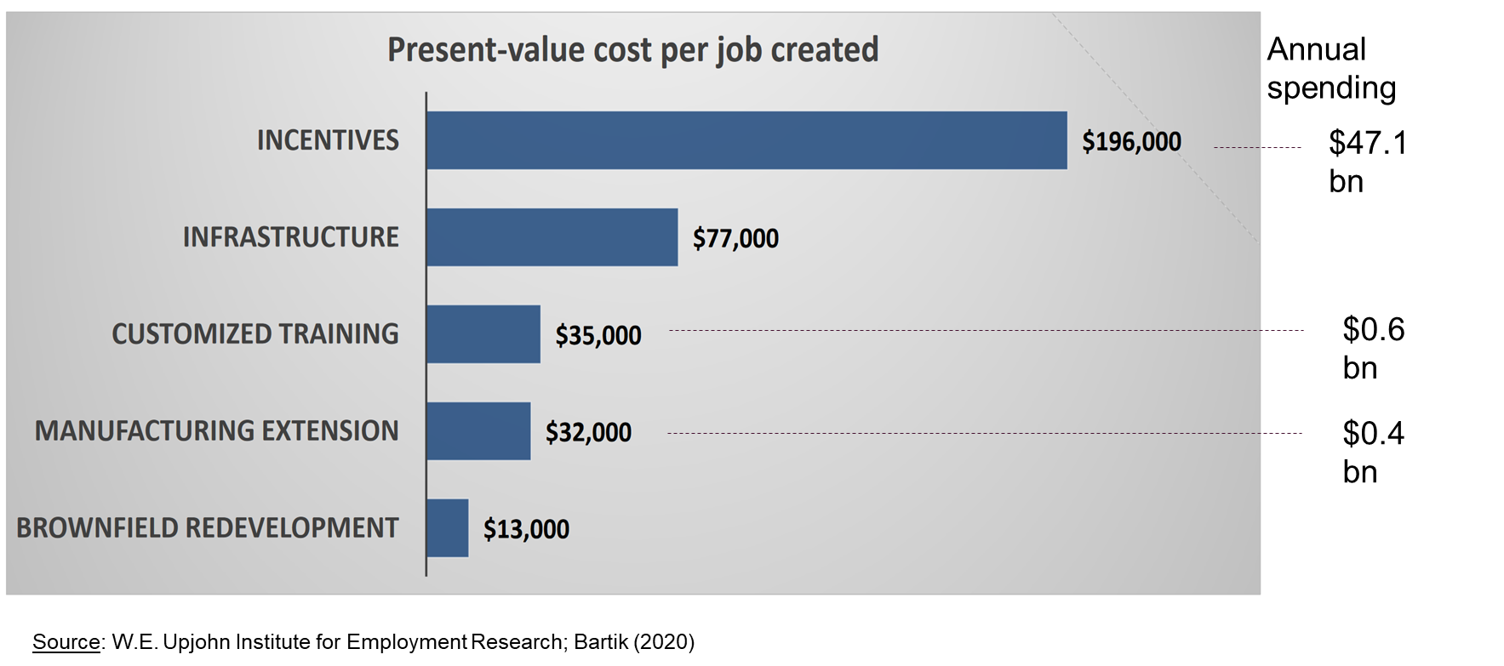
What works better: customized public inputs instead of subsidies
Excessive focus on subsidies
  customized business services/inputs work better
  coordination, workforce & management training, business services, technology, greenfields, regulatory assistance – financing too, when needed
Subsidies are typically cost-ineffective

Slide 14
A new challenge for industrial policy: good jobs
Disappearance of good jobs (through trade, automation, and austerity shocks) has been linked to a variety of social and political ills
  rising rates of crime, addiction, broken families, suicide
  support for right-wing nativist political movements
  increase in authoritarian values

Slide 15
Industrial/innovation/place-based policies as complement to workforce training
Working on demand side of labor markets
  to ensure supply of good jobs
  To ensure skill mix of labor demand matches skill composition of local labor supply
Focusing on productivity
  high wages supportable only through higher productivity
  which depends also on quality of firms (SMEs)
Firm-level complementarity between good firms and good jobs
  significant share of wage dispersion due to differences in firm characteristics (Criscuolo et al., 2020)
  more productive firms offer superior job ladders (Aghion et al., 2019)

Slide 16
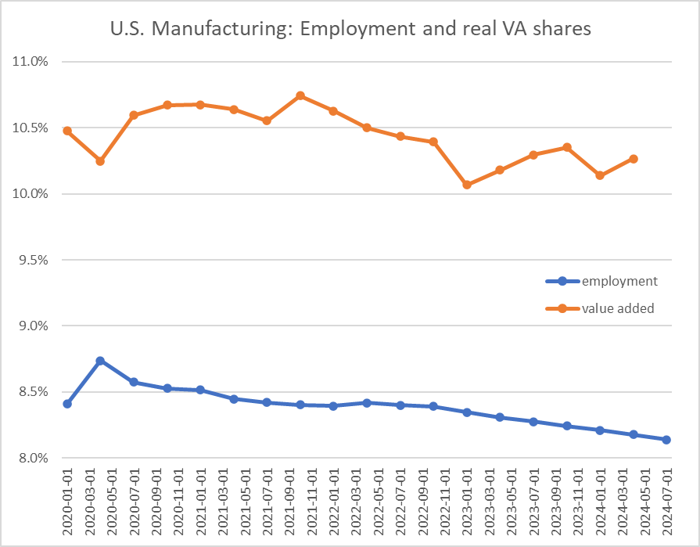
A new focus: from manufacturing to services
Green transition and innovation may still require focus on manufacturing
But jobs are not and will not be in manufacturing
  federal industrial & innovation policy focuses on manufacturing, supply-chains, the green transition, global competitiveness (e.g., CHIPS and IRA Acts)
    good jobs as incidental, or by-product of those other objectives
  TSMC Arizona: $65bn investment, $6bn grants, 6,000 jobs
The future of “industrial” policy for good jobs is in services

Slide 17
The output-employment disconnect in manufacturing

Slide 18
A new focus: labor-friendly technologies
Lack of public investment in/incentives for labor-friendly technologies
Direction of technological innovation is endogenous
  firms often face an envelope of technology choices, with little difference to profit/productivity, but potentially huge implications for workers (Fuchs 2022)
  examples of digital tools and AI systems
    long-term care: real-time info to enable care workers to exercise more autonomy and agency (e.g., vary eating schedules, undertake additional medical tasks, respond to needs of residents)
    retail: info systems that enable specialized sales and customer services, greater autonomy in decision-making
    education: enable provision of specialized services targeted to individuals’ learning needs and objectives
An ARPA-W for workers?

Slide 19
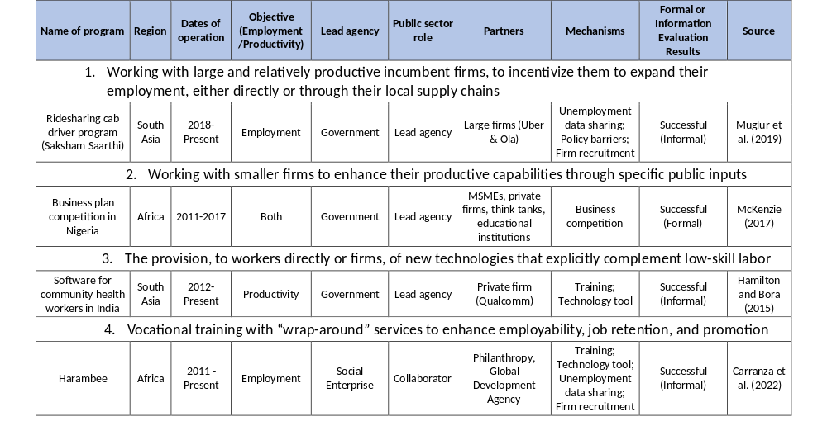
Example: Labor-absorbing services in LDCs
Source: Rodrik and Sandhu (2024)

Slide 20
A new governance model
Traditional approach: top-down, arms’-length, ex ante selection of sectors/firms, hard conditionality (in principle)
  “picking winners”
Proposed approach: iterative, strategic collaboration, where the role of public sector is
  goal-setting
  discovery and provision of missing public inputs
  coordination
  “soft” conditionalities
  monitoring and goal-revision
  fostering local experimentation
Such practices already exist (DARPA/ARPA and successful local economic development coalitions)

Slide 21
Economists’ caricature of industrial policy…
Objective: innovation spillovers + coordination + public inputs + 2nd best
Remedy: Pigovian subsidies + provision of portfolio of services and inputs
Focus on manufacturing, hi-tech sectors + labor-absorbing services & tech
Risks (manageable)
  Lack of information (“governments cannot pick winners”)
  Political capture (Solyndra)
Pre-requisites (capacity is built, not presumed)
  Good information (is dispersed widely among stakeholders)
  Arms’-length relationship with firms (replaced by collaboration and iteration)
  Strict conditionality/discipline (soft; provisional, open-ended and evolving)
Evidence
  Rarely works (context critical but recent causal evidence is much more positive)
…is out of date

