Slide 1
Science, Technology, and Society in the “Modern American Industrial Strategy”
Alondra Nelson
Science, Technology, and Social Values Lab
Institute for Advanced Study
New Thinking in Industrial Policy
Columbia University
November 1, 2024

Slide 2
“Modern American Industrial Strategy”
“a strong animating vision that unifies these laws… It identifies areas where relying on private industry, on its own, will not mobilize the investment necessary to achieve our core economic and national security interests. It then uses public investment to spur private investment and innovation… It encourages that investment to reach all regions and communities. And it invests in workers—the people who will generate all this productivity and innovation”
--Brian Deese, NEC Director, 2022

Slide 3
“Modern American Industrial Strategy”
Advanced Research Projects Agency-Health (ARPA-H) Act
Inflation Reduction Act (IRA)
CHIPS and Science Act
targeted public funding | infrastructure investment | technology

Slide 4
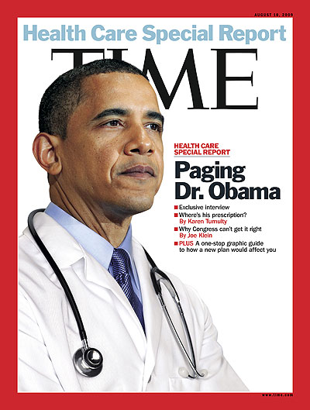
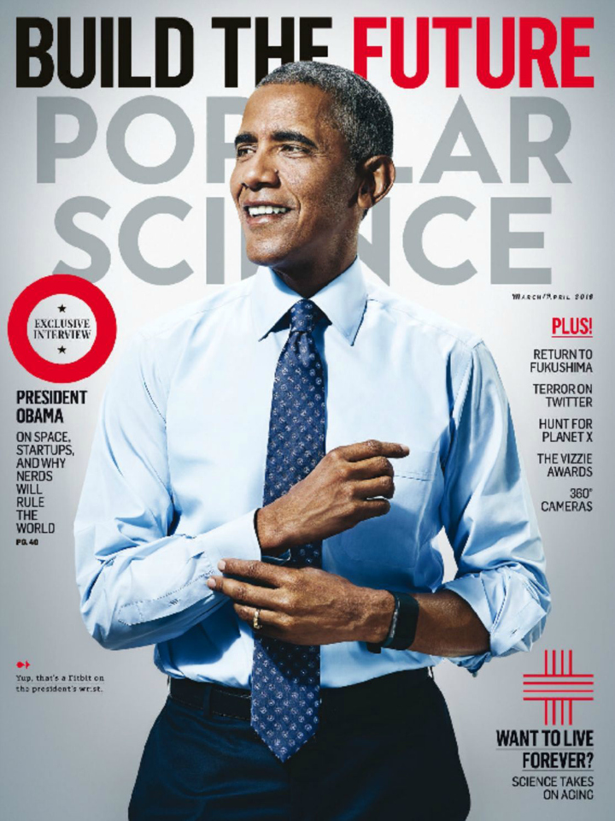

Slide 5
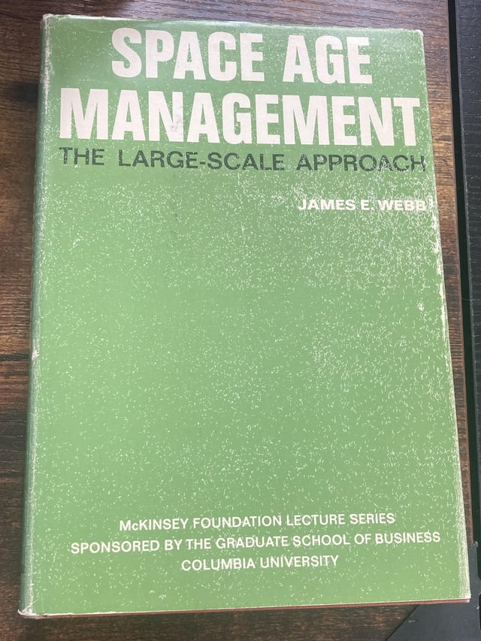
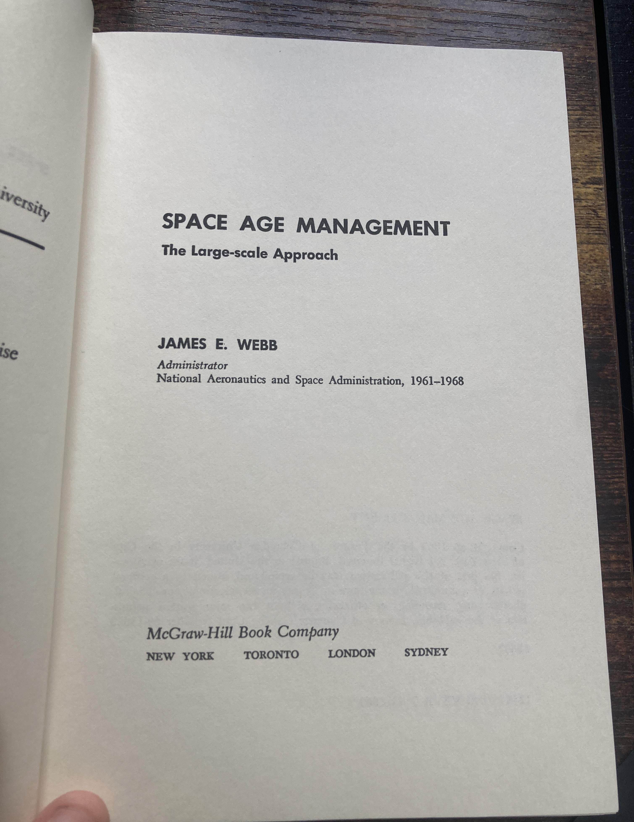

Slide 6
“a fundamental question about large-scale endeavors: Is it necessary to proceed in the blind, as it were, with regard to their possible second- and third-order effects?”
--James E. Webb, 1969: 112

Slide 7
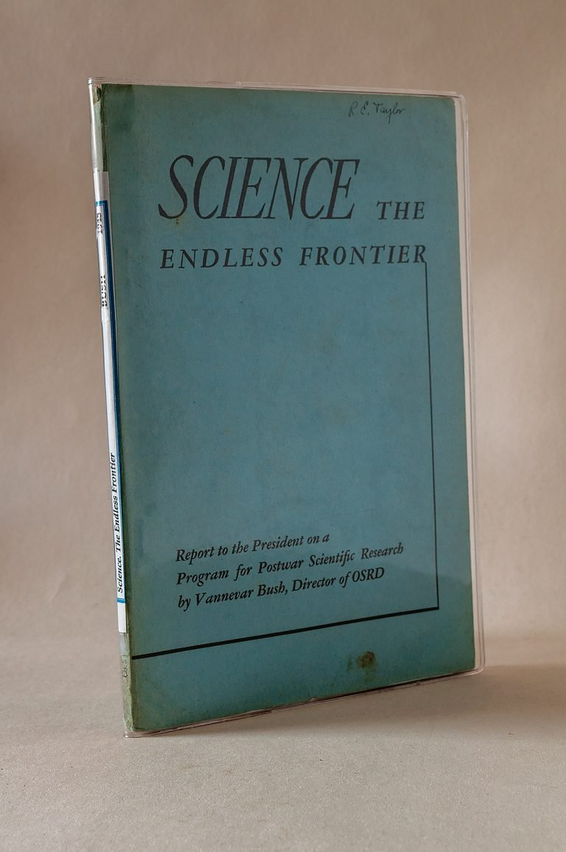
1945

Slide 8
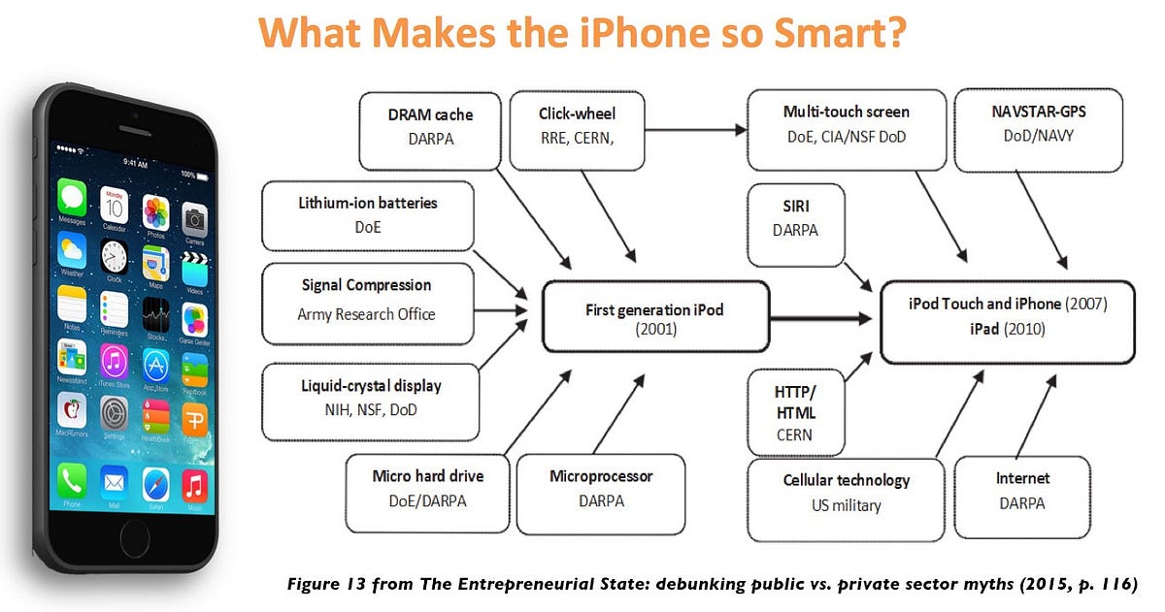

Slide 9
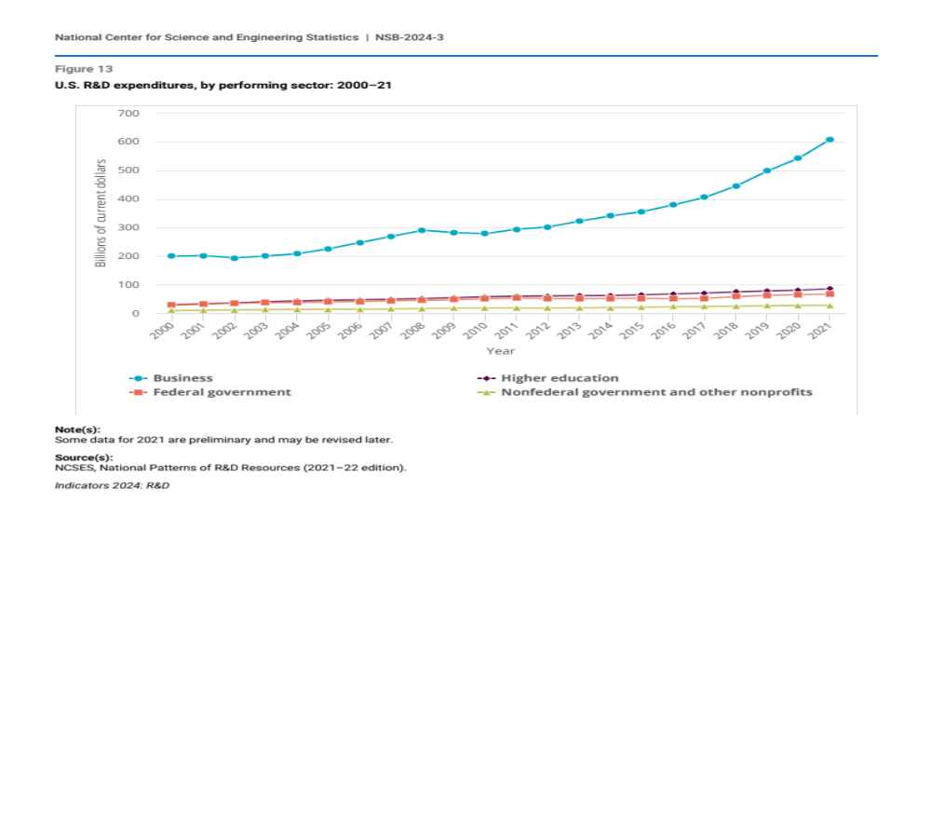

Slide 10



Slide 11
“Modern American Industrial Strategy”
Advanced Research Projects Agency-Health (ARPA-H) Act
Inflation Reduction Act (IRA)
CHIPS and Science Act
targeted public funding | infrastructure investment | technology

Slide 12
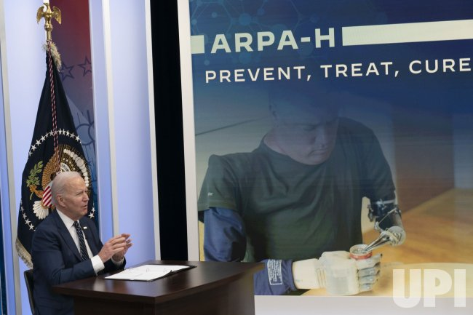

AI for Good
Not Inevitable

Slide 13
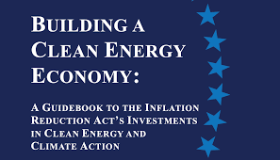

Slide 14
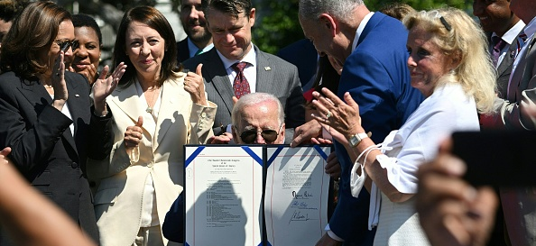
CHIPS and Science Act

Slide 15
CHIPS and Science Act, 2022
$52 billion dollars
Incl $39 billion (mostly incentives) to fund the construction of new and expanded manufacturing facilities
$11 billion to support research into new chip technologies

Slide 16
and Science
Congress has approved, but still has not appropriated, most of the “and Science” part of the CHIPS and Science Act
$13 billion for science, technology, engineering and mathematics (STEM) education and workforce development, including $2 billion to minority-serving institutions
Rural STEM Education Act to break down barriers to education via National Science Foundation grants
$10 billion regional technology and innovation hubs

Slide 17
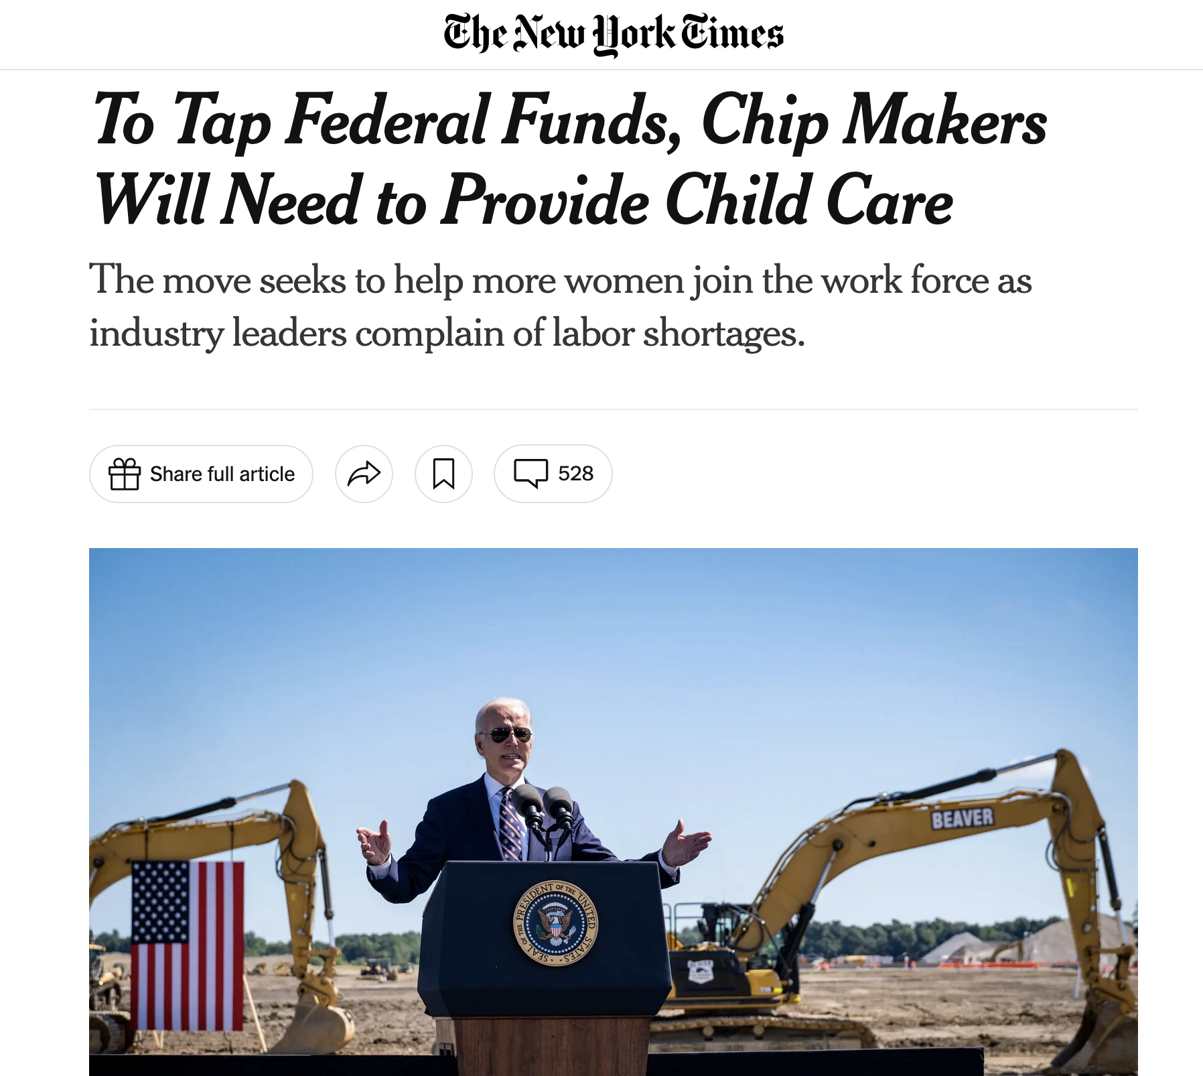

Slide 18

“We will be requiring all applicants who are seeking more than $150 million in direct funding to submit as part of their workforce plan, a plan for how they will provide affordable and accessible accessible childcare for their workers… We right now lack affordable childcare, which is the single most significant factor keeping people especially women out of the labor force. And so we need to see how these companies are going to be meeting their labor force needs.”
-- Sec. Raimondo, 2023

Slide 19
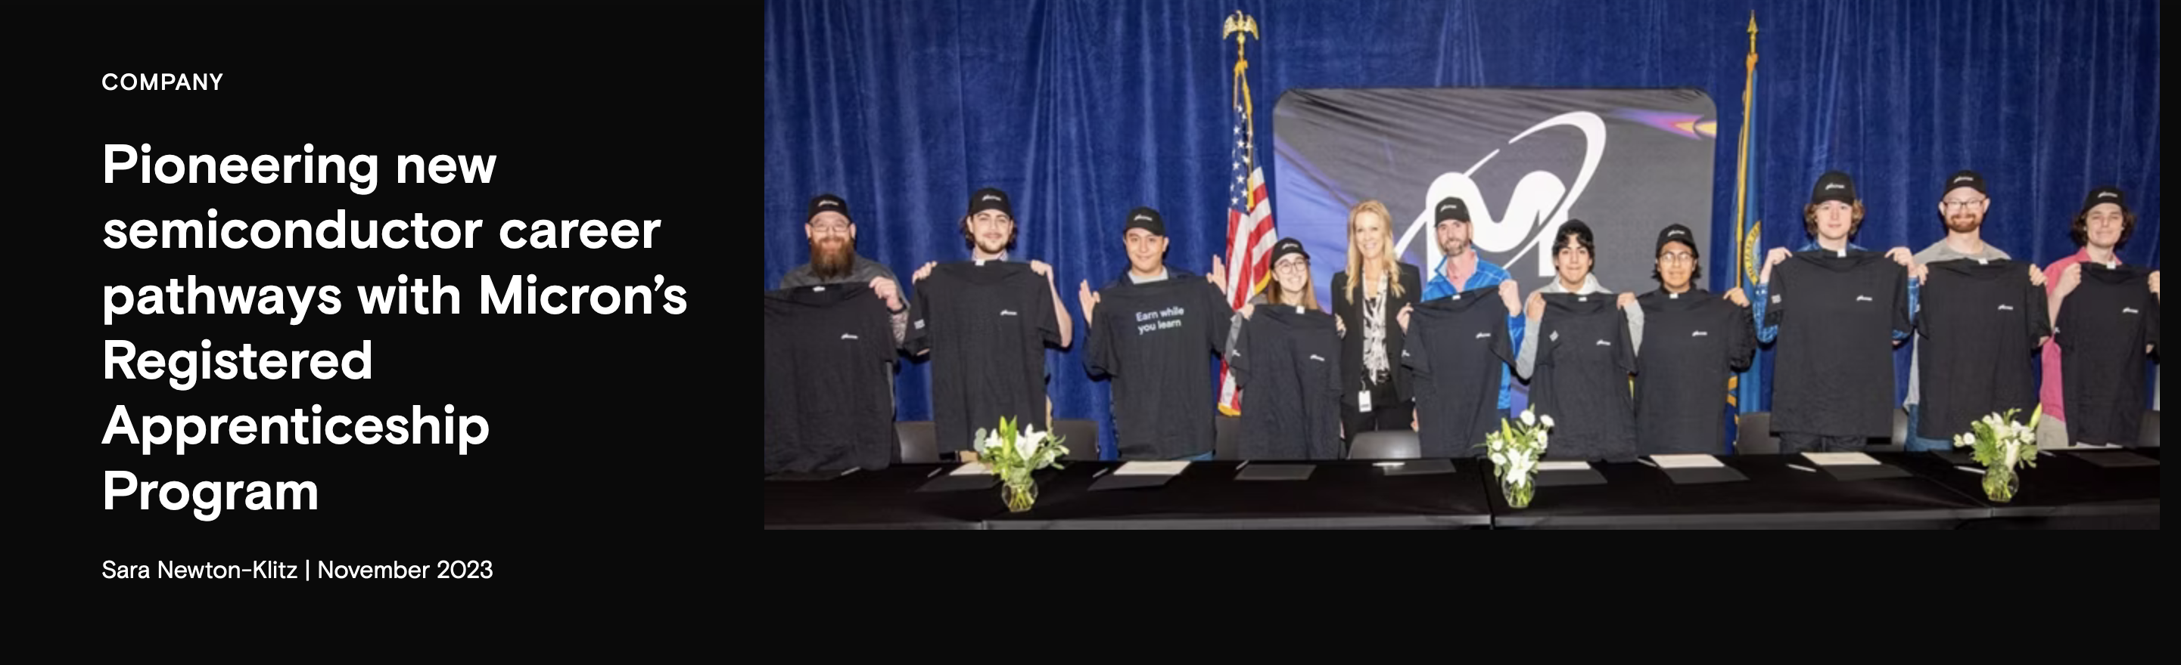

Slide 20
“Modern American Industrial Strategy” and Governing the Future

Slide 21
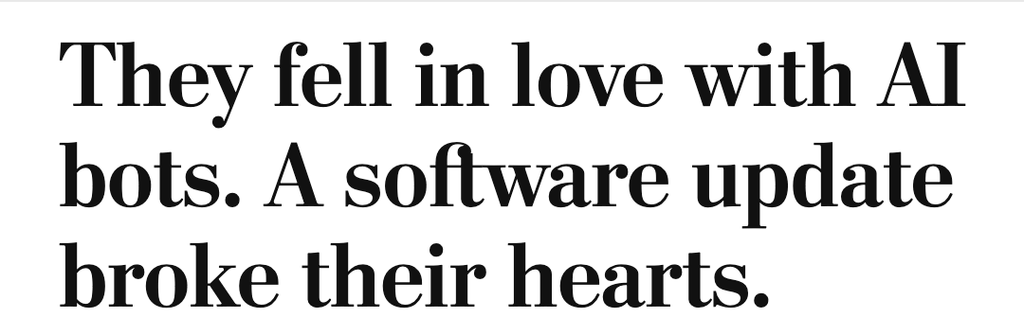
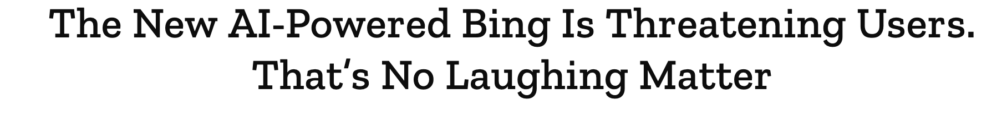
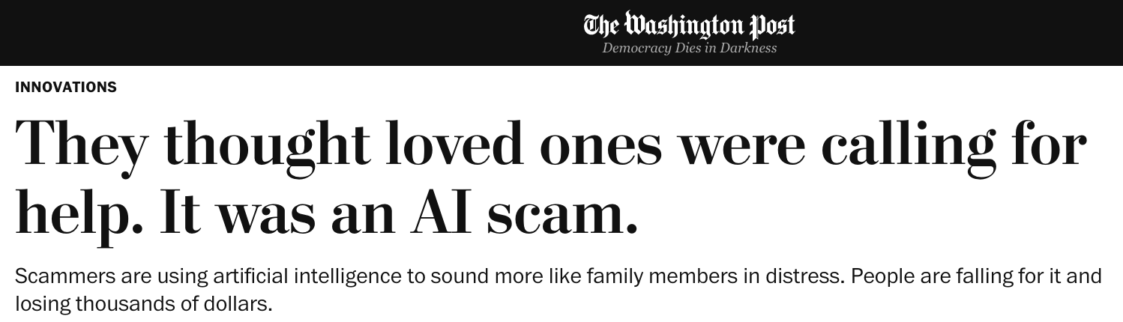
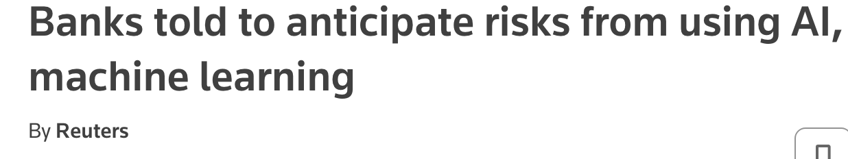
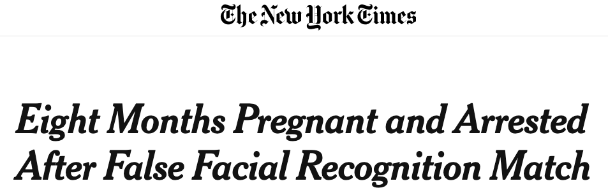
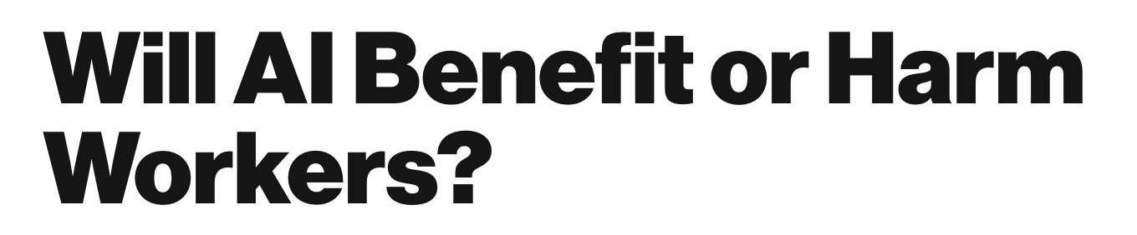
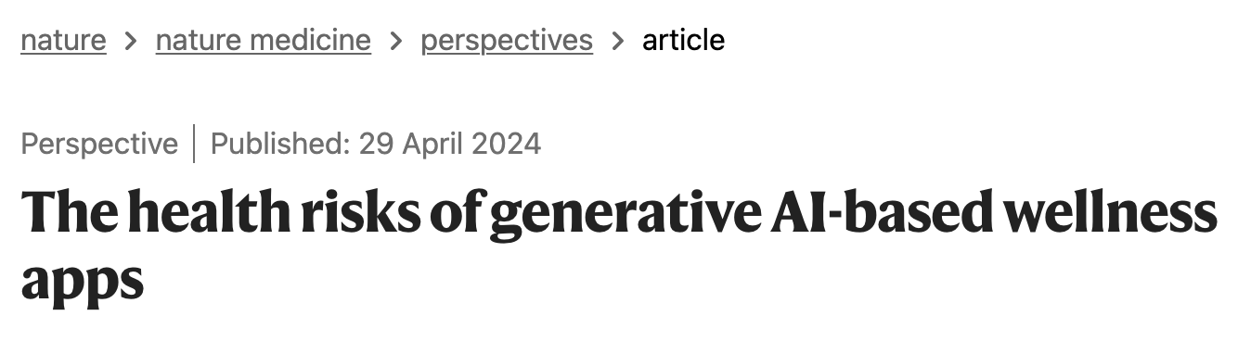
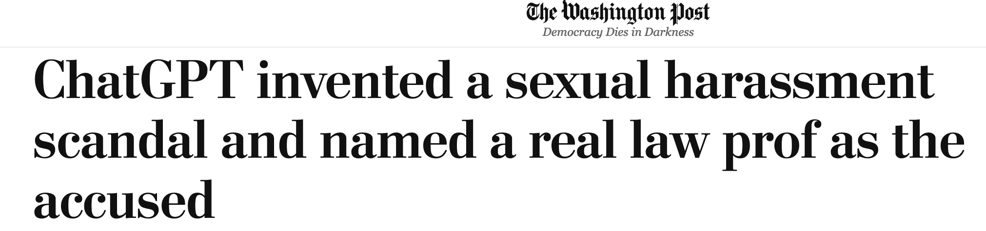

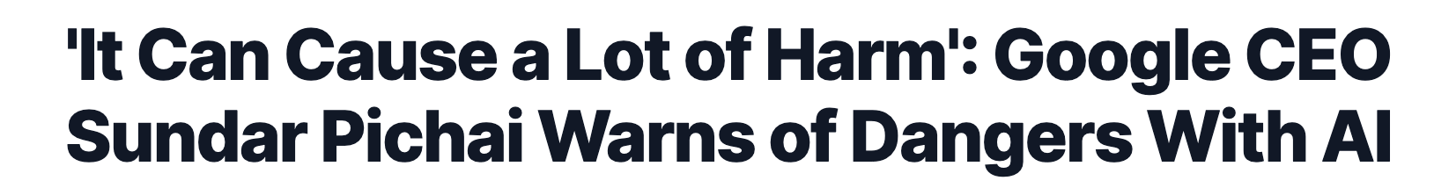
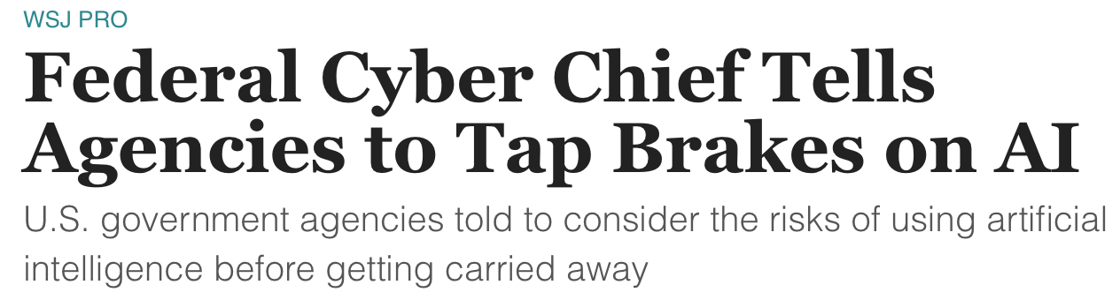
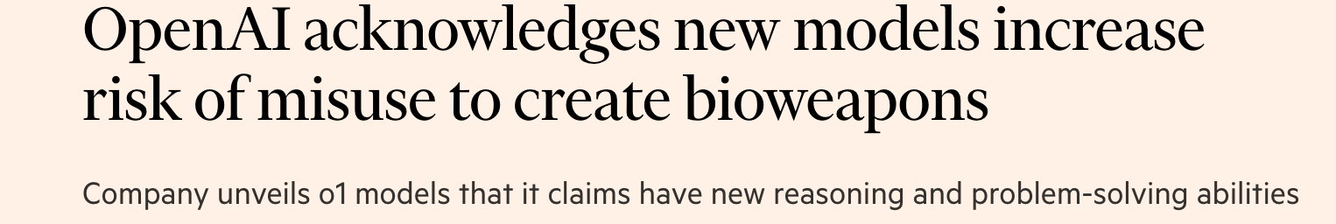

Slide 22

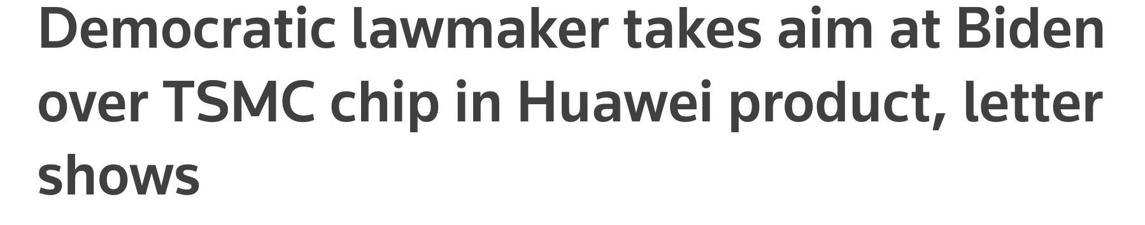


Slide 23
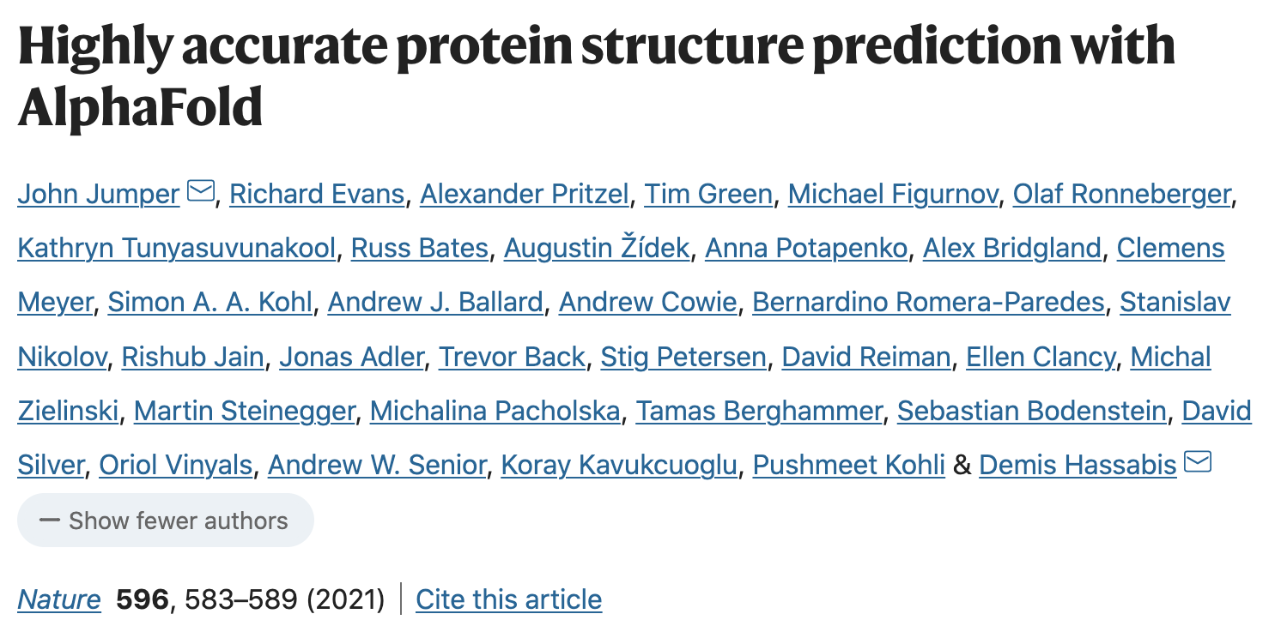
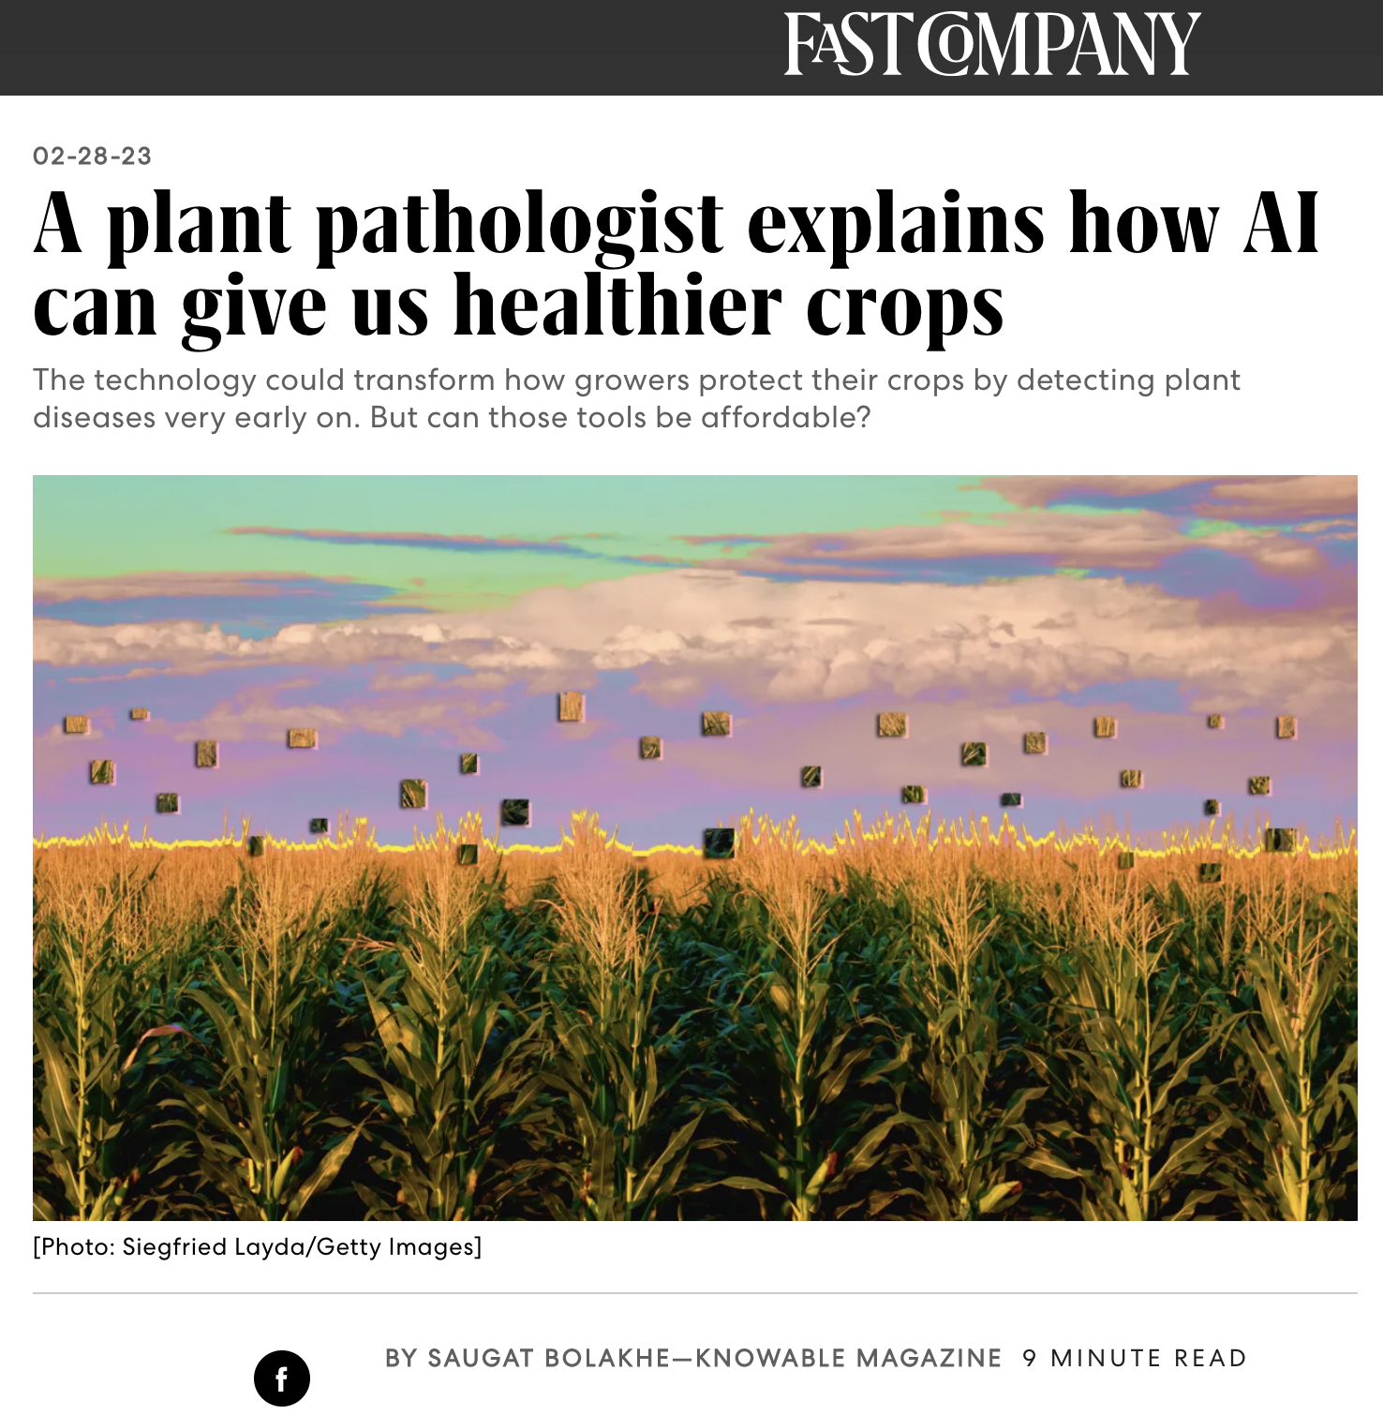

AI for Good
AI for Science
AI for Accessibility
AI for Efficiency

Slide 24
AI for Good
Not Inevitable

Slide 26
1. Return to first principles, including a vision of the public good
2. Recognize that existing laws, rules, norms, and standards apply—and use them
3. Recognize that new laws, rules, norms, and standards may be needed—and craft them

Slide 27
Return to First Principles

Slide 28
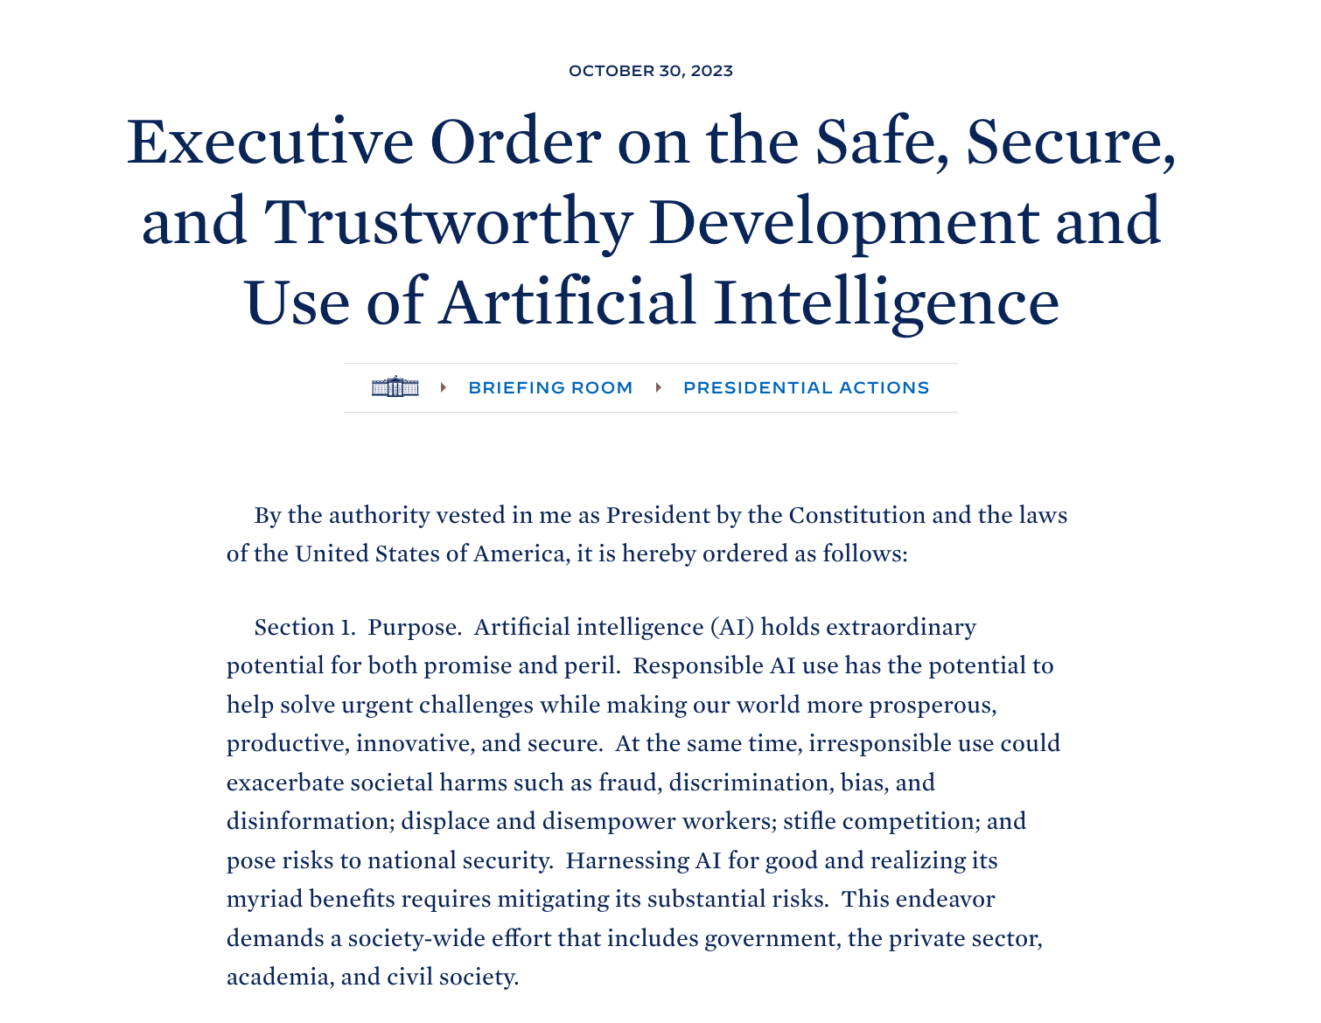
October 2023

Slide 29
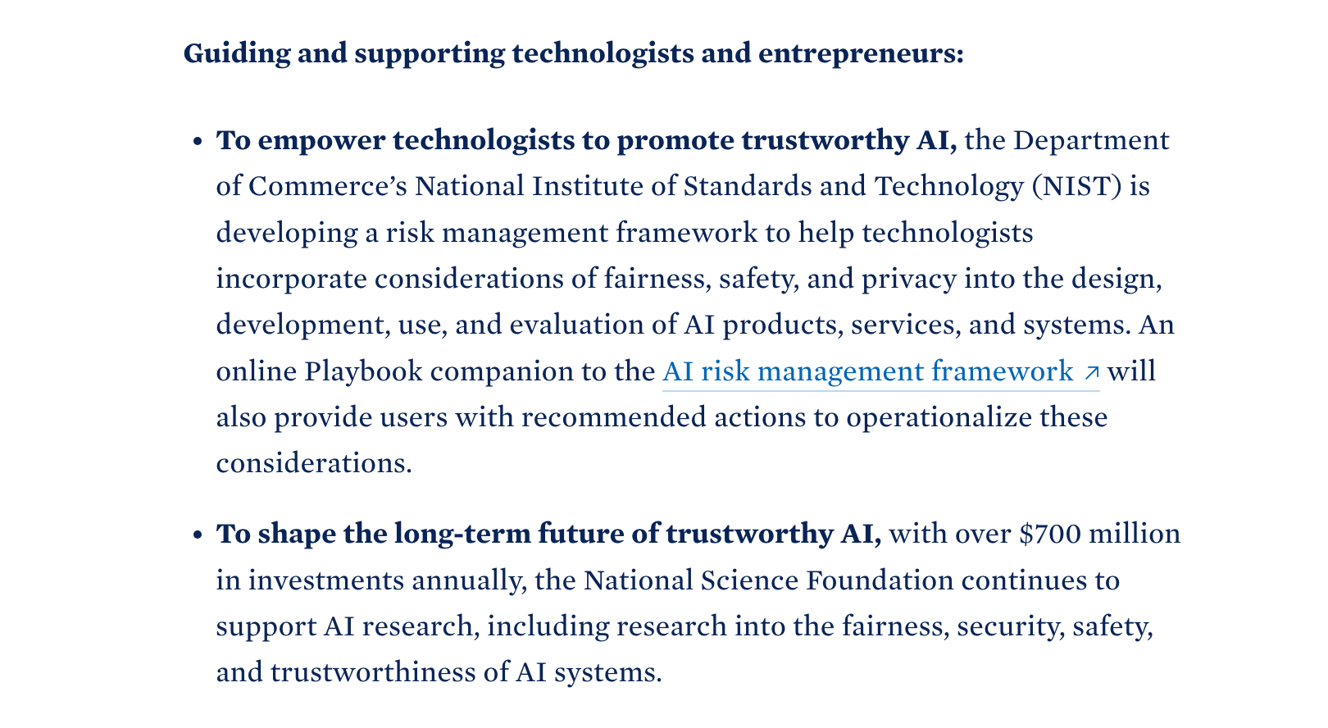

Slide 30
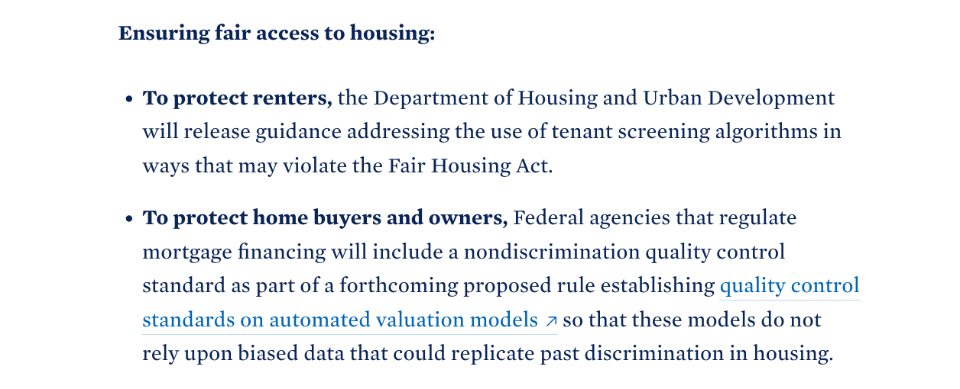

Slide 31
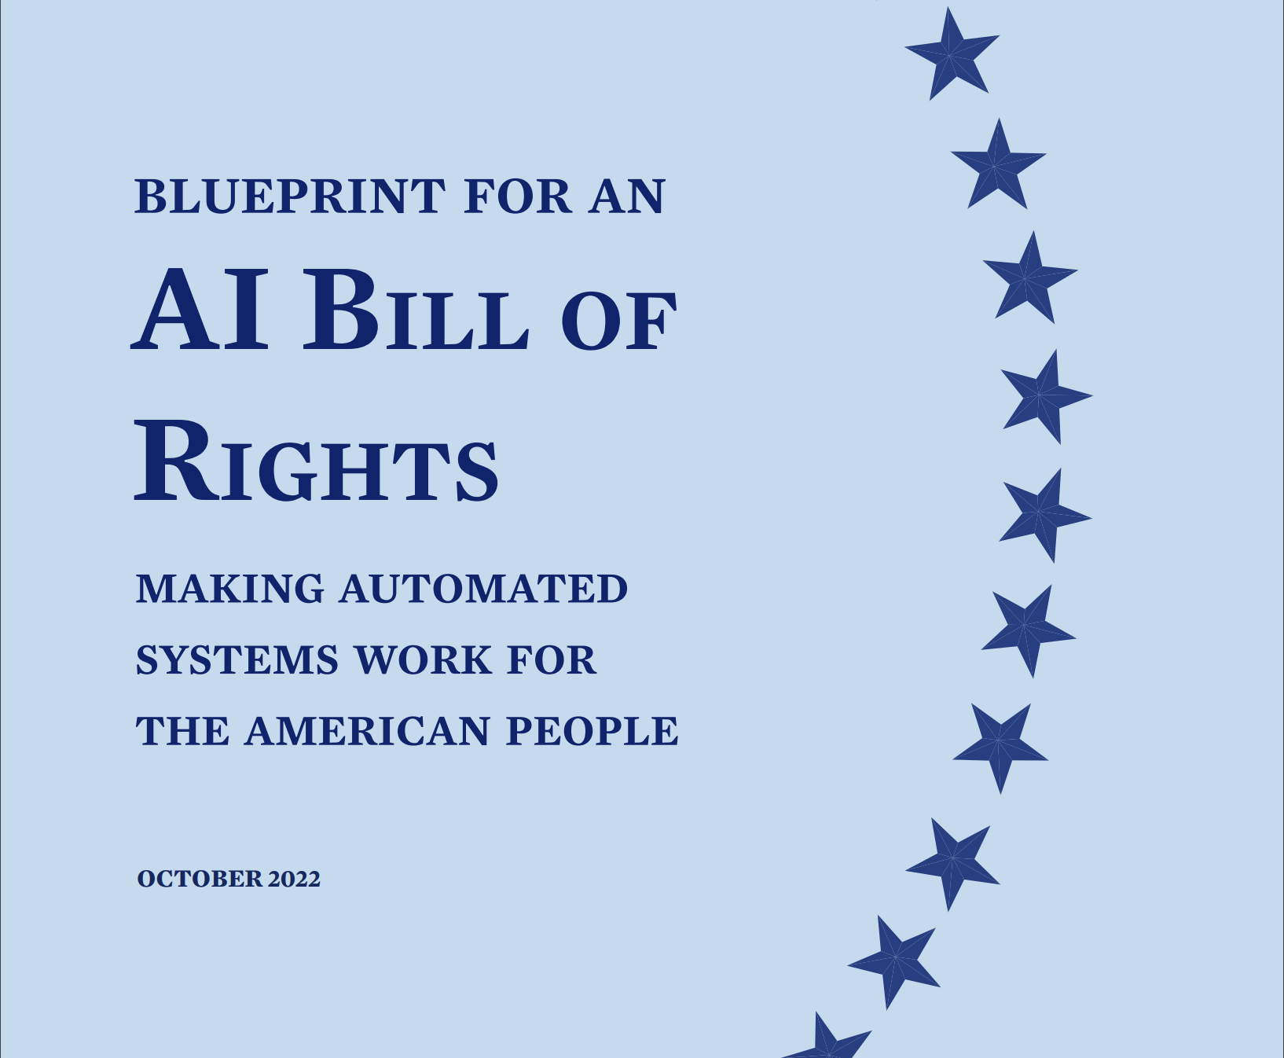


Slide 32
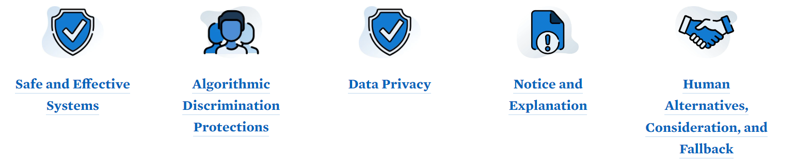
Blueprint for an AI Bill of Rights

Slide 33
Existing Governance Applies

Slide 34


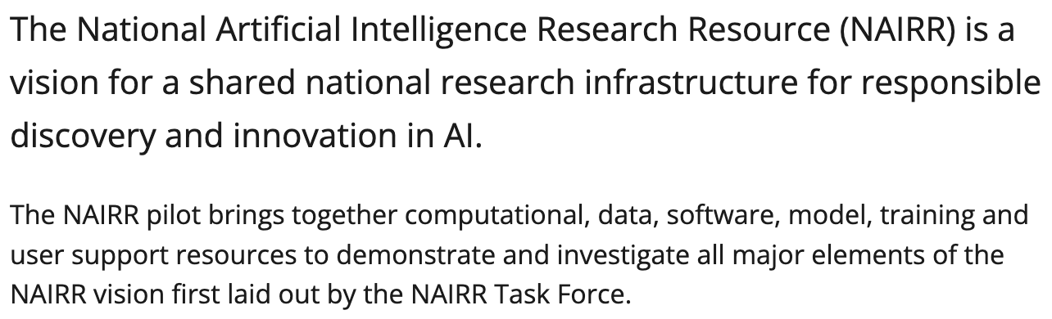

Slide 35
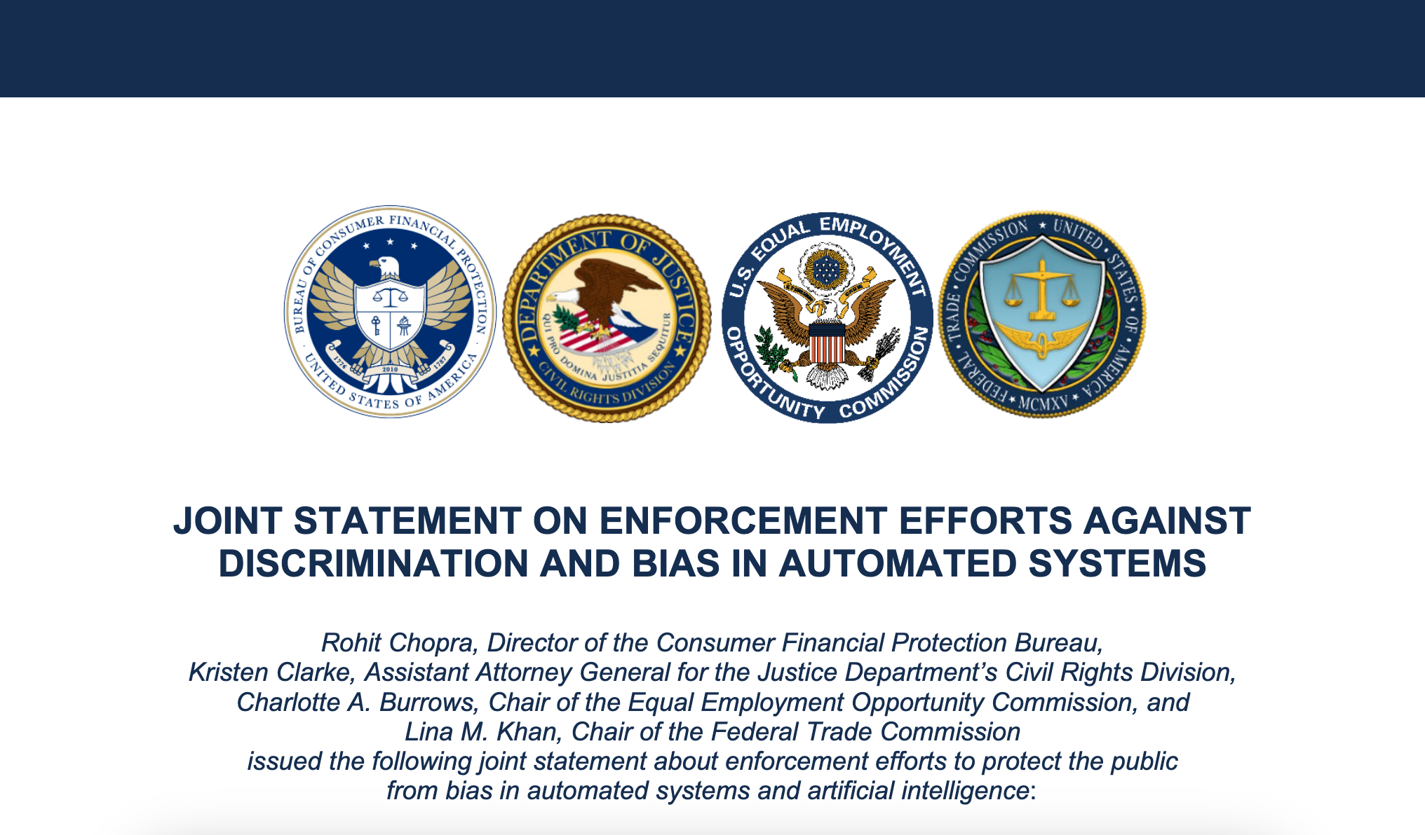
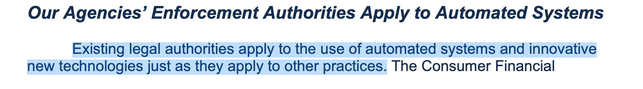
April 2023

Slide 36
New Governance May Be Needed

Slide 37
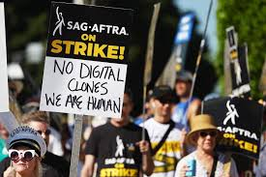
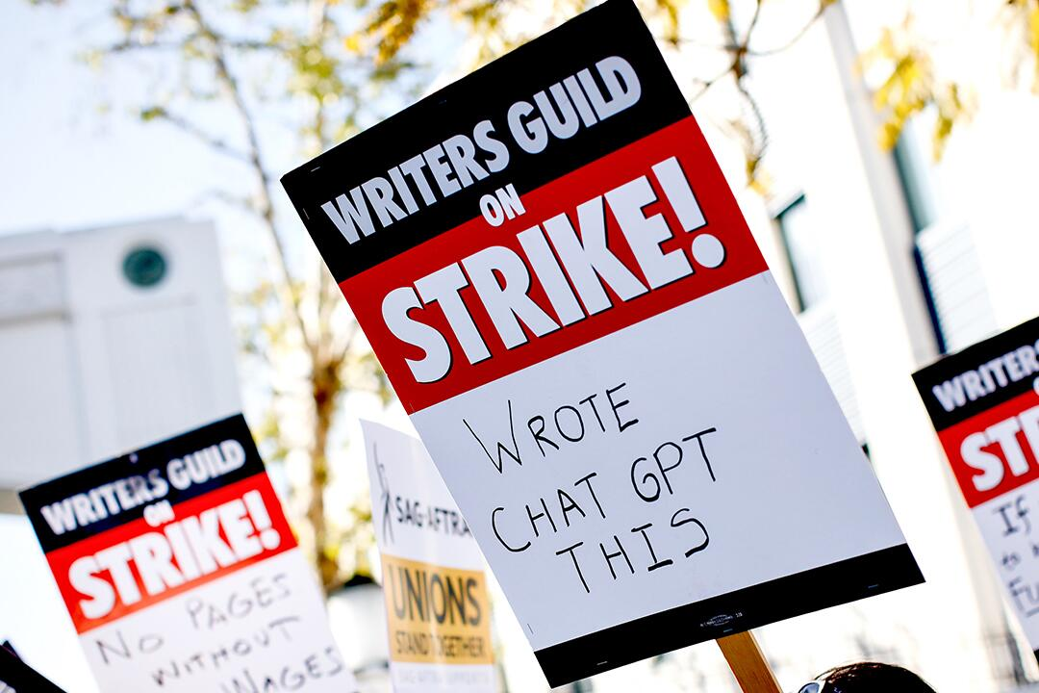

Slide 38
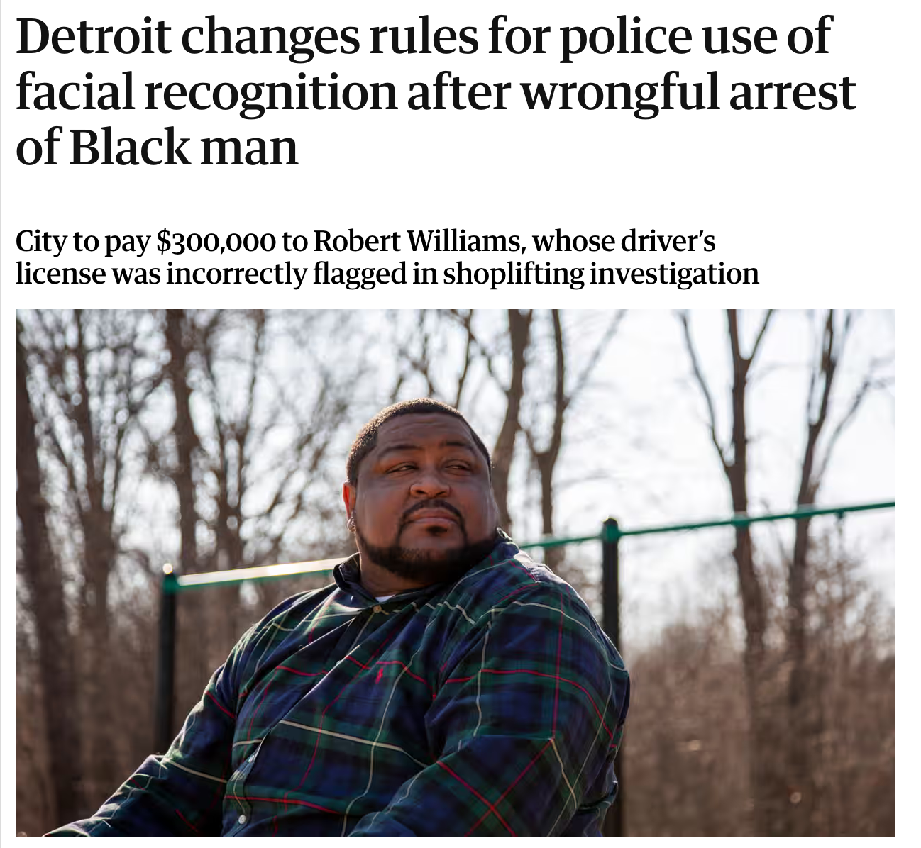


Slide 39
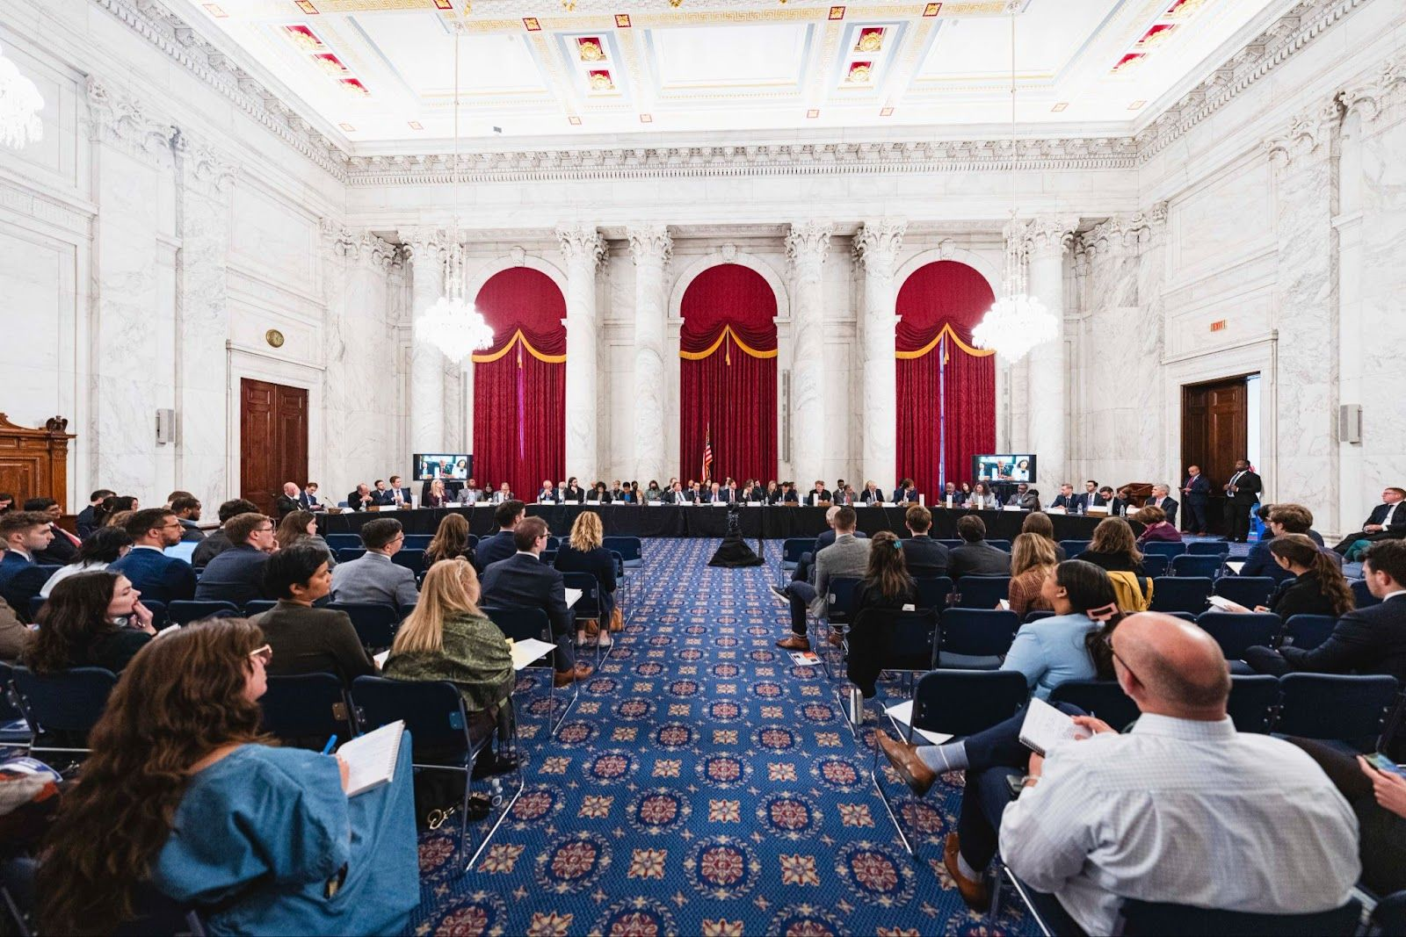

Slide 40
Science and technology as the centerpiece of both domestic policy and international policy
Science, technology, and innovation are both the input and output of “modern American industrial strategy”
New industrial policy as science and technology policy (e.g., AI governance)
Government investments and Industrial policy always has so-called “non-economic” impacts – so shouldn’t we have a strategy?

Slide 41
Science, Technology, and Society in the “Modern American Industrial Strategy”
Alondra Nelson
Science, Technology, and Social Values Lab
Institute for Advanced Study
New Thinking in Industrial Policy
Columbia University
November 1, 2024

