Slide 1
The Politics of the
EU’s New Market Activism
Kathleen R. McNamara
Georgetown University

Slide 2
The Great Rethinking:
Crises & the EU’s Return to Industrial Policy
Fall out from the Global Financial Crisis
Green & Digital Transitions
China’s Rise & US Inward Shift
The Pandemic & Ukraine
2010 2015 2020

Slide 3
EU’s New Market Activism: Goals
The Goals of European Industrial Policy
Aspirational
(Decarbonization/Green Transition; Digital Transition)
Competition & Security
(Tech/innovation, supply chain resilience, weaponized interdependence)

Slide 4
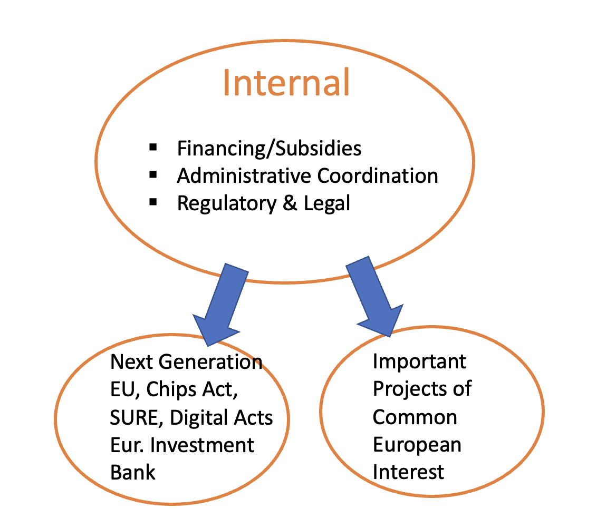
EU Industrial Policy Tools
EU
Member States
Regional/
Local Govts
Private Sector

Slide 5
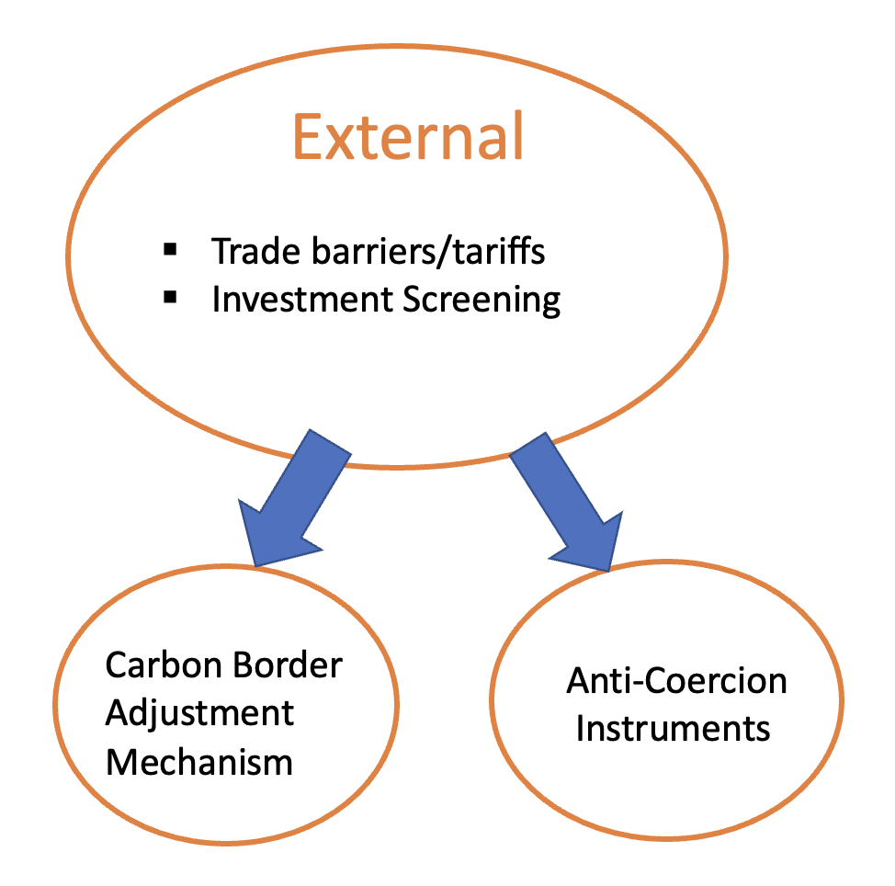
EU Geoeconomic Tools

Slide 6
Industrial Policy/Economic Statecraft =
“The use of public powers
to actively shape domestic and global markets
for the interests and values
of a bounded political community”
McNamara, ”Transforming Europe: The EU’s Industrial Policy & Geopolitical Turn” JEPP 2023

Slide 7
The EU purpose-built for Neoliberalism, today’s political logics very different
Modern EU built for neoliberal market-making
Market activism as visibly distributional
Regulatory powers not enough, fiscal and coercive capacity needed

Slide 8
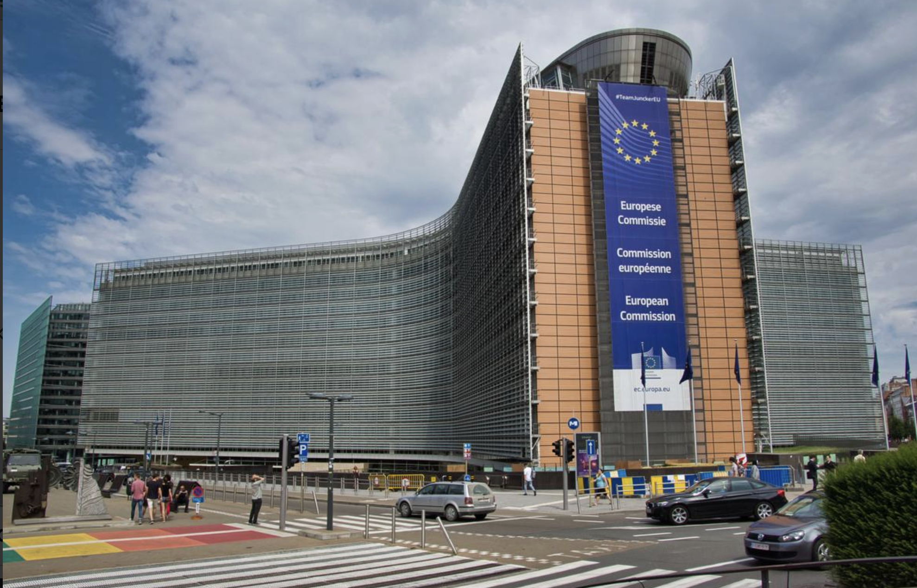
EU Market Activism:
Reshaping Political Coalitions
EU Instutitions & Powers in play
Democratic Legitimation?
Geopolitics & a European military-industrial complex?

Slide 9

Understanding the Underlying Political Logics of Market Activism in the EU
US-EU climate conflicts?

