Slide 1


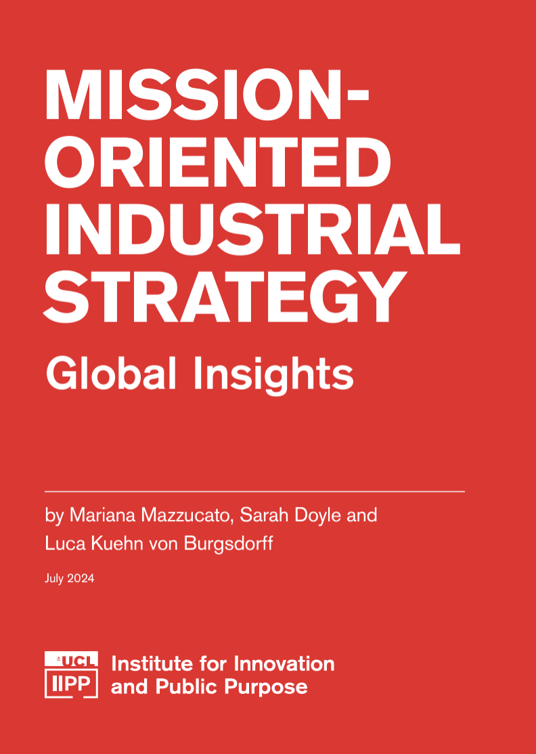

New thinking for new industrial policy :
from fixing markets to shaping them in an outcomes/mission-oriented way
Mariana Mazzucato
Professor in the Economics of Innovation and Public Value Founding Director Institute for Innovation and Public Purpose
University College London
@MazzucatoM www.marianamazzucato.com
Slides ©MarianaMazzucato

Slide 2
Industrial strategy IS growth strategy
(but only if done right)

Slide 3


From market fixing to market shaping.
At Best?
At Worst
“The nine most terrifying words in the English language are ‘I’m from the government, and I’m here to help.’”
- Ronald Reagan
Positive Externalities
Negative externalities
Coordination failures
Information failures
Imperfect competition

Slide 4
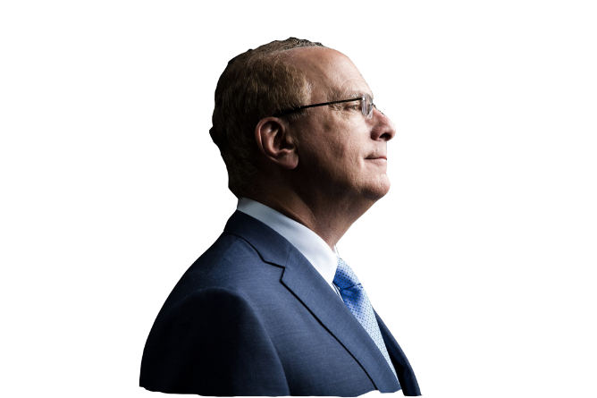
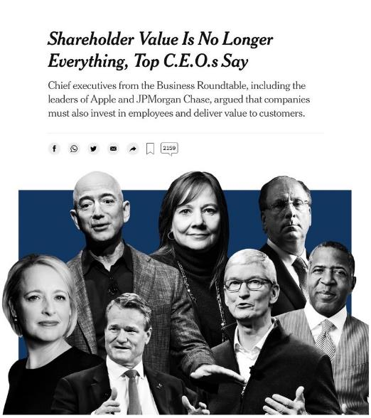

From shareholder maximization to stakeholder capitalism.
“Without a sense of purpose, no company, either public or private, can achieve its full potential.”
- Larry Fink

Slide 5
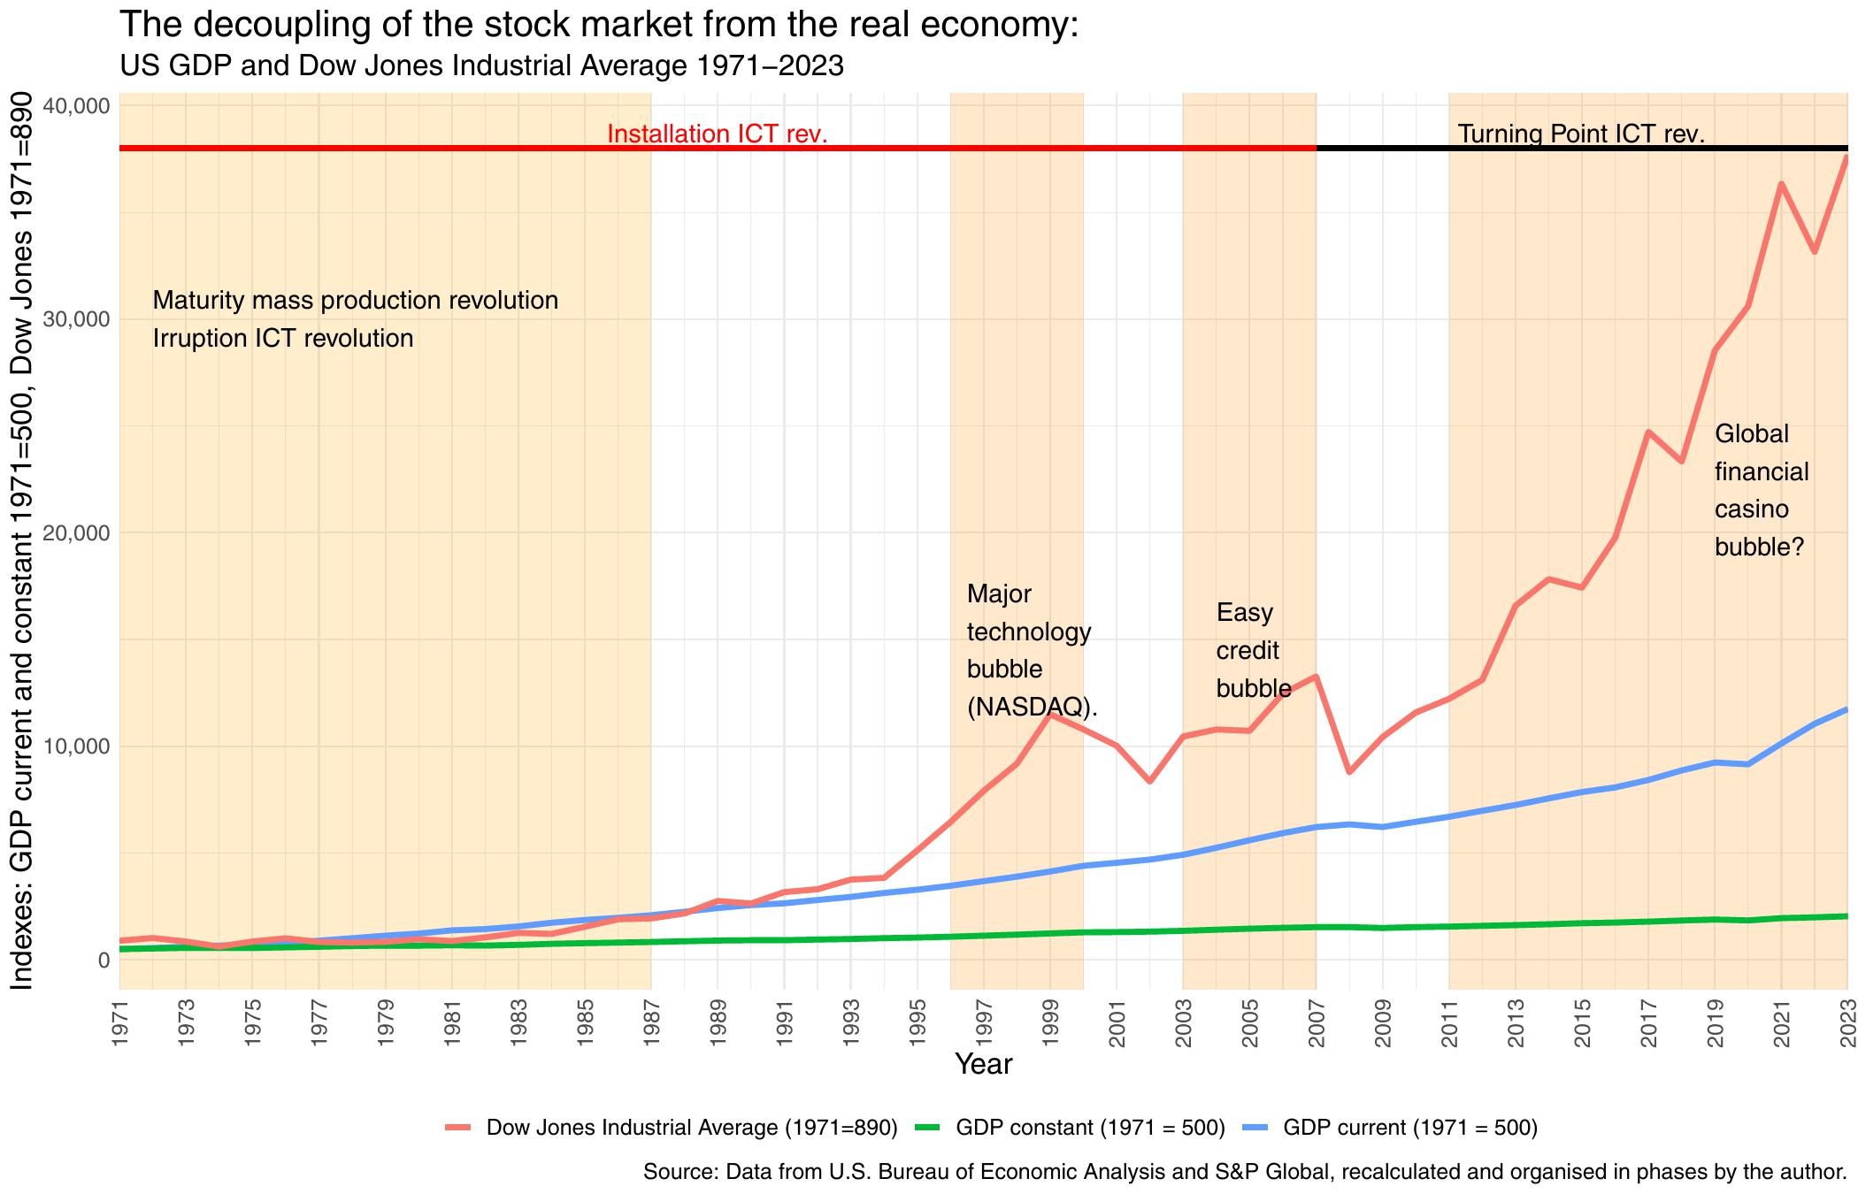
Finance decoupled from the real economy

Slide 6
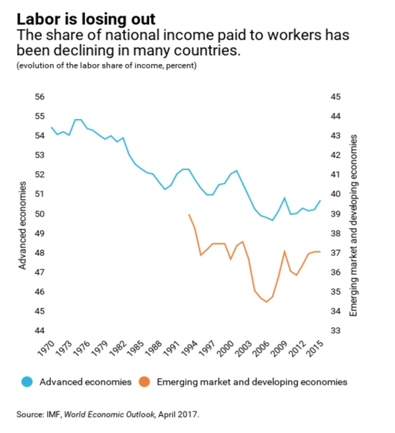
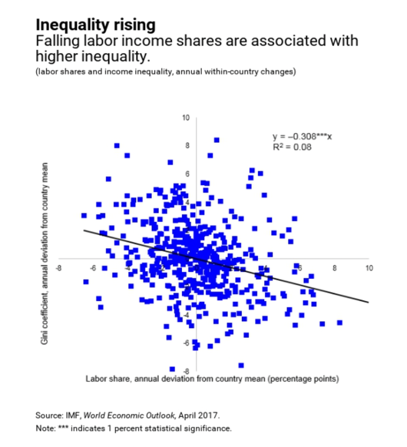
Labour share of income is in decline

Slide 7
Mission-oriented agenda to guide the rethink:
Policy design
Setting a clear direction to foster bottom up innovation towards a socially relevant goal.
Shaping markets not fixing markets
Institution/tool design
Outcomes oriented tools from public finance to public procurement
New social contract
From parasitic contracts to symbiotic public-private partnerships
Co-creation and participation
Community engagement and participation
Dynamic capabilities
Strengthening implementation capacity

Slide 8

Mission-driven policy design

Slide 9
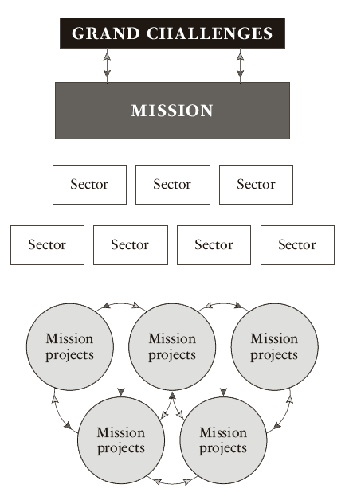

A new approach to policy design
Political agenda setting & civic engagement
Clear targeted mission
Cross sectoral innovation
Portfolio of projects and bottom-up experimentation
©Mariana Mazzucato

Slide 10

Spillovers:
20 things we wouldn’t have without space travel
Camera Phones
Athletic Shoes
Home Insulation
Adjustable Smoke Detectors
Scratch-resistant Lenses
Foil Blankets
Jays of Life
Baby Formula
CAT Scans
Water Purification Systems
Wireless Headsets
Artificial Limbs
LEDs
Dust Busters
Memory Foam
Computer Mouse
Land Mine Removal
Ear Thermometers
Freeze-dried Food
Portable Computer
Source: https://www.jpl.nasa.gov/infographics/20-inventions-we-wouldnt-have-without-space-travel/

Slide 11
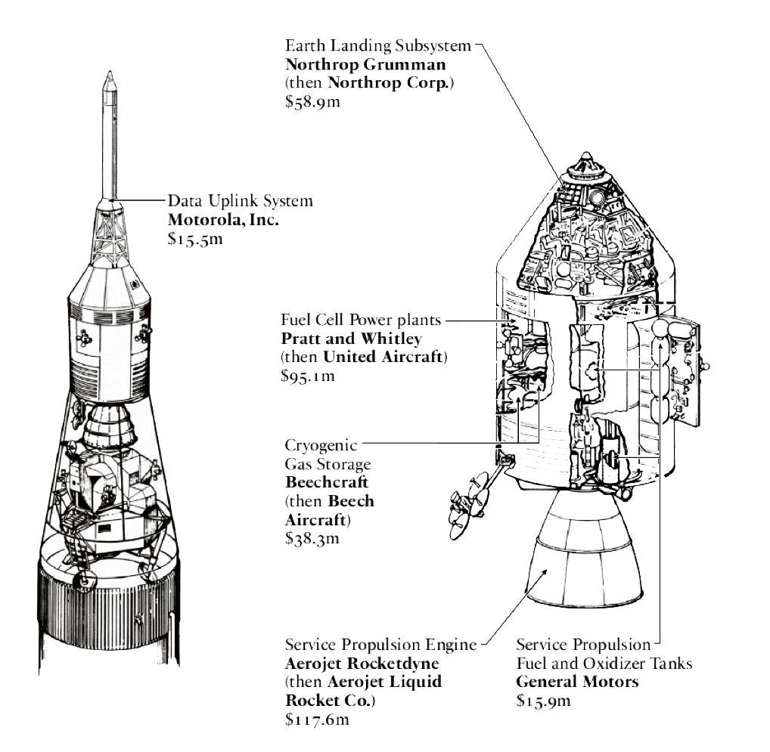
Public-Private Partnership with a common purpose
NASA sought to work in partnership with innovative businesses, showing relevant capabilities and experience, searching for the best partners possible not just the least expensive ones
From cost-plus contracts (easily gamed) to fixed price with incentives.
“No-excess profits” clause!
©Mariana Mazzucato

Slide 12

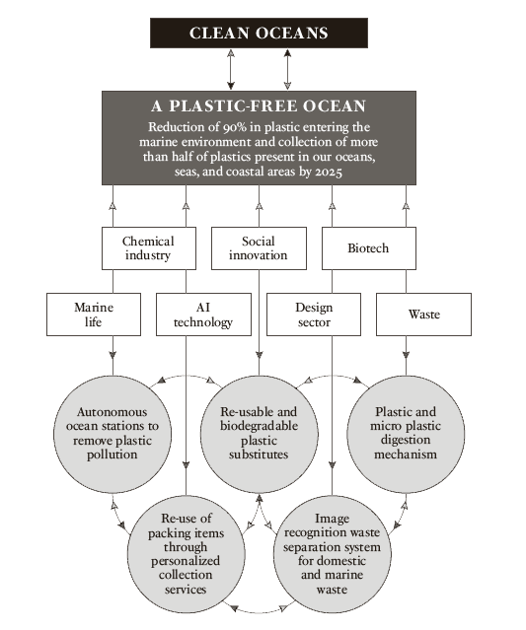
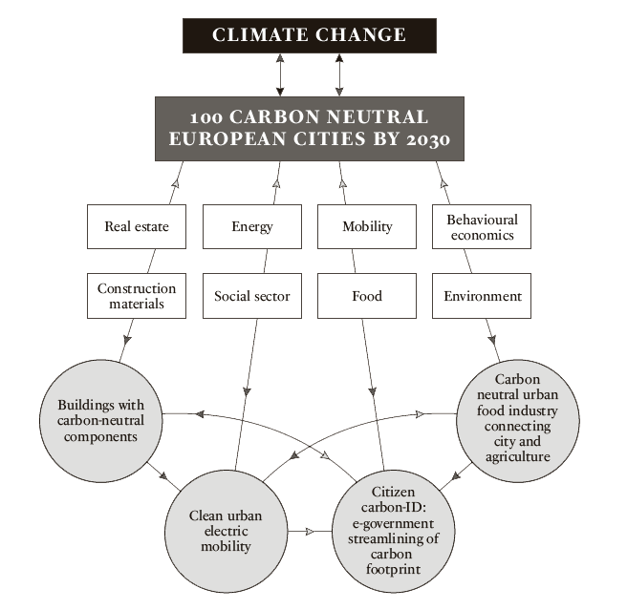
SDG n°14
SDG n°13

Slide 13
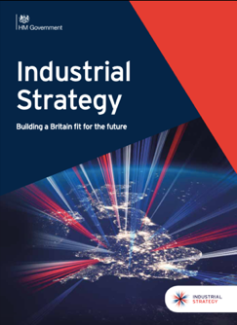
Guiding Industrial Strategy
AI & Data Economy
Clean Growth
We will put the UK at the forefront of the artificial intelligence and data revolution.
We will maximize the advantages for UK industry from the global shift to clean growth.
Future of Mobility
Ageing Society
We will become a world leader in the way people, goods and services move.
We will harness the power of innovation to help meet the needs of an ageing society.

Slide 14
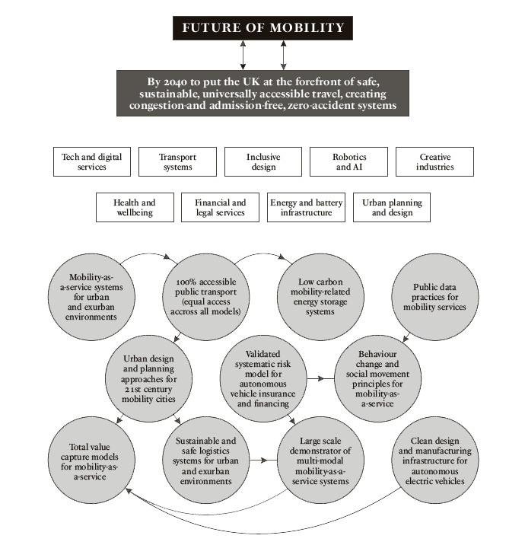
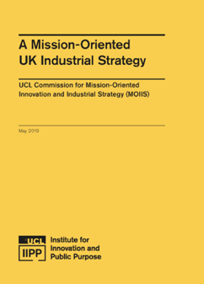
UK Industrial Strategy
Commission chaired by M. Mazzucato & Lord D. Willetts

Slide 15

INSTITUTIONS & TOOLS

Slide 16
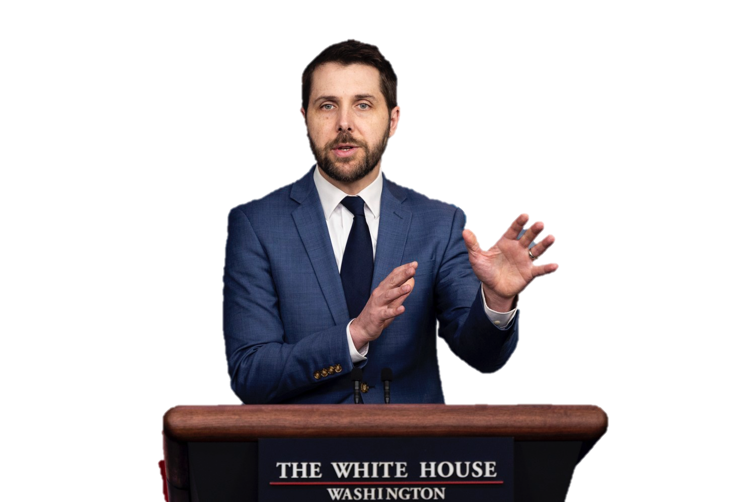
The federal government is the largest buyer in the world, spending over $600 billion in contracts annually, and one of the unique approaches that President Biden has been talking about since the campaign is we need to think about how to leverage this purchasing power strategically to shape markets.
- Brian Deese, Former Director of the National Economic Council

Slide 17
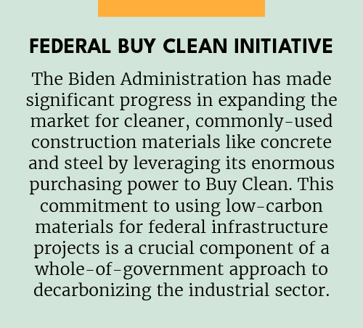
Federal Buy Clean Initiative
Steel produced in the United States is among the cleanest in the world when it comes to carbon emissions, but the U.S. still imports large amounts of steel from countries with higher carbon intensity.
The Federal Buy Clean Initiative incentivizes green procurement:
Prioritize the Federal Government’s purchase of steel, concrete, asphalt and flat glass that have lower levels of emissions.
Increase data transparency through supplier reporting to help American manufacturers track and reduce emissions.
Convene states to partner on Buy Clean.

Slide 18
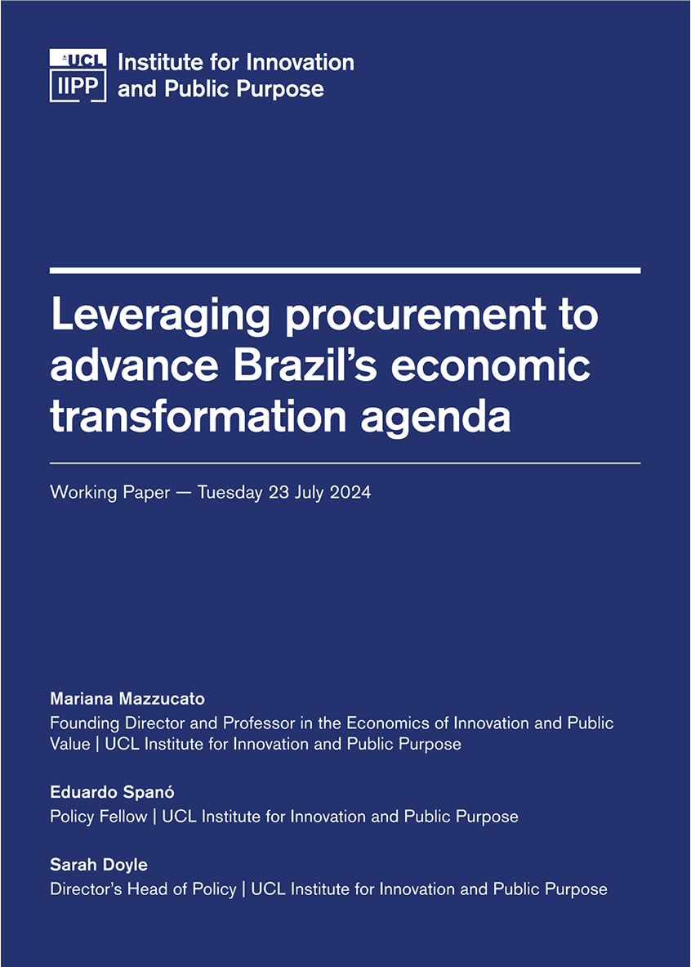
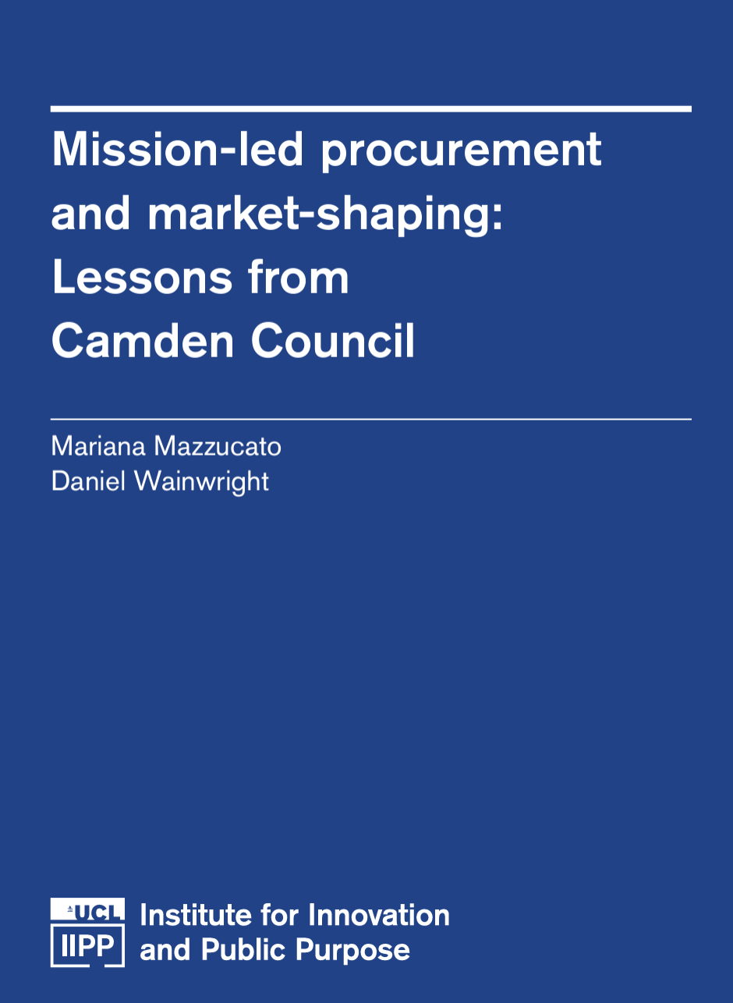
Mission oriented procurement

Slide 19
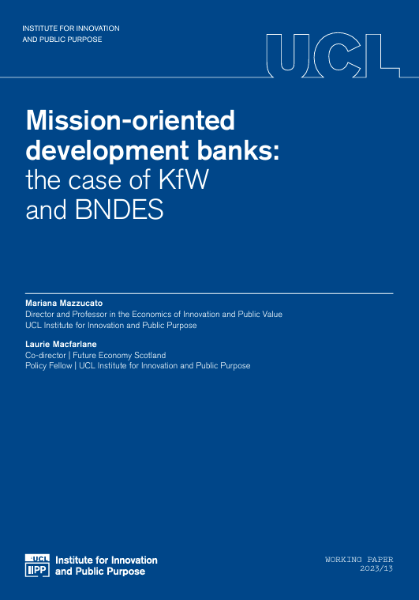
Missions inside public development banks in Germany and Scotland
  KfW has set out Paris Climate Agreement-compatible guidelines with minimum requirements for their loans (95% of financing for steel production technologies is reserved only for transformative technologies that directly contribute to GHG neutrality)
  This policy has helped German steel remain globally competitive at a time when many countries are shifting production towards low-carbon industrial sectors.

Slide 20
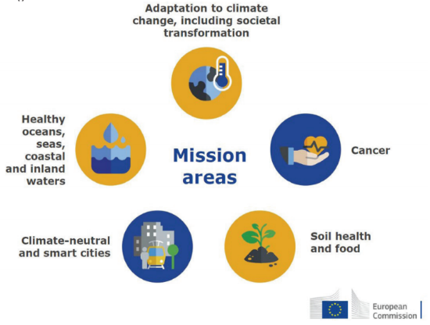
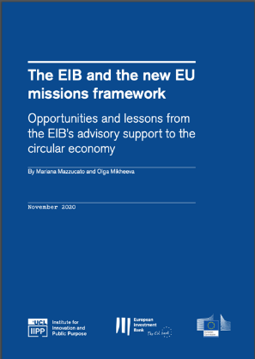
The EIB and EU Missions
Mazzucato, M. and Mikheeva, O. (2020). The EIB and the new EU missions framework, UCL Institute for Innovation and Public Purpose, IIPP Policy Report (IIPP WP 2020-17). Available at: https://www.ucl.ac.uk/bartlett/public-purpose/wp2020-17

Slide 21
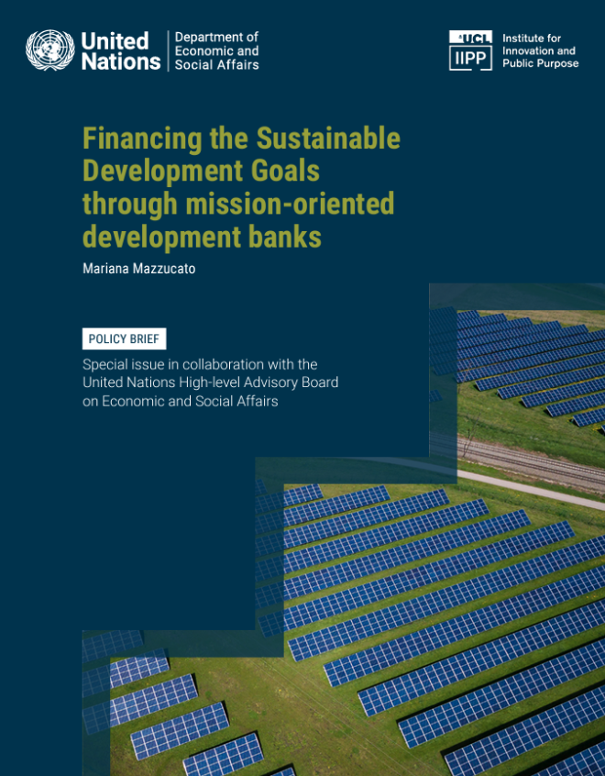
Financing the SDGs through mission-oriented public development banks
$2.2 trillion
Multilateral development banks (MDBs) total assets under management
$20.2 trillion
  National development banks (NDBs) total assets under management

Slide 22
REWARD SHARING AND
A NEW SOCIAL CONTRACT

Slide 23
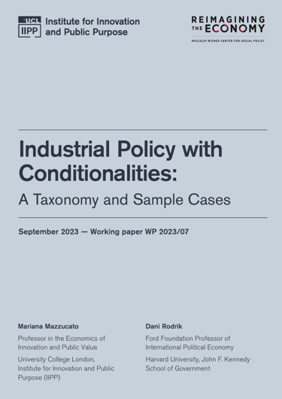
Industrial policy with conditionalities: A taxonomy
Ensure that more citizens and businesses have ACCESS to specific goods, services or technologies.
DIRECT investments towards social or environmental objectives.
Include PROFIT-SHARING provisions between contributing parties.
Promote the REINVESTMENT of business profits into productive activities.

Slide 24
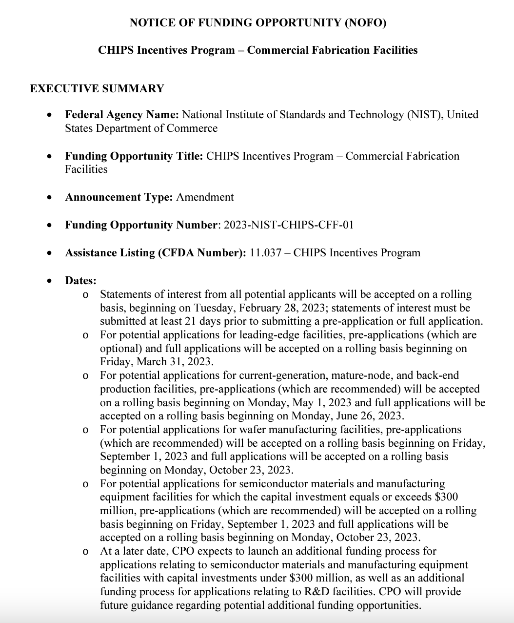
Conditionalities in CHIPS
  No share buybacks or dividends
  Profit sharing for projects priced at $150 million or more
  Access to childcare for projects priced at $150 or more
  Proposals must specify workforce development, investment in R&D, and energy- and water-efficient supply chains

Slide 25
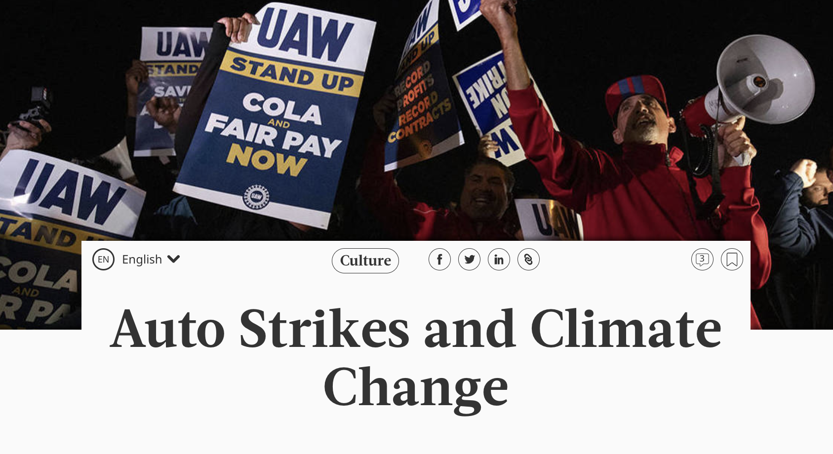
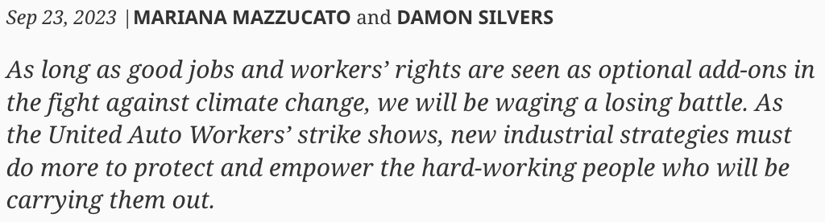
A new social contract with business and labor

Slide 26
CAPABILITIES MATTER

Slide 27
Where should missions sit?
“All of government approach”
Mission-oriented policies
Health
Economy
Environment
Industry/ Innovation
Education
Ministries

Slide 28

From digital governance to a gov labs
Adapting and learning
Aligning public services with needs
Governing data and digital platforms
Inter and intra-governmental learning and coordination
Governing resilient production systems

Slide 29





Gov Labs welcoming experimentation
BRAZIL
CHILE
SCOTLAND
MEXICO CITY
COLOMBIA

Slide 30
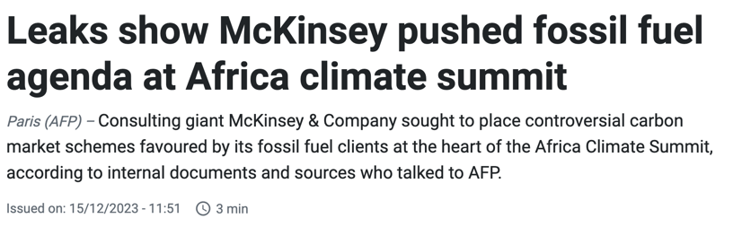

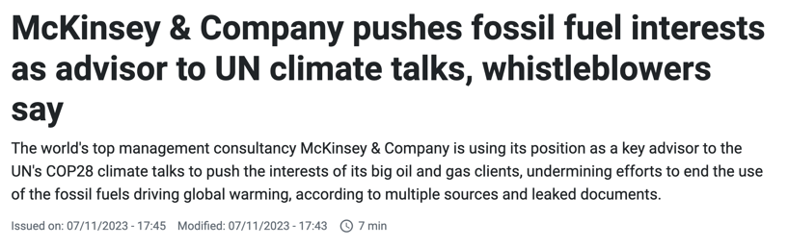
Public sector capacity for our climate agenda

Slide 31
GLOBAL GOVERNANCE

Slide 32
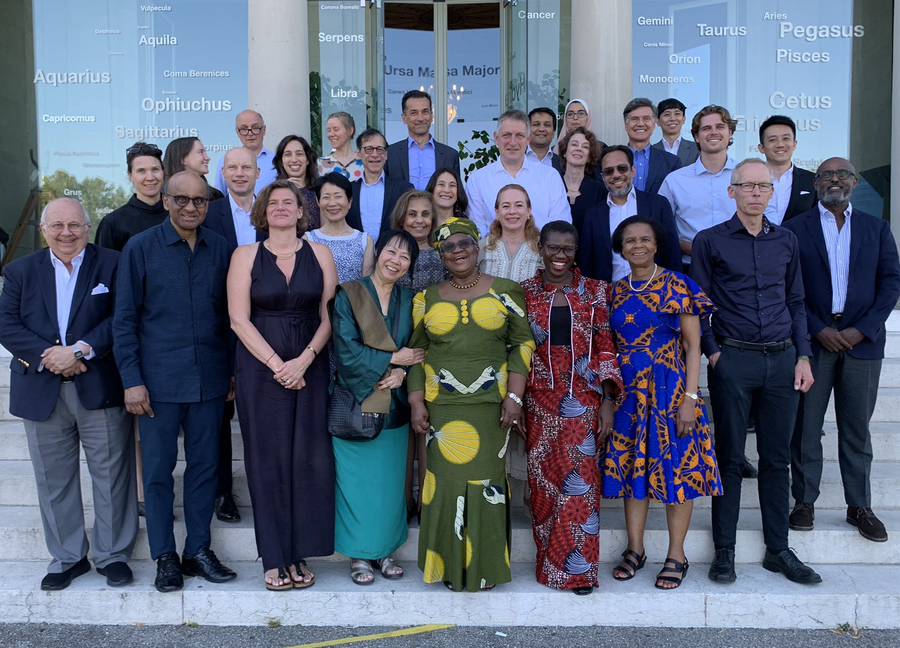
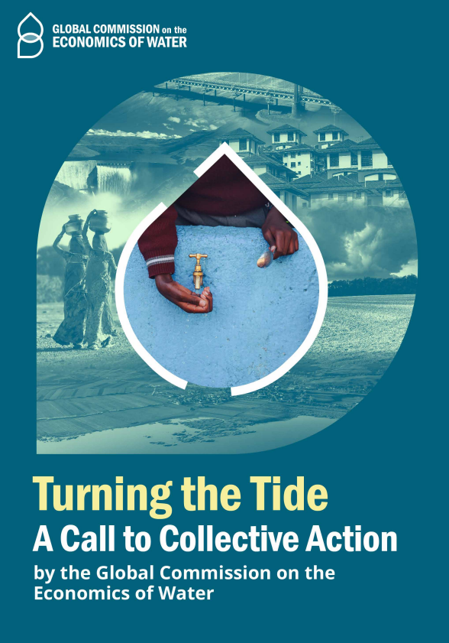
Global Commission on the Economics of Water
We must govern and value the hydrological cycle as a global common good:
1. Countries and communities are interdependent
2. The water crisis, climate change and biodiversity loss are interconnected
3. Water impacts and cuts across all SDGs

Slide 33

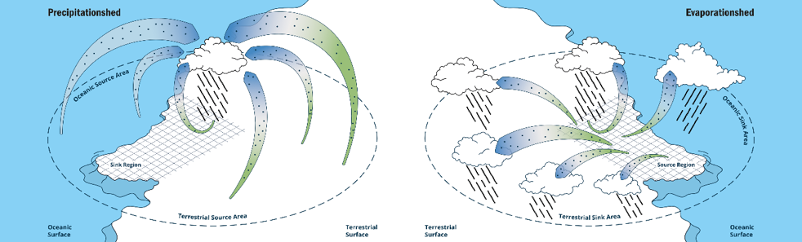
Governing the hydrological cycle as a global common good

Slide 34


Global governance of industrial (and financial) policies
The final report of the G20 TF CLIMA Group of Experts (Mazzucato and Songwe Co-chairs) sets out a framework for new development pathways that align economic growth with climate and equity goals.
Green industrial strategies oriented around ambitious NDC targets
New governance frameworks for global cooperation on green industrial strategy and finance that recognize the global nature of the climate crisis and prioritize equity.

Slide 35

Green industrial strategy in practice
A shift from subsidies to sectors/technologies to orienting industrial strategy around NDCs
Not just about renewable energy. Means transforming how we eat, how we build, how we move.
Align public-private collaboration with shared climate goals and maximise public value.
Requires a whole-of-government approach and changes to government structures, tools and institutions.
Equity between countries and a move away from protectionism
Need for affordable green finance and new financial governance structures

Slide 36
DON’T BELIEVE THE HYPE

Slide 37
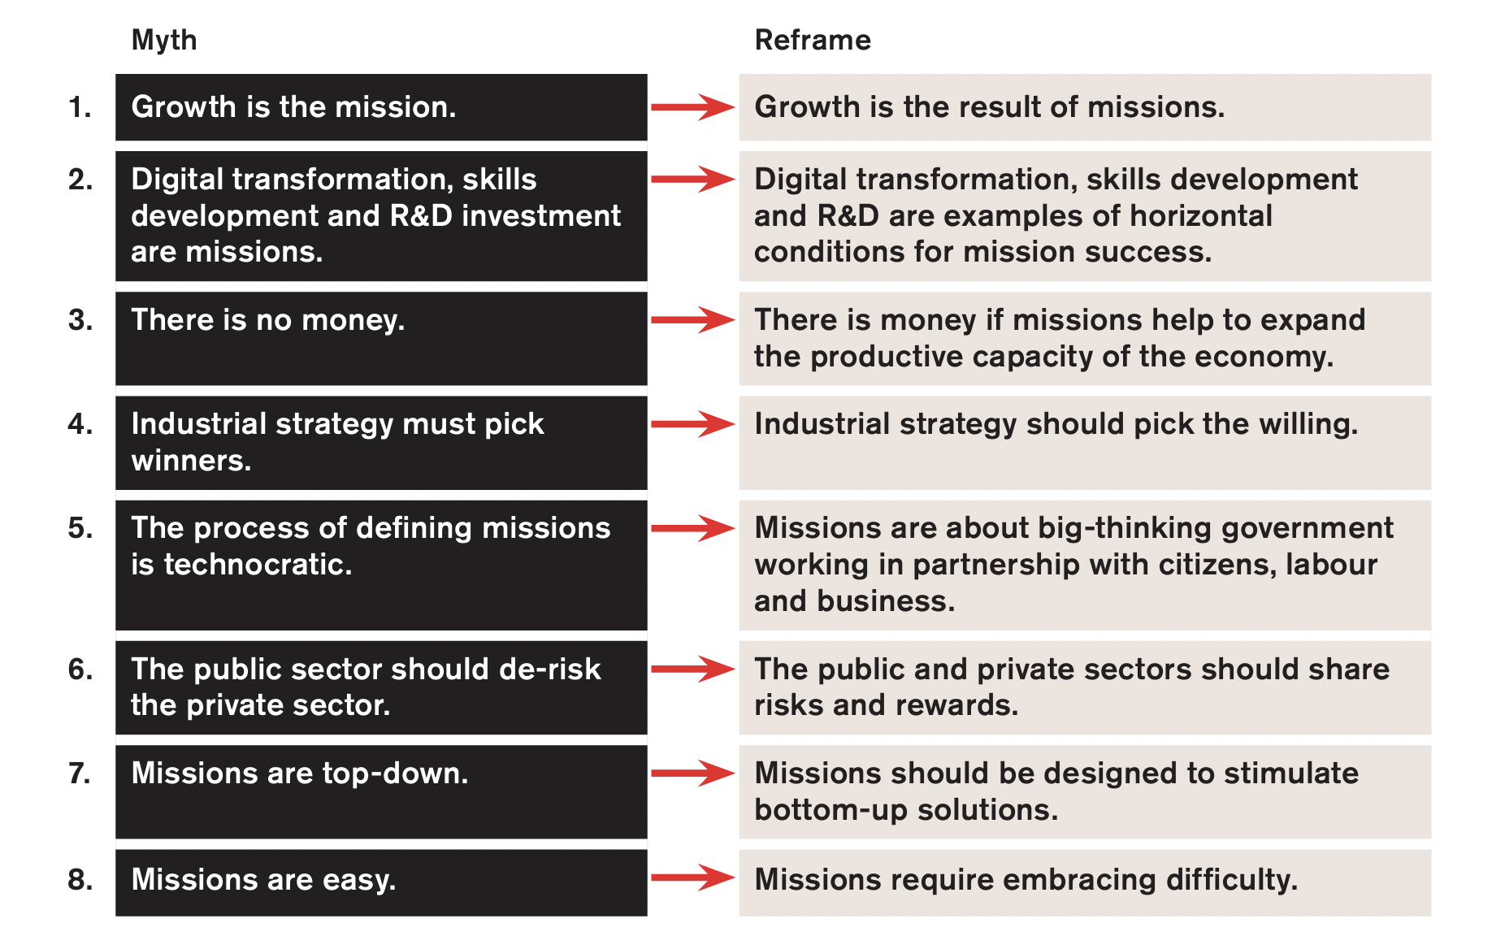
Debunking eight myths around mission-oriented policies

Slide 38

FIXING MARKETS CO-CREATING
DE-RISKING WELCOMING UNCERTAINTY
PICKING WINNERS PICKING THE WILLING
LEVELLING PLAYING FIELD TILTING TOWARD A DIRECTION
OUTSOURCING CAPACITY BUILDING
COST BENEFIT DYNAMIC SPILLOVERS

Slide 39
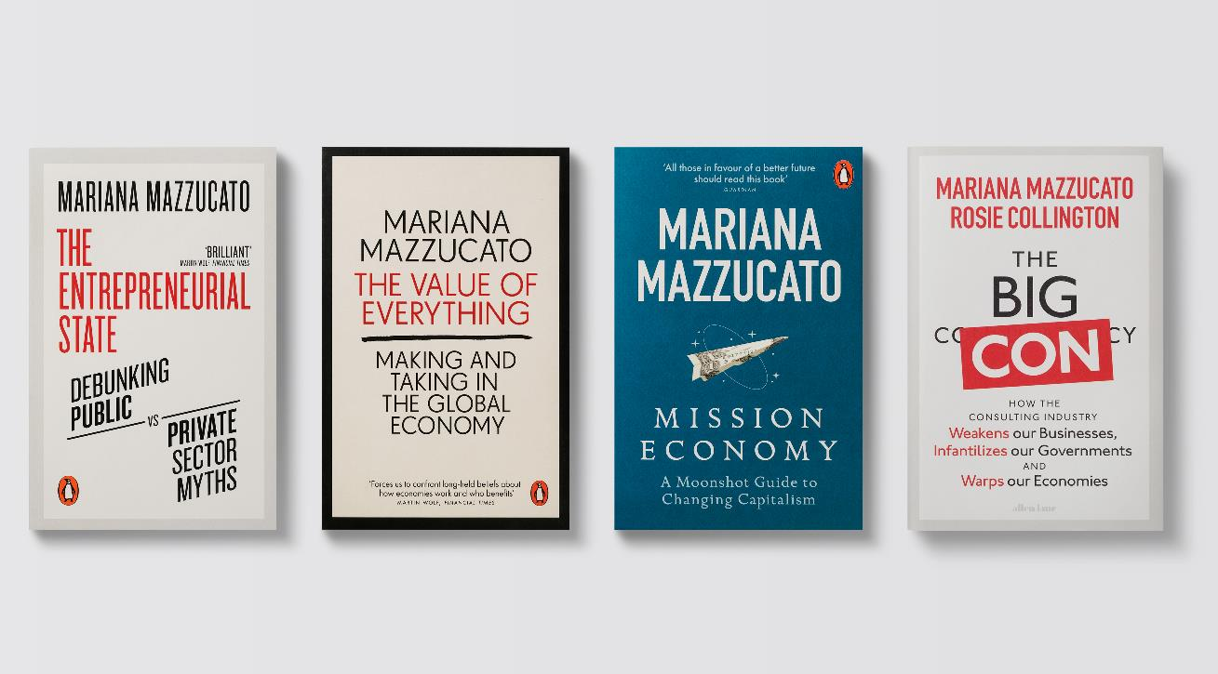
Proactive shaping of economy not market fixing

Slide 40



Thank you!
Mariana Mazzucato
Professor of Economics of Innovation and Public Value
Founding Director, UCL Institute for Innovation and Public Purpose
@MazzucatoM / @UCL_IIPP

