Slide 1
Industrial Strategy for Electric Vehicles: The U.S. Case
Susan Helper
Case Western Reserve University
Columbia University conference on “New Thinking in Industrial Policy”
November 2, 2024

Slide 2
Agenda
Biden policies for EV transition
Status of EV transition
  Employment
  EV penetration
  Chargers
  Suppliers
Obstacles
Lessons

Slide 3
Biden policies for EV transition
Goal-setting (8/2021)
  50 % of US vehicle sales in US EVs by 2030
Supply side subsidies
  for batteries and components, plant conversion, EV chargers
Demand side subsidies
  Consumer subsidies for purchase, leasing
Regulations
  Fuel economy, Made in America
Tariffs, proposed ban on Chinese software in connected vehicles

Slide 4
Outcomes so far

Slide 5
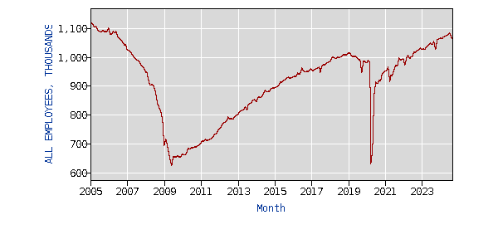
Auto employment is the highest since 2006
If EV transition
not successful
whole industry
Is at risk
Auto industry
connected to
service jobs
not shown on
Chart:
Also at risk:
Software
Design
R&D
BLS.gov All employees, thousands, motor vehicles and parts

Slide 6
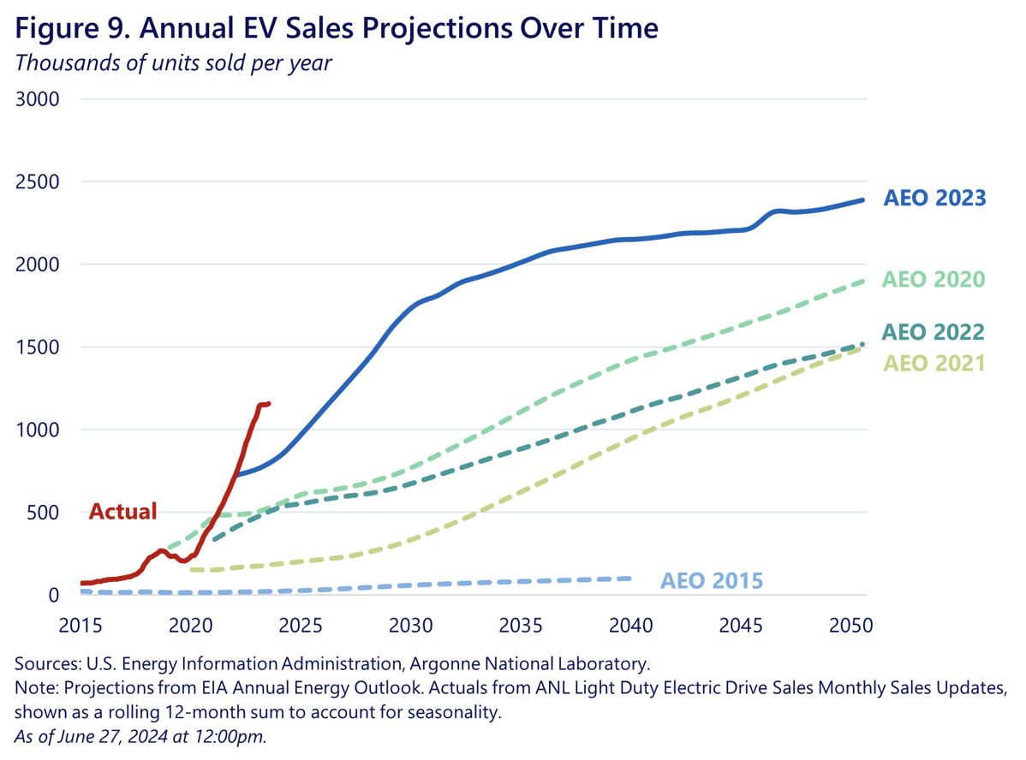
Source: “Building a Thriving Clean Energy Economy in 2023 and Beyond: A Six-Month Update,” by Heather Boushey and Justina Gallegos, Presidential Council of Economic Advisors, July 1, 2024.
https://www.whitehouse.gov/briefing-room/blog/2024/07/01/building-a-thriving-clean-energy-economy-in-2023-and-beyond-a-six-month-update/

Slide 7
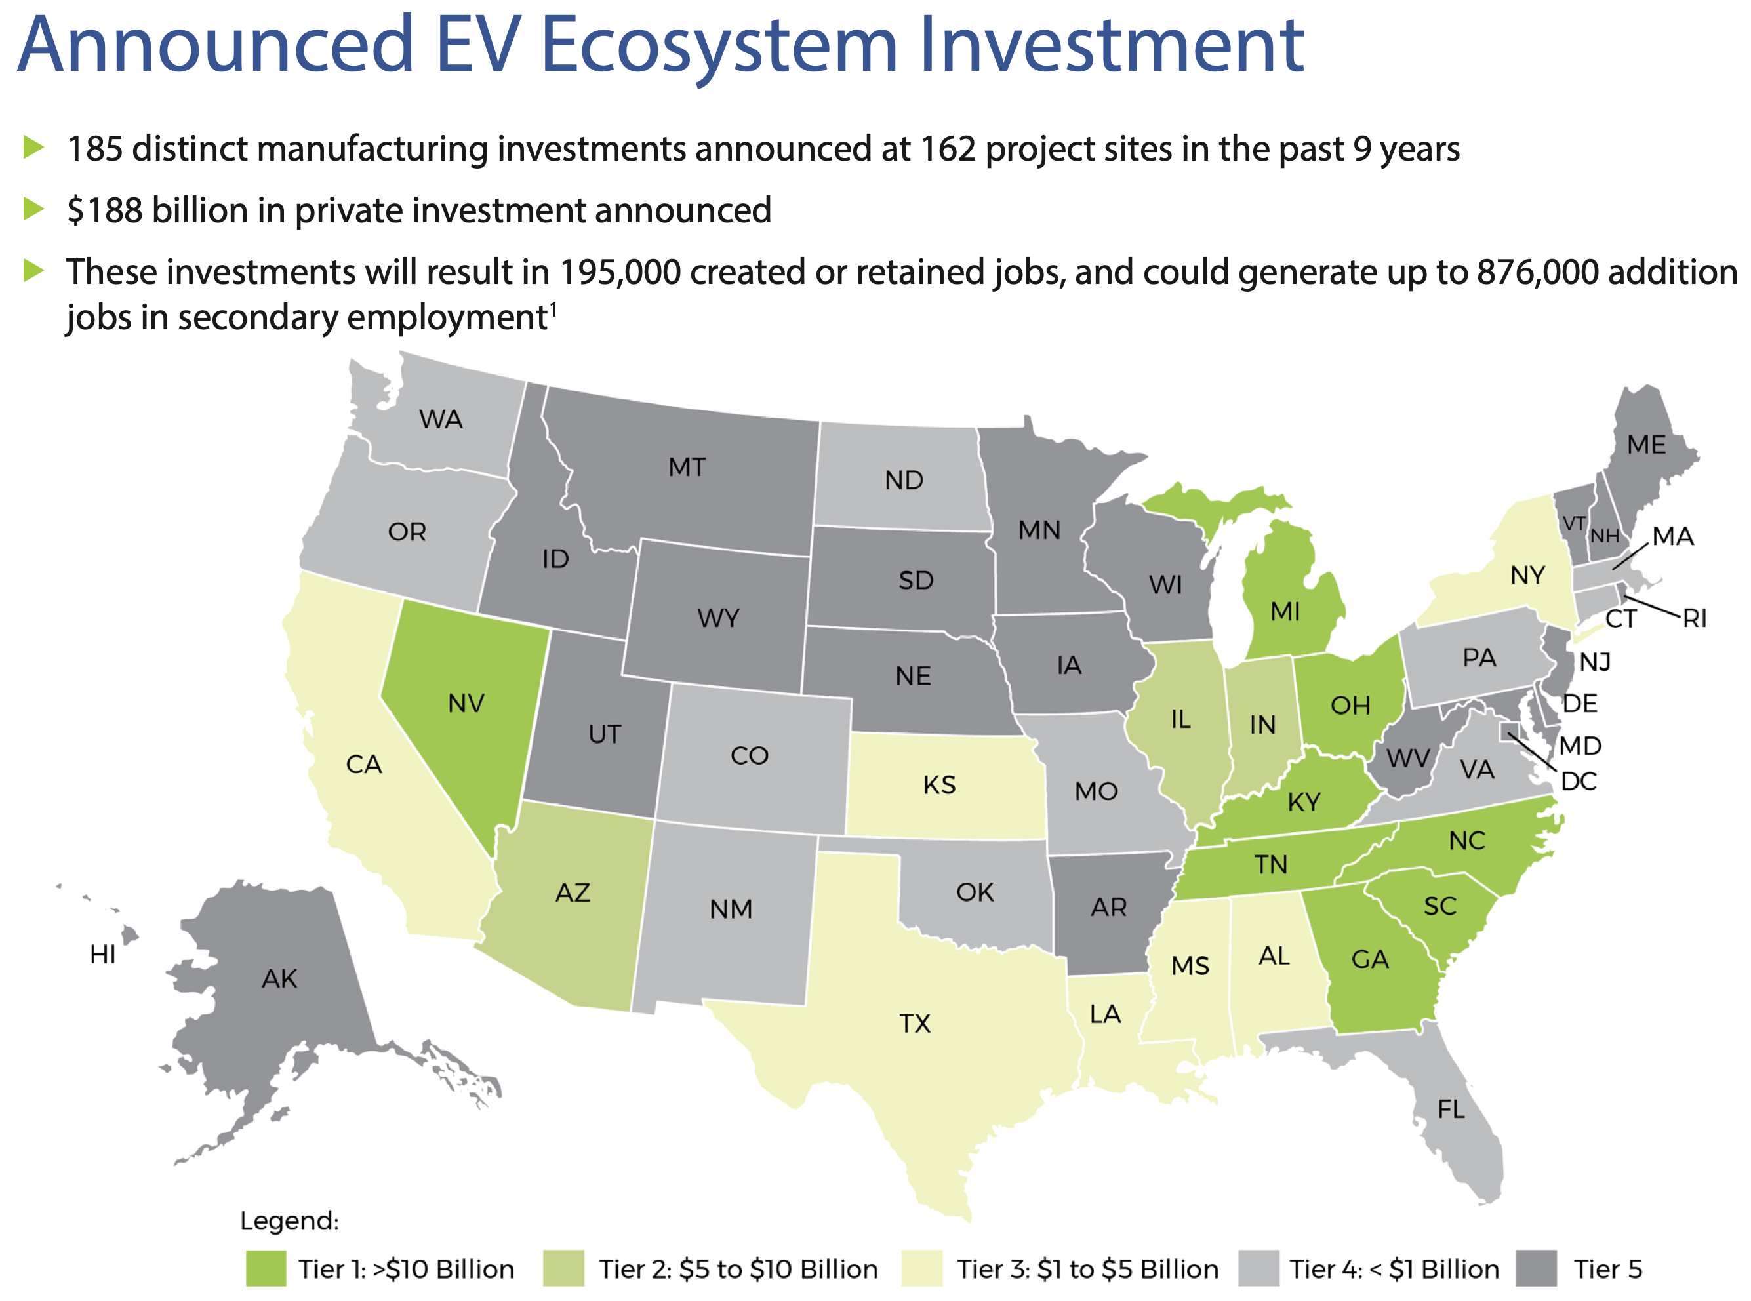
Source: “U.S. Electric Vehicle Manufacturing Investments and Jobs: Characterizing the Impacts of the Inflation Reduction Act after 18 Months,” Environmental Defense Fund, March 2024.
https://www.edf.org/sites/default/files/2024-03/EDF_US_EV_Manufacturing_Investments_Spring2024.pdf

Slide 8
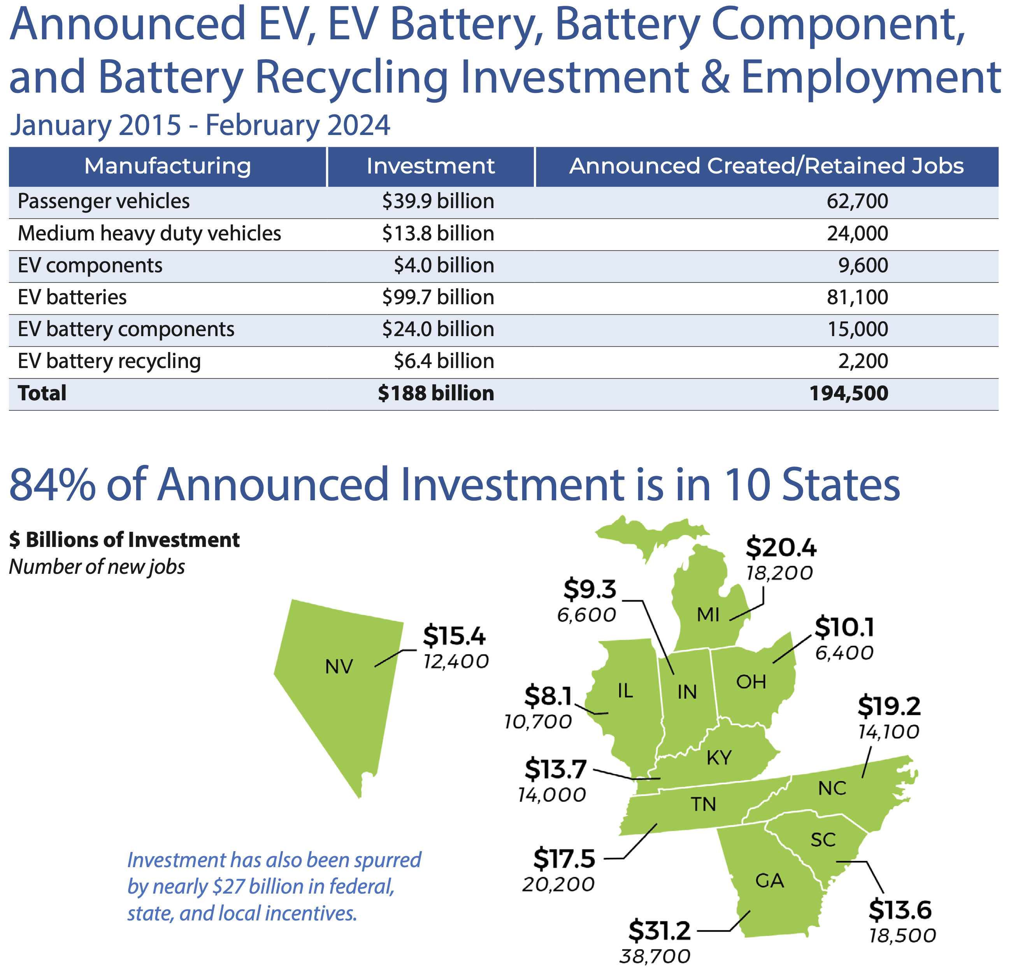
Private investment
Source: “U.S. Electric Vehicle Manufacturing Investments and Jobs: Characterizing the Impacts of the Inflation Reduction Act after 18 Months,” Environmental Defense Fund, March 2024.
https://www.edf.org/sites/default/files/2024-03/EDF_US_EV_Manufacturing_Investments_Spring2024.pdf

Slide 9
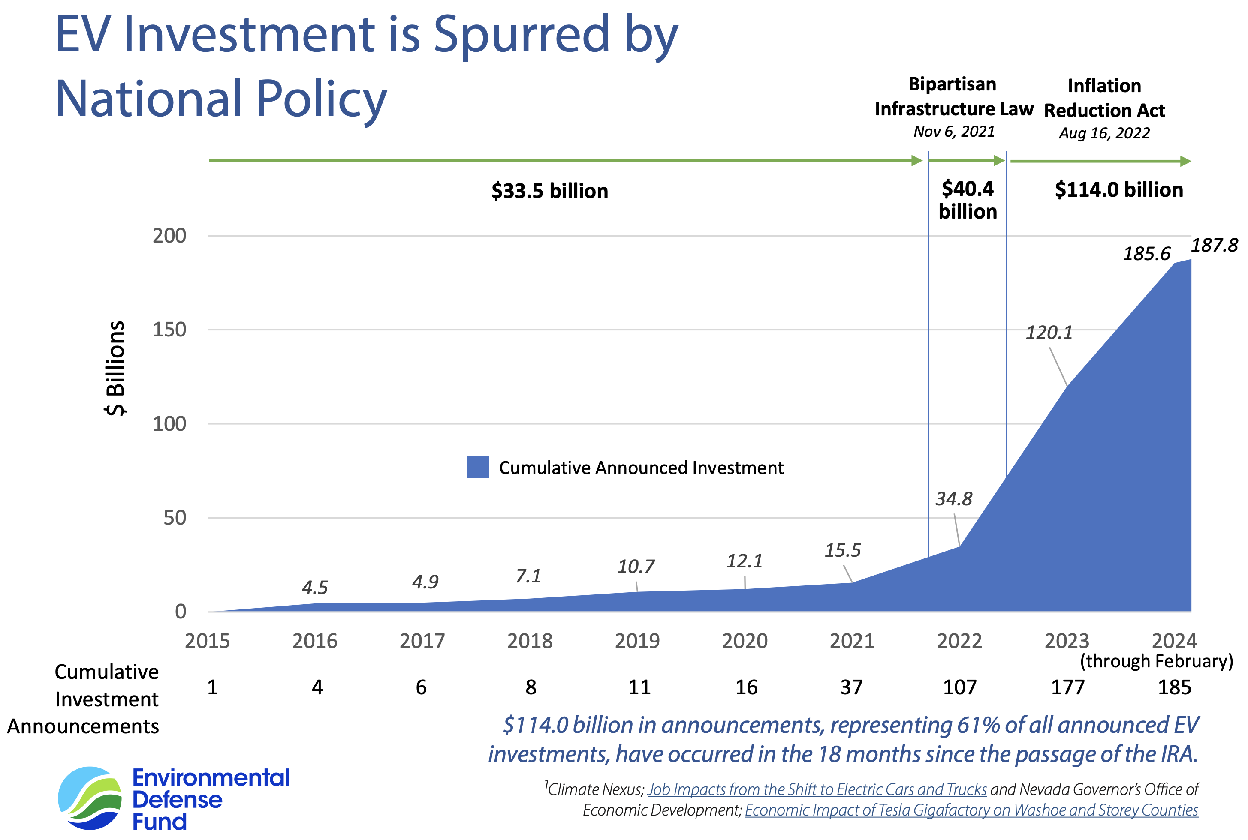
Source: “U.S. Electric Vehicle Manufacturing Investments and Jobs: Characterizing the Impacts of the Inflation Reduction Act after 18 Months,” Environmental Defense Fund, March 2024.
https://www.edf.org/sites/default/files/2024-03/EDF_US_EV_Manufacturing_Investments_Spring2024.pdf

Slide 10
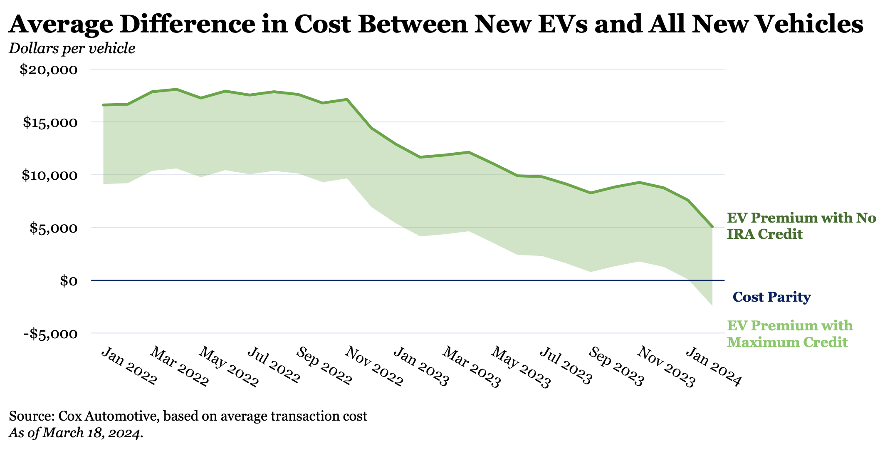
Source: “Growing the Economy from the Middle Out: Laying the Foundation for Growth that is Strong, Stable, and Broadly Shared,” slideshow by Heather Boushey, President’s Council of Economic Advisors, White House, October 2024.

Slide 11
Charging Infrastructure
Level 2: 56,002 Locations, 133,939 EVSE Ports
DC Fast: 10,338 Locations, 43,391 EVSE Ports
Hydrogen Refueling: 58 Stations (57 are in California)
U.S. Total: 65,083 Locations, 177,330 EVSE Ports
The number of public L2 charging 10% Q2 2024 vs Q2 2023
DC Fast chargers 14%
However, total charging ports 11% from the end of 2023.
(For context, E-VIO 17% from the end of 2023 to the end of the second quarter of 2024.)
Charging information from U.S. Department of Energy Alternative Fuels Data Center, stations in operation as of 6/30/2024

Slide 12
Charging is Lacking
Notes:
More than 1 million additional public chargers (933,061 L2 and 138,609 DC Fast) will need to be installed to satisfy the necessary infrastructure estimate by 2030.

Slide 13
Small suppliers
Jobs at risk from transition
  But opportunities in autos, and clean energy
Federal efforts to ease the transition
  Technical assistance (DOE)
  Financing (SBIC) and Grants (DOE)
    High cost of vetting
  Workforce (Battery Workforce Initiative)
    Design new jobs to be good jobs: don't just train workers for employer-defined jobs, but build coalition to design and adopt high standards.
                See FACT SHEET: Taking Action to Support Auto Workers and Manufacturers, Including in Michigan | The White House

Slide 14
Potential future policies
Promote small firm investment with grants to anchor firms & their suppliers.
Anchor firms and their suppliers would apply for grant funds (which they would match).
The large firm's support would show they believe these suppliers are viable and strategic, which eases 2 problems that small firms face in investing in new products or processes:
  1) provides some demand certainty to suppliers
    most small suppliers can afford at most one bet
    High potential social return not just to green products, but smart processes (sensors etc)
  2) reduce the government's vetting costs, since the large firm has already done some vetting and is sharing the risk.

Slide 15
Lessons
Role of place- and technology- based analysis
  Total jobs similar, but 200,000 jobs will be disrupted; ½ in IN MI OH
  Possible to solve excess ICE supply AND insufficient heat pump supply
Investment crowded in due to joint goal-setting, identification of bottlenecks
  Charging, battery components, small firms
Importance of active stakeholders and state capacity
  UAW action → battery salaries increased from $16.50 to $30/hour
  DOE learning + personnel → stronger community benefits agreements
  Most states lack experience with any project like EV charging
Job and climate goals not necessarily in conflict
  Biden adm created a US fast charging industry without slowing roll-out
  Creation of agile suppliers and good jobs would promote both
Policies so far do not fully incentivize organizational/supply chain transformation

