Slide 1
The Quest for Prosperity
How Developing Economies Can Take Off
Justin Yifu Lin
National School of Development
Peking University

Slide 2
Introduction
The world was quite flat in terms of income disparity among countries before the industrial revolution in the 18th century. There was a great divergence afterwards.
Most developing countries started their independent quest for prosperity after WWII.
Most countries failed in their attempts. In 1950-2008, only 28 economies in the world were able to narrow their income gap with the United States for 10 percentage point or more. Among them only 12 were non-European economies or non-oil/diamond exporters.
Most countries continue their quest for prosperity in spite of repeated failures.
Hope this book will provide a new hope to achieve this old pursue.

Slide 3
Overview of Presentation
The needs for rethinking development economics
The new structural economics as the third wave of development thinking
The Growth Identification and Facilitation: A new approach to Industrial Policy
Concluding remarks

Slide 4
Why do we need to rethink development Economics

Slide 5
Why Do We Need Rethinking?
Rethinking
Economic Theory
Failure to:
Failure to:
Explain Observed Economic Phenomena
Guide Economic Policies or Choices

Slide 6

Development theory is in need of rethinking
Successful East Asian Tigers: Export Promotion
China, Vietnam and Mauritius: Dual-track approach to transition
Rethink
Development
Market based economies with proactive role for government
Development Economics 1.0
Structuralism
Focus on Market Failures:
Import Substitution Strategy
Disappointing results
Development Economics 2.0
Washington Consensus
Focus on Government Failures:
Privatization and Marketization
Lost decades
1950
1960
1970
1980
1990
2000
2010

Slide 7
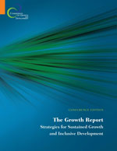
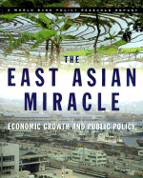
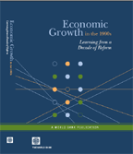
World Bank has been in the Process of Rethinking Economic Development
Export Orientation and Market-Friendly Government
No one-size fits all
Openness;
Macro stability;
High rates of saving & investment;
Market mechanism;
Committed, credible & capable government

Slide 8
The New Structural Economics

Slide 9
Let’s go back to Adam Smith
But not to The Wealth of Nations, which reflects findings of Adam Smith’s research
Let’s go back to Adam Smith’s methodology, that is, An Inquiry into the Nature and Causes of the Wealth of Nations

Slide 10
The Nature of Modern Economic Growth
Sustainable income growth in the West is a modern phenomenon
The nature of modern income growth is a process of continuous changes in the structure of technologies, industries, and soft and hard infrastructure of the economy
The research on economic development should focus on the causes of structural transformation

Slide 11
New Structural Economics
An application of neoclassical economic approach to study the determinates of economic structure and its evolution in development, which is the nature of modern economic growth
Why do I call this approach New Structural Economics?
  By convention, it should be called structural economics
  Add “new” to distinguish it from structuralism

Slide 12
What Determines Structure and its Change?
The main hypothesis. Industrial structure is endogenous to endowment structure, which is given at any specific time and changeable over time
Initial endowments. Determine the economy’s total budgets and relative factor prices at time t.
  Comparative advantage
  Optimal industrial structure (endogenous)
Dynamics. Income growth depends on:
  Upgrading industrial structure
  Upgrading of endowments
  Improvements in “hard” and “soft” infrastructure
The low-income trap and the middle-income trap are both the result of a country’s inability to have a dynamic structural change
Following comparative advantage (determined by the endowment structure) to develop industries is the best way to upgrade the endowment structure and to sustain industrial upgrading, income growth, and poverty reduction.

Slide 13
The Market and the State
Firms maximize profits…choice of technology and industries based on relative factor prices…
    Need for a competitive market system
Industrial upgrading and diversification needs to:
  Address externalities
  Solve coordination problems
  Need for a facilitating state

Slide 14
NSE and The Growth Commission’s Stylized Facts
Growth Report Stylized Facts:
#4 #5
Policy Recommendation from NSE
  Following comparative advantage : Conditions
    Market economy
    Facilitating State
The results:
  Openness and advantage of backwardness
  Competitiveness and strong external as well as fiscal accounts: fewer home-grown crises and larger scope for countercyclical fiscal policies.
  Large economic surplus and high returns to investment: high rate of savings and investment.
The NSE’s recommendations are consistent with the East Asian Miracle’s findings.
#1
#2
#3

Slide 15
“No one size fits all” then “What size fits what?”
New theoretical insights and Areas for Further Research:
Optimal Financial Structure
  will vary across stages of development, due to different optimal industrial structures, firm sizes, capital requirements and nature of risks.
Human capital Investment
  Due to the same arguments as in optimal financial structure, the human capital requirement will differ across stages of development
  Without dynamic growth, the return to human capital investment will be low.
  Human capital investment takes a long gestation and has a lower costs at young. In a dynamic growing economy, the human capital investment should precede the industrial upgrading.
Openness: good or bad?
  Openness is a precondition for following the comparative advantages in development
  In the transition from an import-substitution regime to a comparative-advantage following regime, some protections to old priority sectors would be desirable
International Capital Flow
  Foreign direct investments are more likely to be beneficial to developing countries
  Portfolio flows are more likely to be harmful to developing countries
Beyond Keynesianism
  Ricardian equivalence holds unless fiscal stimulus finances productivity enhancing investment
  In HICs, these investment opportunities are scarce, but they are more abundant in LICs/MICs
Liquidity trap
  Likely to happen in developed countries during the recession
  Unlikely to happen in developing countries due to the possibility for industrial upgrading

Slide 16
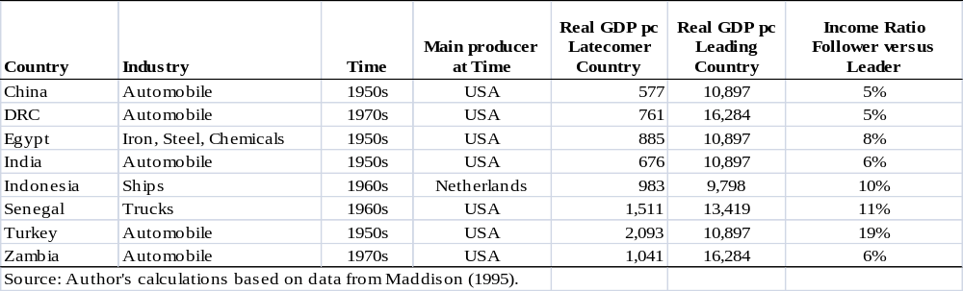
NSE and the Failure of Structuralism
Structuralism advised governments to develop industries that were too far advanced compared to their countries’ level of development and went against their comparative advantages.
The firms were non-viable in competitive markets and required government policy support for their initial investment and continuous operation.
This led to rent-seeking, corruption, and political capture.

Slide 17
NSE and the Failure of the
Washington Consensus
All transitional economies started with many nonviable firms in their old priority sectors due to their comparative advantage-defying development strategy.
The Washington Consensus failed to recognize that the distortions were endogenous when advocating for the protection of nonviable firms in the priority sectors and advised the government to eliminate all distortions immediately, which caused the collapse of old priority sectors.
The Washington Consensus also opposed that government play a proactive role in facilitating firm entry into sectors consistent with the country’s comparative advantages.
The dynamically growing transitional economies adopted a dual-track approach:
  The government continued to provide transitional support to nonviable firms in the old priority sectors and removed distortions only when firms in those sectors became viable or the sectors become very small.
  The government facilitated private firms’ entry to sectors that were consistent with the country’s comparative advantage, which were repressed before the transition.

Slide 18
The
Growth Identification and Facilitation:
An New approach to industrial policy

Slide 19
Conditions for dynamic growth
Market economy
  Necessary Condition for efficient resource allocation and firms’ incentives for innovations and following comparative advantage
Facilitating state
  Necessary condition for overcoming coordination and externality issues in the process of industrial upgrading and diversification

Slide 20
Industrial Policy and Facilitating State
Industrial Policy is desirable in a market economy
  Contents of coordination will be different, depending on industries
  The government’s resources and capacities are limited and need to be used strategically
Historically, all the successful countries, their government used industrial policies to play the facilitating role in the process of industrial upgrading. The governments in developed countries continue to play that role through patents, supports for basic research, procurements and mandates.
Most industrial policies in developing countries failed. The governments in developing countries will continue to try to play that role no matter we like it or that.
The key issue is how to help them have right industrial policies?

Slide 21
Latent Comparative Advantage and Picking Winners
For an industrial policy to be successful, it should target sectors that conform to the economy’s latent comparative advantage:
  Firms will be viable and the sectors will be competitive once the government helps the firms overcome coordination and externality issues.
But how can the government pick the sectors that are in line with economy’s latent comparative advantages?

Slide 22
What Can Be Learned From History?
Historical experience shows that successful countries’ industrial policies, in general, targeted industries in countries with a similar endowment structure and somewhat higher per capita income:
  Britain targeted the Netherlands’ industries in the 16th and 17th centuries; its per capita GDP was about 70% of the Netherlands’.
  Germany, France, and the USA targeted Britain’s industries in the late 19th century; their per capita incomes were about 60% to 75% of Britain’s.
  In Meiji restoration, Japan targeted Prussia’s industries; its per capita GDP was about 40% of Prussia’s. In the 1960s, Japan targeted the USA’s industries; its per capita GDP was about 40% of the USA’s.
  In the 1960s-80s, Korea, Taiwan, Hong Kong, and Singapore targeted Japan’s industries; their per capita incomes were about 30% of Japan’s.
  In the 1970s, Mauritius targeted Hong Kong’s textile and garment industries; its per capita income was about 50% of Hong Kong’s.
  In the late 1980s, Ireland targeted US’s chemical, pharmaceutical, electronic and information industries and its per capita income was about 45% of the US’s.
  In the 1990s, Costa Rica targeted the memory chip packaging and testing industry; its per capita GDP was about 40% of Taiwan’s, which was the main economy in this sector.
Unsuccessful industrial policies, in general, targeted industries target industries in countries where their per capita GDPs were less than 20% of the targeted countries

Slide 23
Growth Identification and Facilitation
Step 1
Find fast growing countries with similar endowment structures and with about 100% higher per capita income. Identify dynamically growing, tradable industries that have performed well in those countries over the last 20 years.
Step 2
See if some private domestic firms are already in those industries (existing or nascent). Identify constraints to quality upgrading or further firm entry. Take action to remove constraints

Slide 24
Growth Identification and Facilitation
Step 3
In industries where no domestic firms are currently present, seek FDI from countries examined in step 1, or organize new firm incubation programs.
Step 4
In addition to the industries identified in step 1, the government should also pay attention to spontaneous self discovery by private enterprises and give support to scale up successful private innovations in new industries.

Slide 25
Growth Identification and Facilitation
Step 5
In countries with poor infrastructure and bad business environments, special economic zones or industrial parks may be used to overcome barriers to firm entry, attract FDI, and encourage industrial clusters.
Step 6
The government may compensate pioneer firms identified above with:
  Tax incentives for a limited period
  Direct credits for investments
  Access to foreign exchange

Slide 26
Two additional points
Agricultural development is crucial for developing countries:
  For poverty reduction, and
  For providing capital and a market for industrial products.
  Agricultural development also requires structural change in technology and product composition
A resource-abundant country’s resources will be a blessing if:
  It has a good management of resources. (E.g., some of it must be saved for future generations, and enclave rent capture avoided.)
  It uses (part of) the wealth generated from resources to facilitate structural transformation.

Slide 27
Concluding Remarks
Every developing country has the potential to grow continuously at 8% or more for several decades, and to become a middle-income or even a high-income country in one or two generations, as long as the government has the right policy framework to facilitate the development of the private sector along the lines of the country’s comparative advantages and taps into the latecomer advantages.
A change in the development thinking is required for the government to play the right facilitating role
  In the past, developing thinking advised the governments in developing countries to use high-income countries as references and develop what they did not have but high-income had (advanced industries in development economics 1.0) or improve what they could not do well but high-income countries could do relatively well (Washington consensus in development economics 2.0)
  The new development thinking (development economics 3.0) proposes the governments in developing countries to develop what the developing countries can do well now (that is, their comparative advantages) based on what they have (that is their endowments)

Slide 28
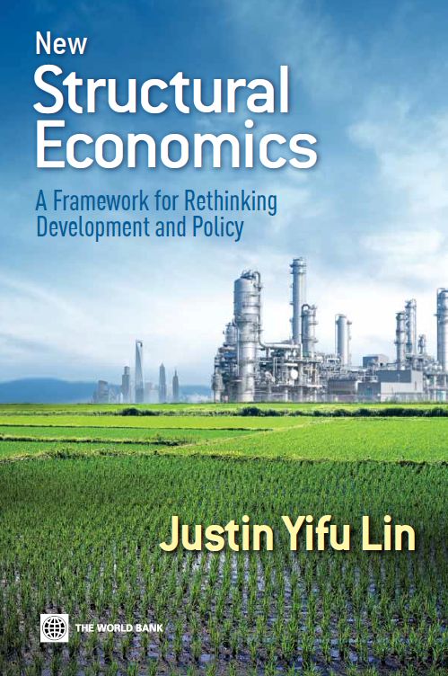

This book can be downloaded for free from the World Bank:
http://go.worldbank.org/QZK6IM4GO0
The book was published by the Princeton University Press in September and is available on Amazon.com.

