Slide 1

Industrial Policy 2025
Bringing the State Back In (Again)
Presentation by Todd N. Tucker, Director of Industrial Policy and Trade

Slide 2
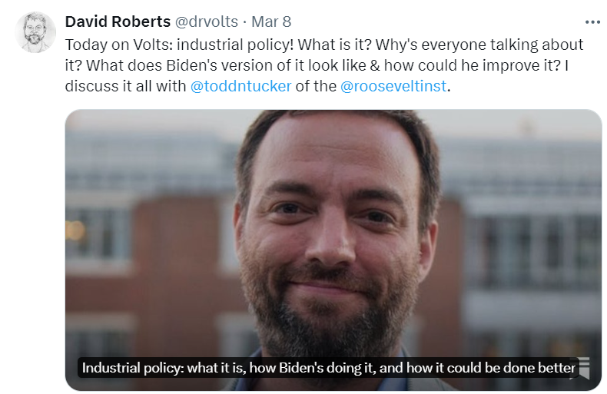
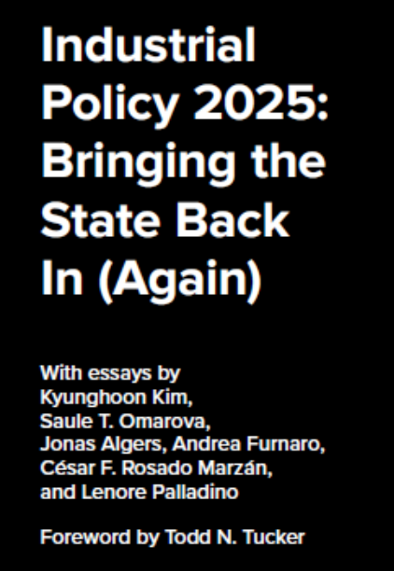

Today: Biden’s industrial policy today and in 2025

Slide 3
Bidenomics’ Four Bills and Three Pillars
  Industrial Policy: From “shall not be named” to policy by default
  ARPA + 3 Uncles (Bil + Ira + Chip)
  Making public investments in America
  Empowering workers to grow middle class
  Promoting competition and challenging corporate concentration

Slide 4
Public investment pillar
Tax credits that unsubmerge the state: $391b - $3 trillion
Grants and loans with points based system; up to $250 billion at DOE; $40 billion in CHIPS
Procurement: Buy Clean, redone Buy American
Trade tools (still in development)

Slide 5
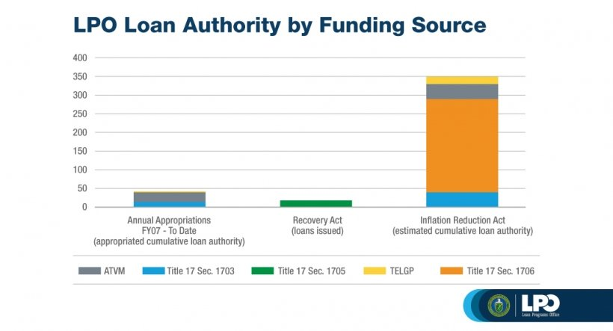
How big is the shift in subsidies? From capped to uncapped, and…

Slide 6
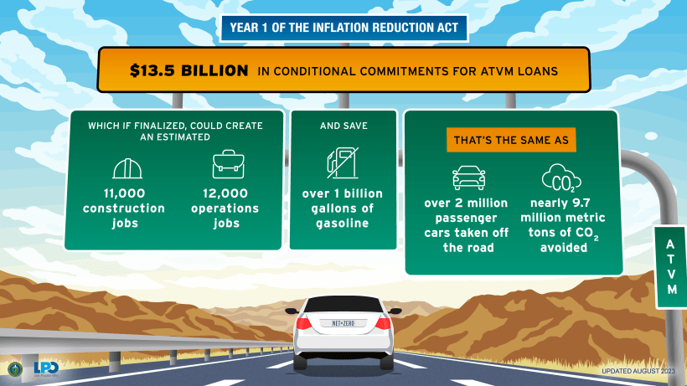

Slide 7
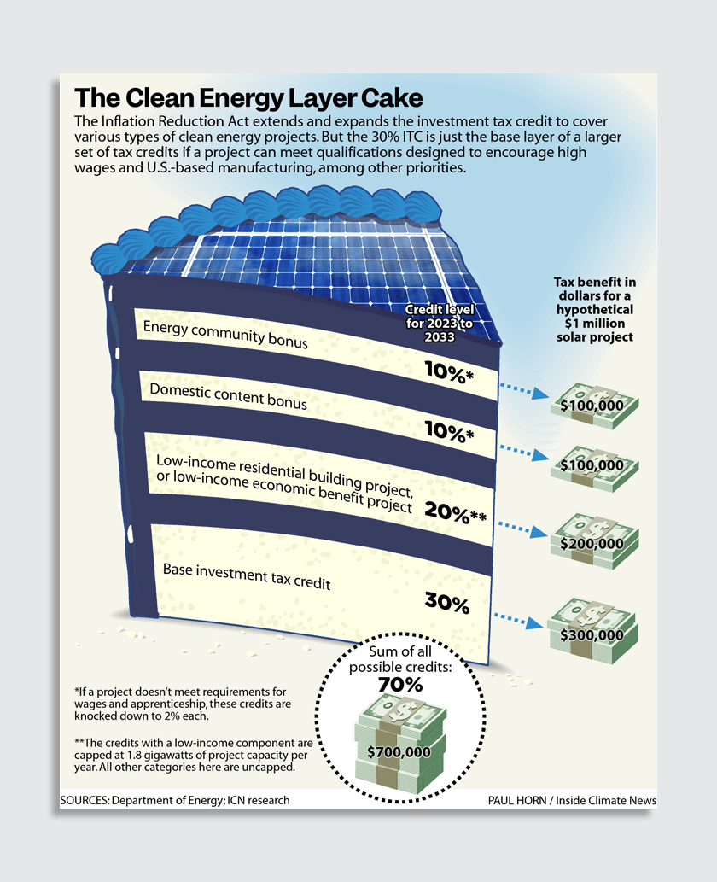
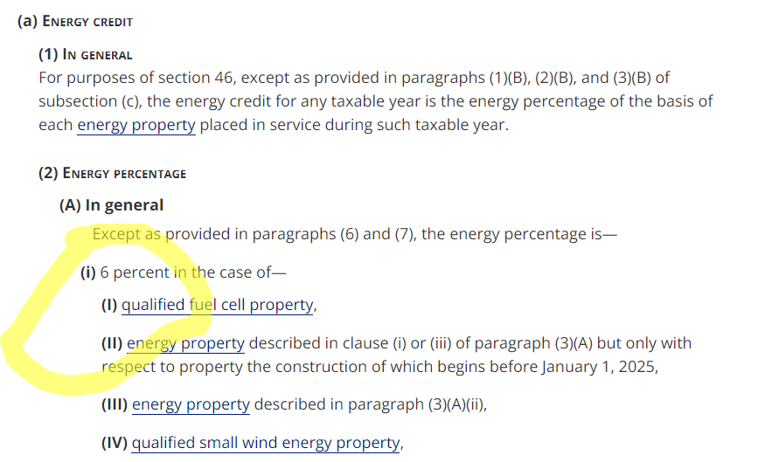
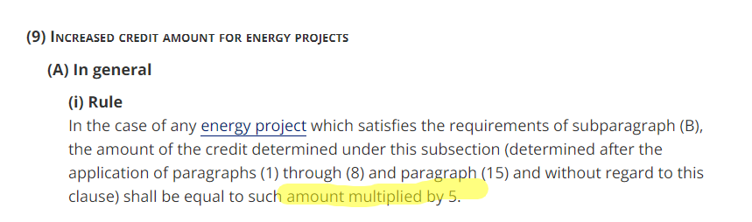

Slide 8
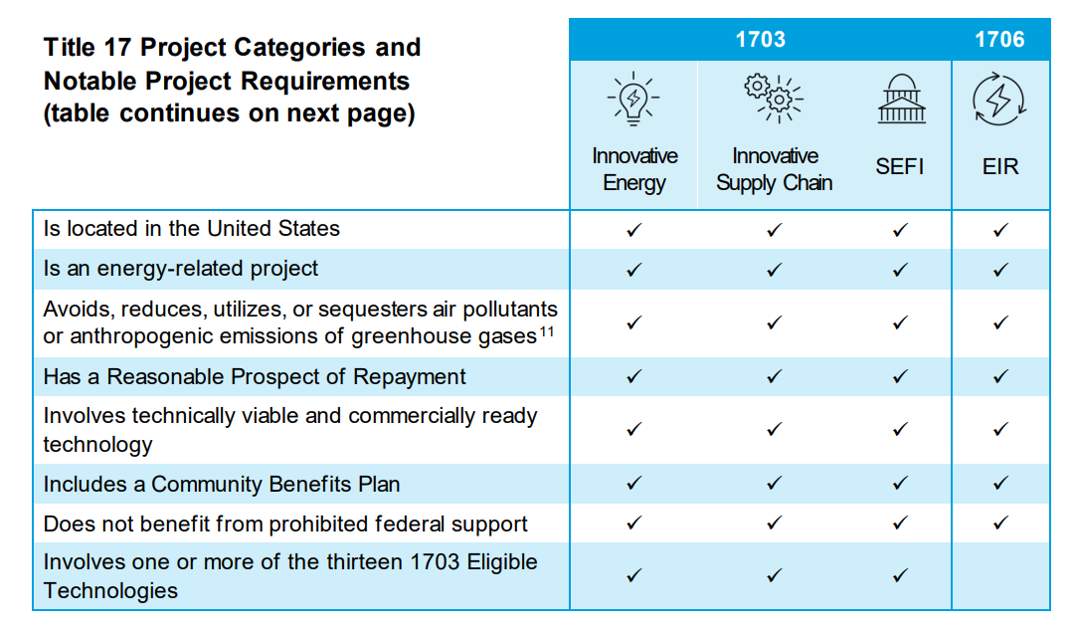
80-20 Points System: Technical v. Policy Criteria

Slide 9
Promising initial results
The contribution of manufacturing construction to GDP is at the highest levels on record
Employment in construction has reached highs not seen since the advent of modern record-keeping
US-made solar and wind energy are now cost competitive with imports for the first time in generation
Total investment in the clean energy economy reached $176 billion in late 2023, up 40% post-IRA and CHIPS

Slide 10
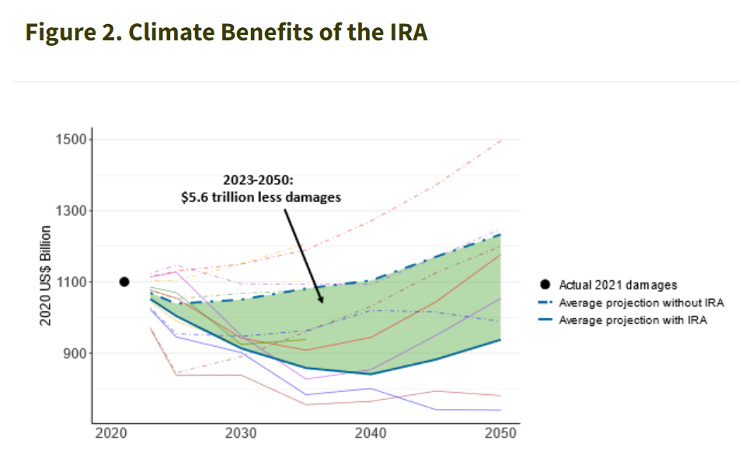

Slide 11

But faces four central criticisms
The “what” critique: is industrial policy even possible given Hayekian information problem + public choice concerns?
The “where” critique: should we care which state or region produces the widgets?
The “how” critique: is the state trying to be responsive to too many interests at once?
The “who” critique: is industrial policy that involves the private sector doomed to fail?

Slide 12
Ways these are being addressed
“What”/state: much deeper due diligence + picking activities, not winners
“Where”/nation: Incentives to reshore, not requirements; EV exception. Coalitional + resilience considerations + national-bound global challenges
“How”/demos: Policy criteria not excessive, timing/nature of trade offs
“Who”/capital: US starting from a largely private energy system, direct pay pushes in other direction.

Slide 13
Even among those sympathetic to Bidenomics, concerns about headwinds
MIT Clean Energy Monitor / Brian Deese: some lagging sectors, some leading
Rodrik / Dube: Better labor law “relieves pressure” on industrial policy
Roosevelt Institute: Does “public sector-enabled, private sector-led” leave the state with too little devlopmental steer?

Slide 14
Missing institutions
National development bank: Omarova
Labor empowerment strategy / countervailing power: Rosado Marzan
Direct public steer through ownership stakes: Kim and Palladino
Sticks / phase out strategy: Furnaro and Aronoff
Sticks / heavy industry strategy: Algers and Estevez

Slide 15
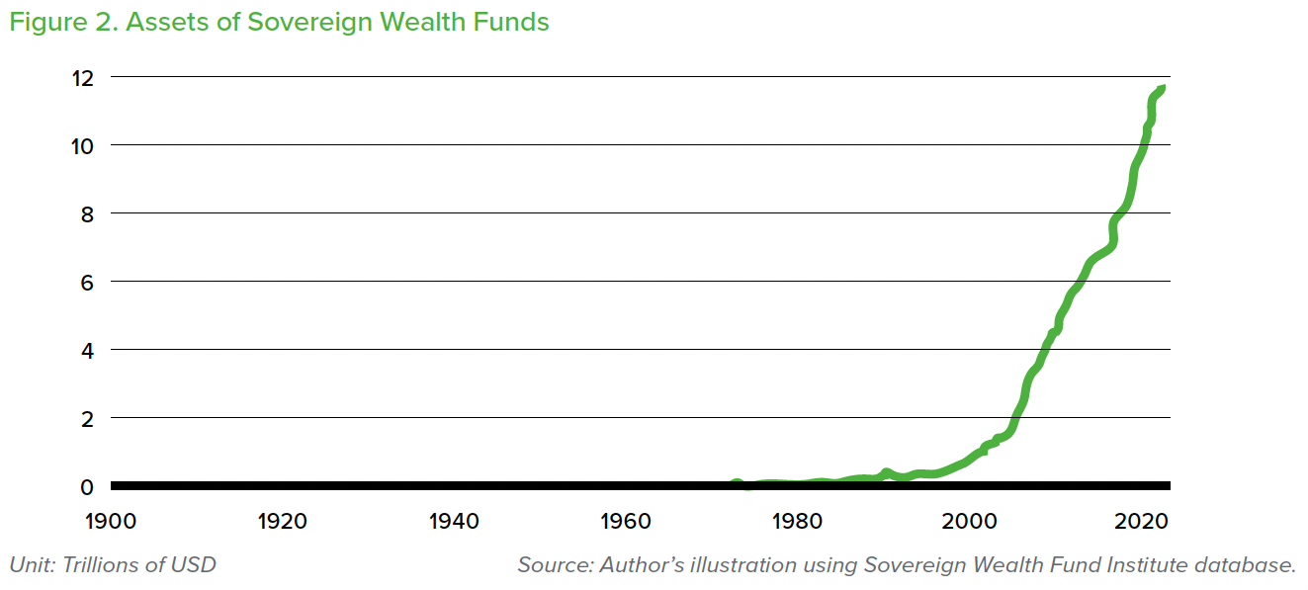
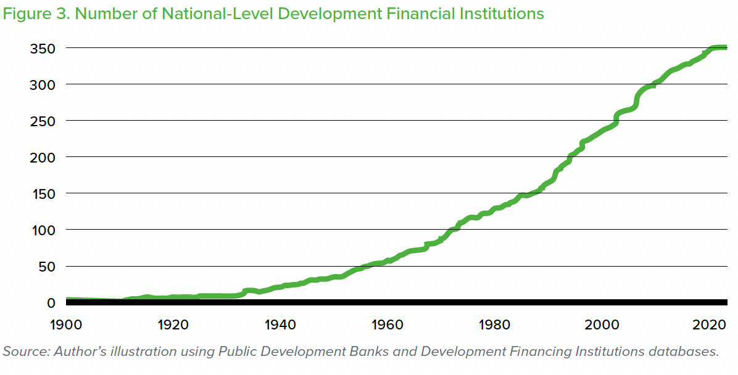

Slide 16
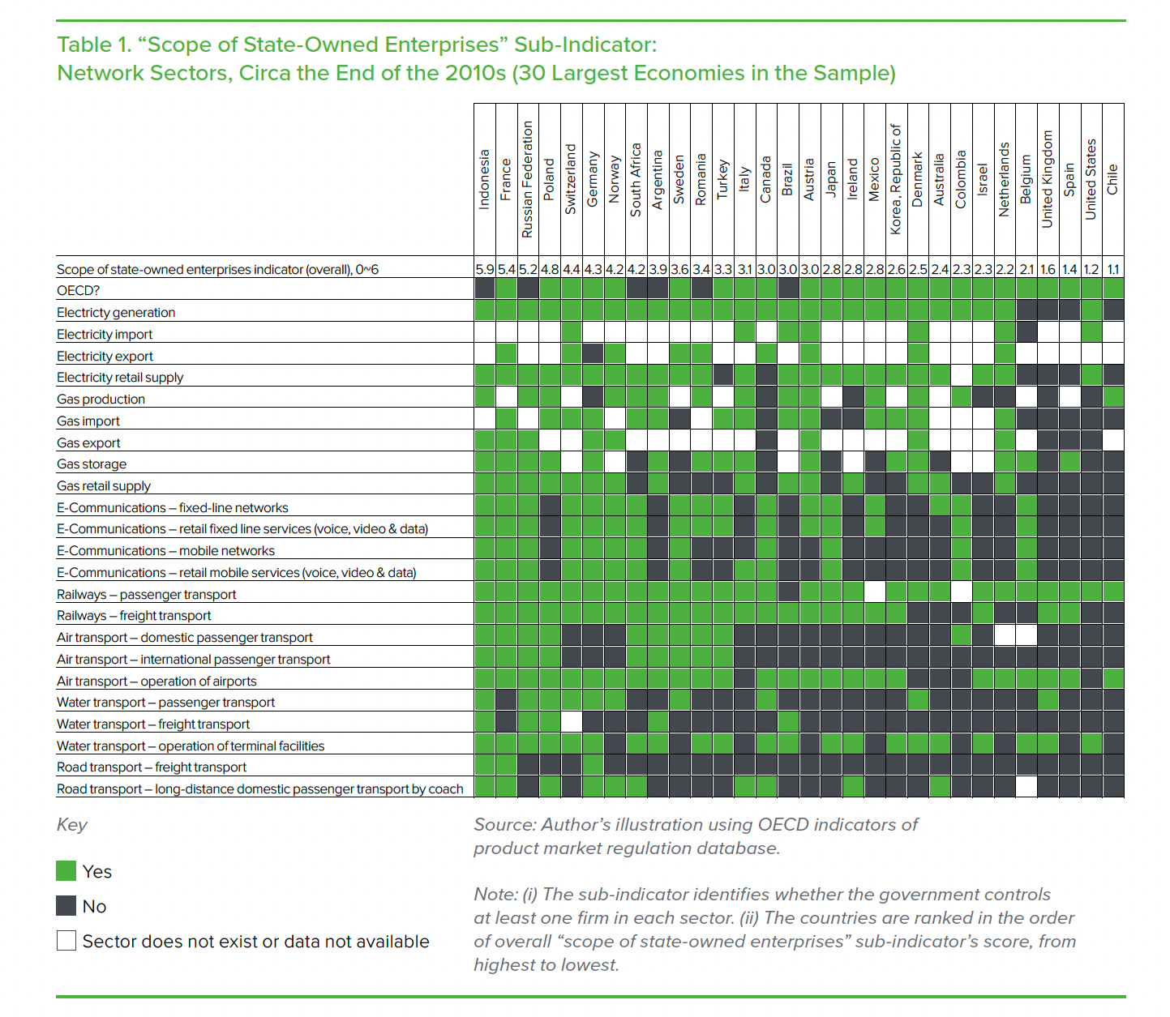

Slide 17
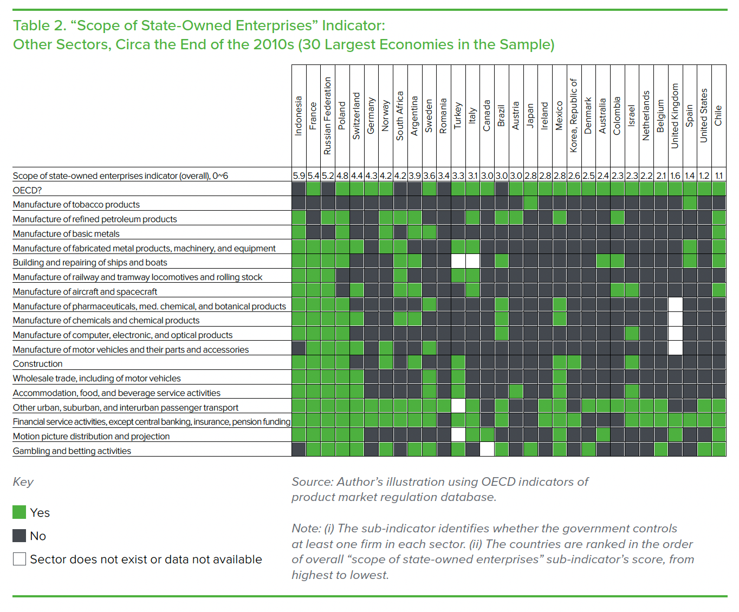

Slide 18
Finance as a Tool of Industrial Policy
The Sovereign Wealth Fund Model
  Special-purpose, government-owned portfolio investment vehicles that pursue a wide variety of domestic policy objectives, including macroeconomic stabilization, cross-generational wealth preservation, and socioeconomic development
  Generally aim to preserve and grow the nation’s financial resources by building diversified portfolios of primarily publicly traded, FX denominated securities
  Typically have no debt liabilities allowing them to take longer investment views and act as suppliers of “patient” capital critical for transformative infrastructure projects
  Operate on the cusp of market and politics in a very particular way. Because they do not borrow in private capital markets, their capacity to make mission-driven investments is not constrained by private bondholders’ demands.
Norway’s Government Pension Fund Global (GPFP)

Slide 19
Finance as a Tool of Industrial Policy
The National Development Bank Model
  NDBs, differ from SWFs in their explicitly domestic focus, more diverse sources of funding, and greater flexibility of their investment strategies
  Unlike SWFs, NDBs are predominantly credit institutions
  NDBs generally invest in the construction of traditional physical infrastructures, agricultural development, social housing, strategic export industries, and other areas prioritized by their governments
Germany’s Kreditanstalt Für Wiederaufbau (KfW)

Slide 20
Finance as a Tool of Industrial Policy
The State Holding Company Model
  While an SHC can be seen as simply another form of state-owned enterprise it can also be designed as a public asset manager, a public interest-oriented counterpart to private asset managers
  In this capacity, an SHC can be utilized for the purposes of industrial policy in a much more direct and assertive way than either an NDB or a SWF model would typically allow.
Singapore’s Temasek

Slide 21
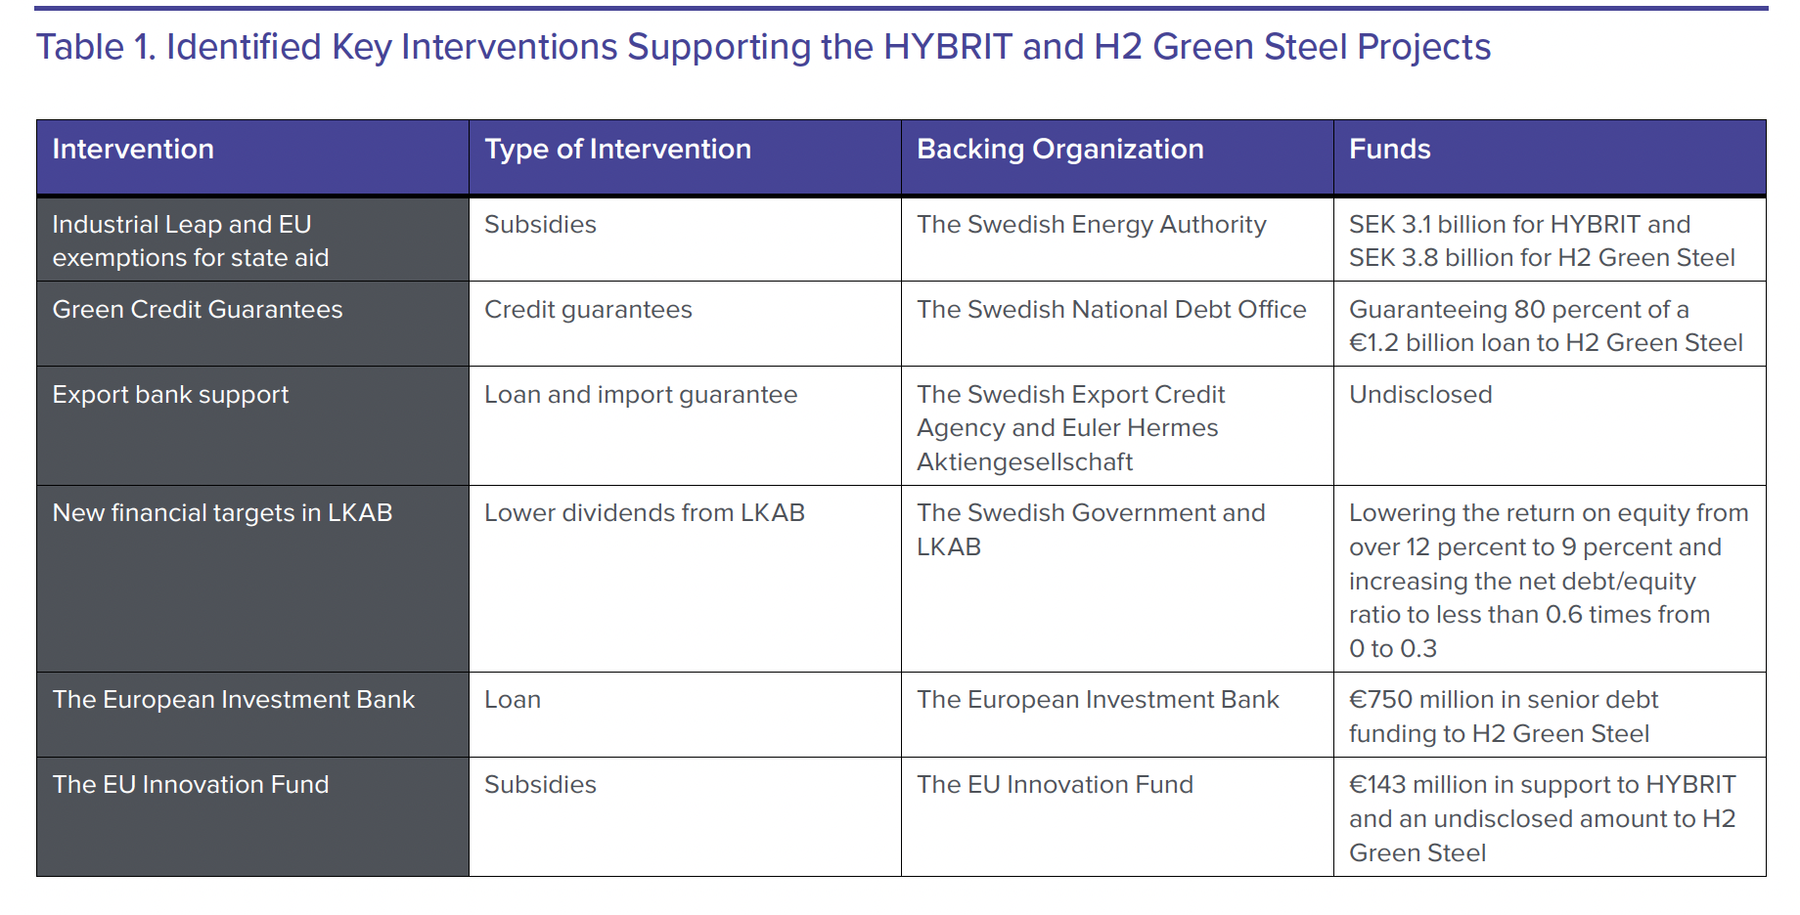

Slide 22
Leading with Industrial Policy
About 90 percent of primary steelmaking uses a blast furnace (BF) to reduce the iron ore into iron and a basic oxygen furnace (BOF) to turn iron into steel.
Green hydrogen from renewable energy as a reductant, hydrogen-based steelmaking can reduce emissions from primary steel by 95 percent compared to the BF-BOF baseline
Sweden’s Green Steel Projects
  HYBRIT initiative
  H2 Green Steel

Slide 23
Leading with Industrial Policy
HYBRIT is a joint venture between Swedish power utility Vattenfall, miner LKAB,and steelmaker SSAB. The second project is the start-up H2 Green Steel (H2GS), which was started by venture capitalist Harald Mix
  The differences between these two projects show how distinct types of actors—with different types of state involvement—can play complementary roles across the same innovation system.
The state has had a direct engagement in fostering the development of green steel in Sweden.
  The Climate Policy Framework gave clear directionality for the Swedish iron and steel industry toward deep decarbonization, and the Fossil Free Sweden also formalized a framework for coordinating business initiatives for decarbonization with policymakers.
  The state—both at the national level and at the EU level—has played a key role in taking on risk and financing the transition through several channels

Slide 24
Plausible in the US context?
Bipartisan Industrial Finance Corporation bill / NIA in Build Back Better
PRO Act, JD Vance and American Compass on sectoral bargaining
Public ownership: limited CHIPS claw-back, AIG and Detroit precedents
Sticks: Sequencing questions, bipartisan carbon border adjustment

Slide 25
Sullivan described the new industrial strategy as “the surest path to restoring the middle class, to producing a just and effective clean-energy transition, to securing critical supply chains, and, through all of this, to repairing faith in democracy itself”—not only in the United States, but also in our trading partners.

Slide 26
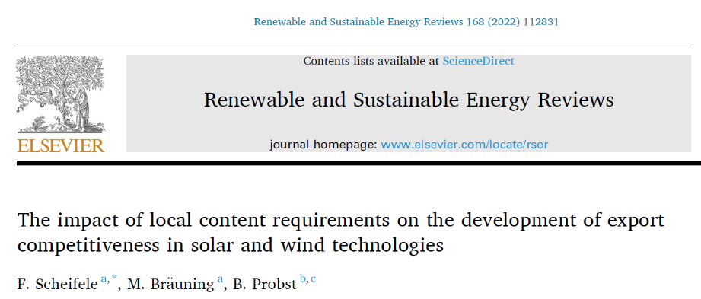
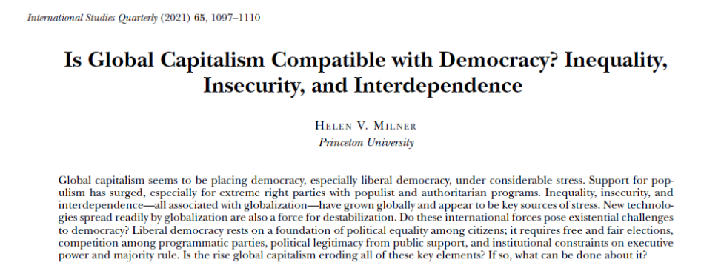
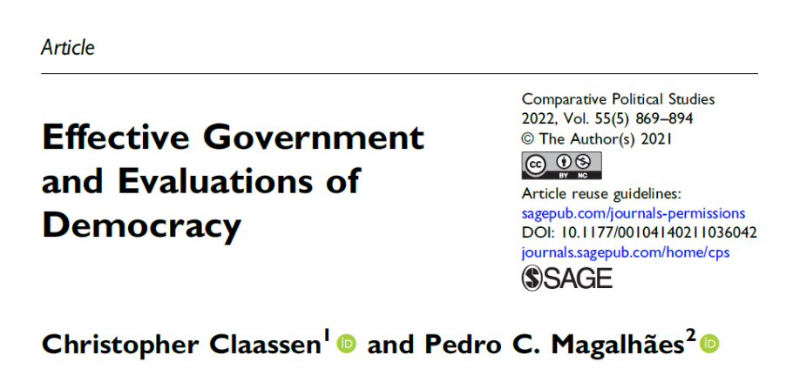
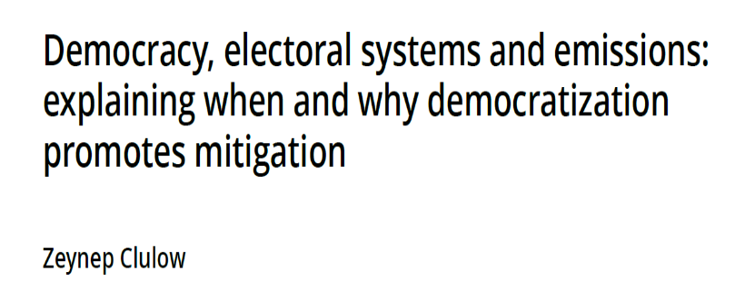
Democracies doing energy transitions need a political strategy

Slide 27
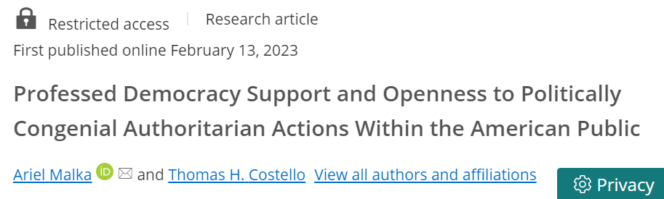
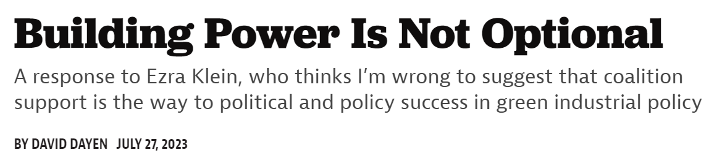

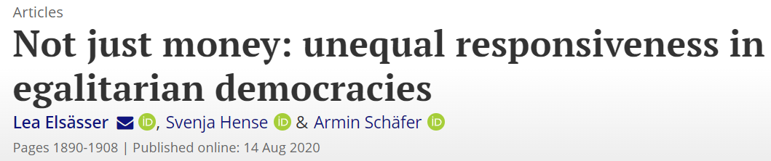
Demand side liberalism versus supply side liberalism

